Slide 1
CCC Council Meeting
July 12-13, 2023

Slide 2
General Agenda
1:00 PM | Welcome and Introductions
1:45 PM | View from DC by CRA Government Affairs
2:30 PM | Review of 2022-23 Activities
3:00 PM | Brainstorming Session for 2023-24: Part 1
4:00 PM | BREAK
4:30 PM | Small Group Breakout Time (TF’s, RFI’s, etc.)
5:30 PM | BREAK
6:00 PM | Dinner

Slide 3
Welcome and Introductions
Notes:
Housekeeping - Accounting / Reimbursements

Slide 4

View from DC by CRA Government Affairs

Slide 5
Review of 2022-23 Activities
Workshops:
  AI/OR Workshop II
  Mechanism Design for Improving Hardware Security
  Building Resilience to Climate Driven Extreme Events with Computing Innovations: In-Person Workshop
  Building Resilience to Climate Driven Extreme Events with Computing Innovations - Virtual Workshop
  Accessible Technology for All
  Community-Driven Approaches to Research in Technology and Society
  5 Year update to the Next Steps in Quantum Computing
Whitepapers:
  Fostering Responsible Computing Research Report Recommendations for Computing Research Institutions: Actionable Steps
  Mid-cycle Update to the US National Robotics Roadmap

Slide 6
Review of 2022-23 Activities (cont.)
Requests for Information:
  Response to Federal Video and Image Analytics Research and Development Action Plan (September)
  (CRA-I) and (CCC) Response to the Second Draft of the National Institute of Standards and Technology (NIST) Artificial Intelligence Risk Management Framework (September)
  Response to the National Institute of Standards and Technology (NIST) Manufacturing USA Semiconductor Institutes Request for Information (November)
  Response to the Office of Science and Technology Policy (OSTP) Request for Information on Digital Assets Research and Development (March)
  Response to the Networking and Information Technology Research and Development (NITRD) National Coordination Office (NCO), and National Science Foundation (NSF) Request for Information on the 2023 Federal Cybersecurity Research and Development Strategic Plan Request for Information (March)
  Response to the National Telecommunications and Information Administration’s AI Accountability Request for Comment (June)
  Response to the Food and Drug Administration (FDA) Using AI and ML in the Development of Drug and Biological Products (July)

Slide 7
NextGen AI
What we’re working on
  RFI on National Priorities for Artificial Intelligence – submitted July 7
  RFI on PCAST Working Group on Generative AI Invites Public Input - due August 1
What’s planned/in flight
  2024 Robotics Roadmap Update, led by Henrik Christensen with CCC support
    Call for whitepapers out soon
    Workshops planned in Philadelphia (9/8), Austin (11/30), and Phoenix (12/7)

Slide 8
Unique Ways to Compute
What we’re working on
  Quantum Workshop 5-Year Update: Drafting Report
What’s planned/in flight
  Systems and Applications Challenges for the Emerging Bazaar of Accelerators - August 9-10
    (Katie Schuman of University of Tennessee, Knoxville, John Shalf of LBNL, and Tom Conte of Georgia Tech)

Slide 9
Computing Challenges to Humanity: Climate
What we’re working on:
  Building out a network of people who work at the boundary of computing research and climate change
  Sending to the CRA Socially Responsible Computing Group for comments, then sending out to the community (CRA Board, participants of workshops, roundtables, etc.)
  Form Link: https://form.jotform.com/231794819872169

Slide 10
Socio Technical Resilience
What we’re working on
  Algorithmic Robustness paper (aiming to finalize during working time of Council Meeting)
  CDARTS workshop report is underway (aiming to finalize in early September)
What’s planned/in flight
  Pam is leading the Digital Resilience of Youth Workshop
Notes:
Brian will probably do this slide (Ufuk will if he is on but probably not)

Slide 11
Computational Challenges in Healthcare
What’s planned/in flight
  Future of Pandemic Prevention and Response Workshop: Sept 20-21 in Ann Arbor
    9 steering committee members (5 external)
    29 confirmed participants
    Moving forward with emergency simulation run by The Massachusetts General Hospital Center for Disaster Medicine
Notes:
Mona

Slide 12
Research Ecosystem Working Group
Are Computing Challenges Grand Enough?
The Era of Global Competition

Slide 13
NSF Proposal Status Update
Notes:
Housekeeping - Accounting / Reimbursements

Slide 14
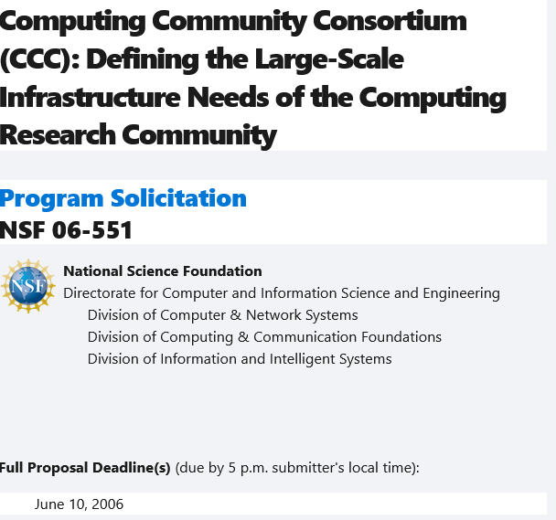
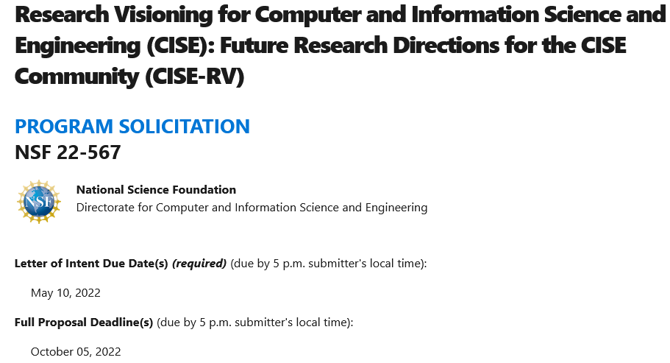
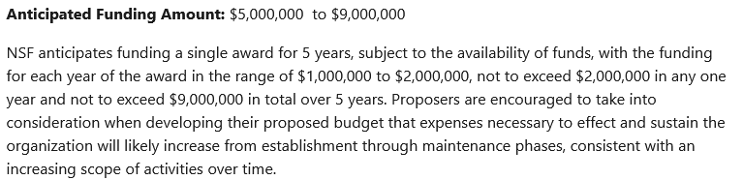
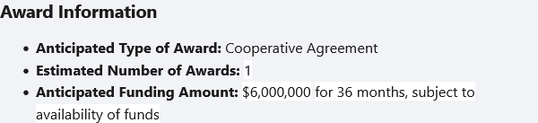
NSF Solicitations from 2006 and 2022
2006
https://www.nsf.gov/pubs/2006/nsf06551/nsf06551.htm
2022
https://www.nsf.gov/pubs/2022/nsf22567/nsf22567.htm
Anticipated Funding Amount: $5,000,000 to $9,000,000
NSF anticipates funding a single award for 5 years, subject to the availability of funds, with the funding for each year of the award in the range of $1,000,000 to $2,000,000, not to exceed $2,000,000 in any one year and not to exceed $9,000,000 in total over 5 years.
Anticipated Funding Amount: $6,000,000 for 36 months, subject to availability of funds.

Slide 15
Our Back and Forth with NSF To Date
Proposal Item | Date NSF Requested | Date We Submitted | # of Pages
LOI | Feb 9, 2022 | May 10 , 2022 | 1
Proposal | Feb 9, 2022 | Oct 5, 2022 | 96
COI’s | Oct 17, 2022 | Oct 31, 2022 | 3 tables
NSF gives date for RSV | Jan 9, 2022
RSV Quad Chart | Feb 10, 2023 | Feb 21, 2023 | 1
Communication Data | Feb 14, 2023 | Mar 1, 2023 | 2
RSV Presentation | Mar 15, 2023 |  | 59 slides
Additional Q’s Post-RSV | Mar 15, 2023 | Mar 15, 2023 | 5
RSV Report Response | Apr 17, 2023 | May 5, 2023 | 10
Additional Q’s | June 2, 2023 | June 16, 2023 | 22

Slide 16
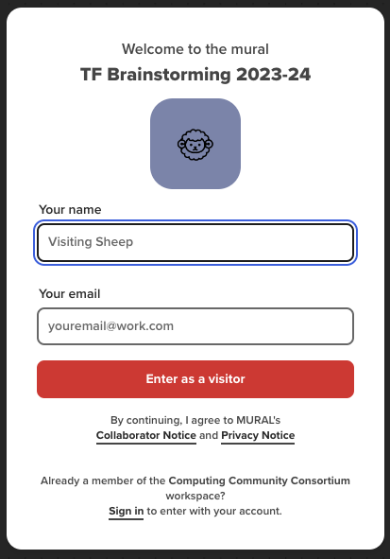
Brainstorming Session for 2023-24: Part 1
Mural Link: https://app.mural.co/t/computingcommunityconsortium5164/m/computingcommunityconsortium5164/1688659714107/1391c397a39e1350af95b6afb82e97fc681094a6?sender=ccc2421
You do not need to enter a name or email when you are prompted, you can just click the “Enter as a Visitor” button to get in.

Slide 17
4:30-5:30pm: Small Group Breakout Time
Breakout time for groups to work on the following initiatives. We will have more time for small group work tomorrow.
All Breakout rooms are on the lobby level. Go down one flight of stairs, turn right, and go through the glass doors (Haley, Cat & Maddy will be directing).
Research Ecosystem Papers (Dan/Bill Regli-Virtual/In Ballroom):
Are Computing Challenges Grand Enough?
The Era of Global Competition
Active RFI’s:
TIP Roadmap RFI - Due July 27th (Cat-Marshall Joffre)
PCAST Generative AI RFI - Due August 1 (Maddy-Chief Poker Jim)
Task Forces:
Computational Challenges in Healthcare: Pandemics Workshop Organizing Meeting (Haley-Roy Yates)
Sociotechnical Resilience: Algorithmic Robustness Whitepaper (David J -Sam Hill)
Notes:
the Department of Commerce’s National Telecommunications and Information Administration (NTIA) launched a request for comment (RFC) to advance its efforts to ensure artificial intelligence (AI) systems work as claimed – and without causing harm. The insights gathered through this RFC will inform the Biden Administration’s ongoing work to ensure a cohesive and comprehensive federal government approach to AI-related risks and opportunities.

Slide 18
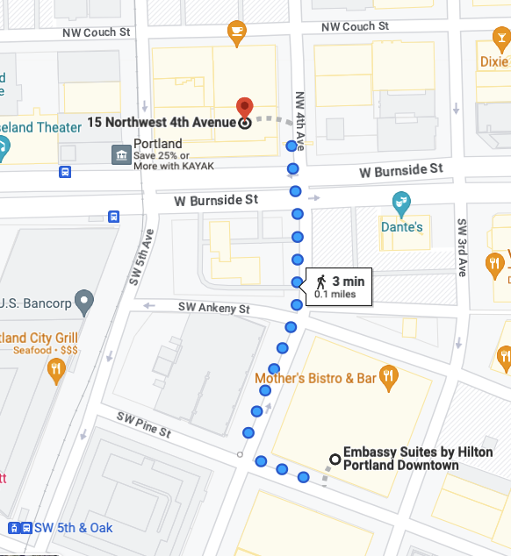
Dinner at 6:00 pm
Dinner will be off-site at the Hoxton Hotel in the “Apartment” Meeting Space of Lovely Rita Restaurant (15 NW 4th Ave., Portland, OR 97209).
We will meet in the lobby at 5:50 to walk over (approx. 3 minute walk).

Slide 19
Break from 4-4:30 pm
Food & Drink in area directly outside of ballroom

Slide 20
4:30-5:30pm: Small Group Breakout Time
Breakout time for groups to work on the following initiatives. We will have more time for small group work tomorrow.
All Breakout rooms are on the lobby level. Go down one flight of stairs, turn right, and go through the glass doors (Haley, Cat & Maddy will be directing).
Research Ecosystem Papers (Dan/Bill Regli-Virtual/In Ballroom):
Are Computing Challenges Grand Enough?
The Era of Global Competition
Active RFI’s:
TIP Roadmap RFI - Due July 27th (Cat-Marshall Joffre)
PCAST Generative AI RFI - Due August 1 (Maddy-Chief Poker Jim)
Task Forces:
Computational Challenges in Healthcare: Pandemics Workshop Organizing Meeting (Haley-Roy Yates)
Sociotechnical Resilience: Algorithmic Robustness Whitepaper (David J -Sam Hill)
Notes:
the Department of Commerce’s National Telecommunications and Information Administration (NTIA) launched a request for comment (RFC) to advance its efforts to ensure artificial intelligence (AI) systems work as claimed – and without causing harm. The insights gathered through this RFC will inform the Biden Administration’s ongoing work to ensure a cohesive and comprehensive federal government approach to AI-related risks and opportunities.

Slide 21
CCC Council Meeting
July 13, 2023

Slide 22
General Agenda - Day 2
7:30 AM | Breakfast
8:45 AM | Group Picture
9:00 AM | Regroup
9:10 AM | Brainstorming Session for 2023-24: Part 2
10:30 AM | BREAK
11:00 AM | Small Group Breakout Time (TF’s, RFI’s, etc.)
12:00 PM | Networking Lunch with CRA Board Members

Slide 23
Small Items
CRA Reimbursements / Updated Policies
AI and Manufacturing
Future Activities:
  The Future of Research on Social Technologies

Slide 24
Brainstorming Session for 2023-24: Part 2
Mural Link: https://app.mural.co/t/computingcommunityconsortium5164/m/computingcommunityconsortium5164/1688659714107/1391c397a39e1350af95b6afb82e97fc681094a6?sender=ccc2421

Slide 25
Break until 11:00 am

Slide 26
Small Group Breakout Time
Breakout time for groups to work in Task Forces, on RFI’s, or on other discussions/projects.
Active RFI’s:
TIP Roadmap RFI - Due July 27th
PCAST Generative AI RFI - Due August 1st
Notes:
the Department of Commerce’s National Telecommunications and Information Administration (NTIA) launched a request for comment (RFC) to advance its efforts to ensure artificial intelligence (AI) systems work as claimed – and without causing harm. The insights gathered through this RFC will inform the Biden Administration’s ongoing work to ensure a cohesive and comprehensive federal government approach to AI-related risks and opportunities.

Slide 27
Networking Lunch with CRA Board Members

