Slide 1
The Computing Community Consortium (CCC)
Ann Schwartz Drobnis
Director
adrobnis@cra.org
March 2021

Slide 2
THE COMPUTING COMMUNITY CONSORTIUM (CCC)
Established in 2006 as a standing committee of the Computing Research Association (CRA)
Funded by NSF under a Cooperative Agreement
  Third four-year award began in April 2018
Facilitates the development of a bold, multi-themed vision for computing research and communicates that vision to stakeholders
Led by a broad-based Council
Staff based at CRA
CRA-WP
CRA-E
CRA
CCC
Govt
Affrs
CERP
Notes:
For more information, see www.cra.org and www.cra.org/ccc

Slide 3
OUR MISSION
Enable the pursuit of innovative, high-impact research that aligns with pressing national and global challenges
  CCC is of, by, and for the computing research community: a responsive, respected, visionary organization that seeks diversity, equity, and inclusivity in all of its activities.
  CCC is a powerful convener that brings together thought leaders from industry, academia, and government to articulate and advance compelling research visions.
  CCC is an effective communicator with stakeholders, policymakers, the public, and the broad computing research community regarding the substance, and the importance, of those visions.

Slide 4
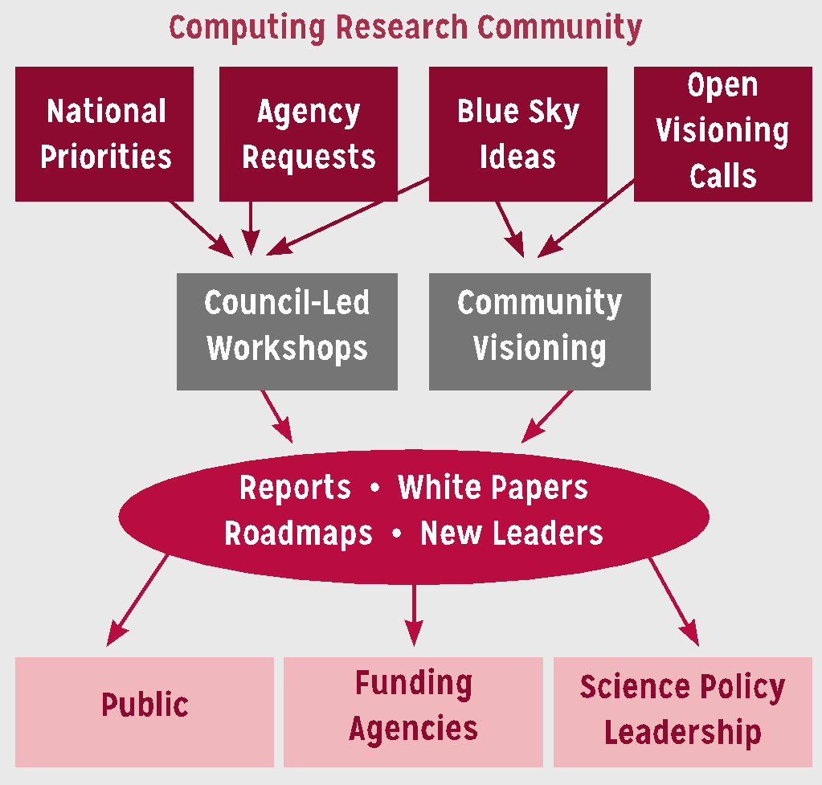
HOW WE DO THIS
Visioning workshops
Activities at conferences
White papers & social media
Roadmaps & reports
Biennial Symposium in DC
Human Development
Notes:
Think of CCC is a bridge between the CS research community, the funders of that research, and the beneficiaries of that research. We work to promote the health of that enterprise.

Slide 5






COMMUNICATION IS KEY
Visioning workshop outputs: reports, slide decks, briefings, …
White Papers
  CCC works with the computing research community to produce timely white papers that inform policymakers and the broader community about issues that are apropos of national priorities
CCC Blog
  Provides a continuous stream of information on advances in computing research
  Opportunities for community to get involved
  Forum for community discussion
Website
  Collection of resources
Great Innovative Ideas
  Showcases the exciting new research and ideas generated by the computing research community
"Catalyzing Computing” Podcast
  Features interviews with researchers and policy makers about their background and experiences in the computing community.
Events
  CCC Symposium, CRA Snowbird, Early Career Researcher Symposium, ...

Slide 6
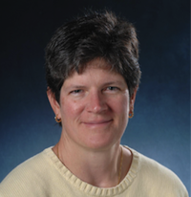
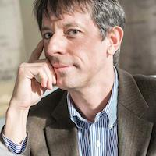
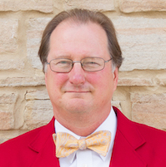
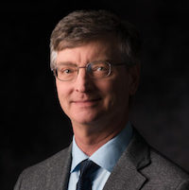
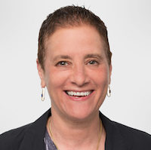
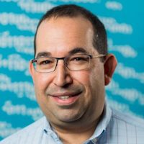
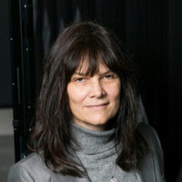
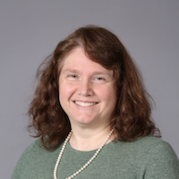
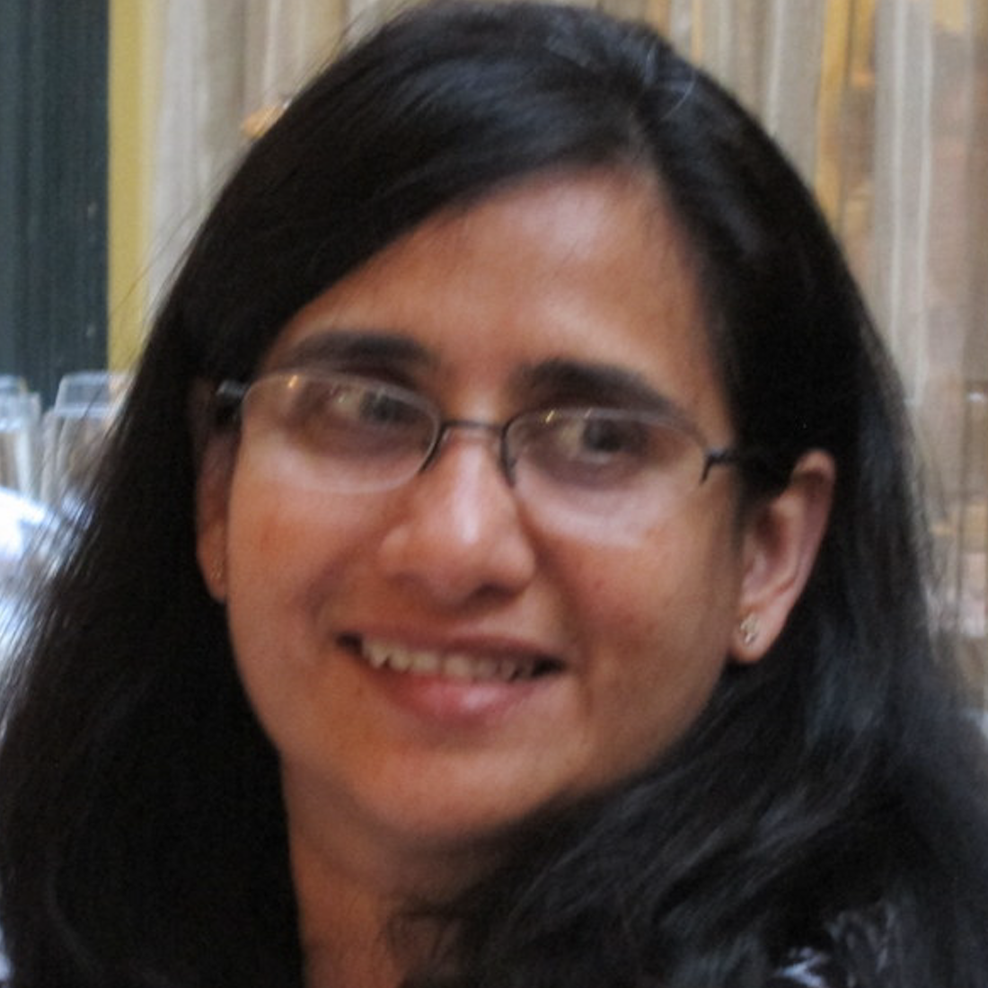
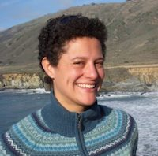
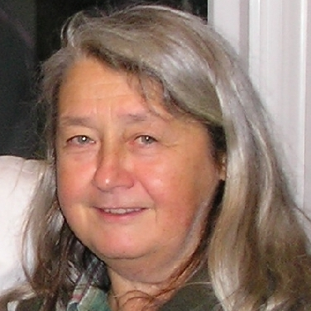
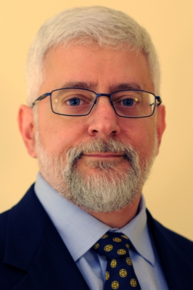
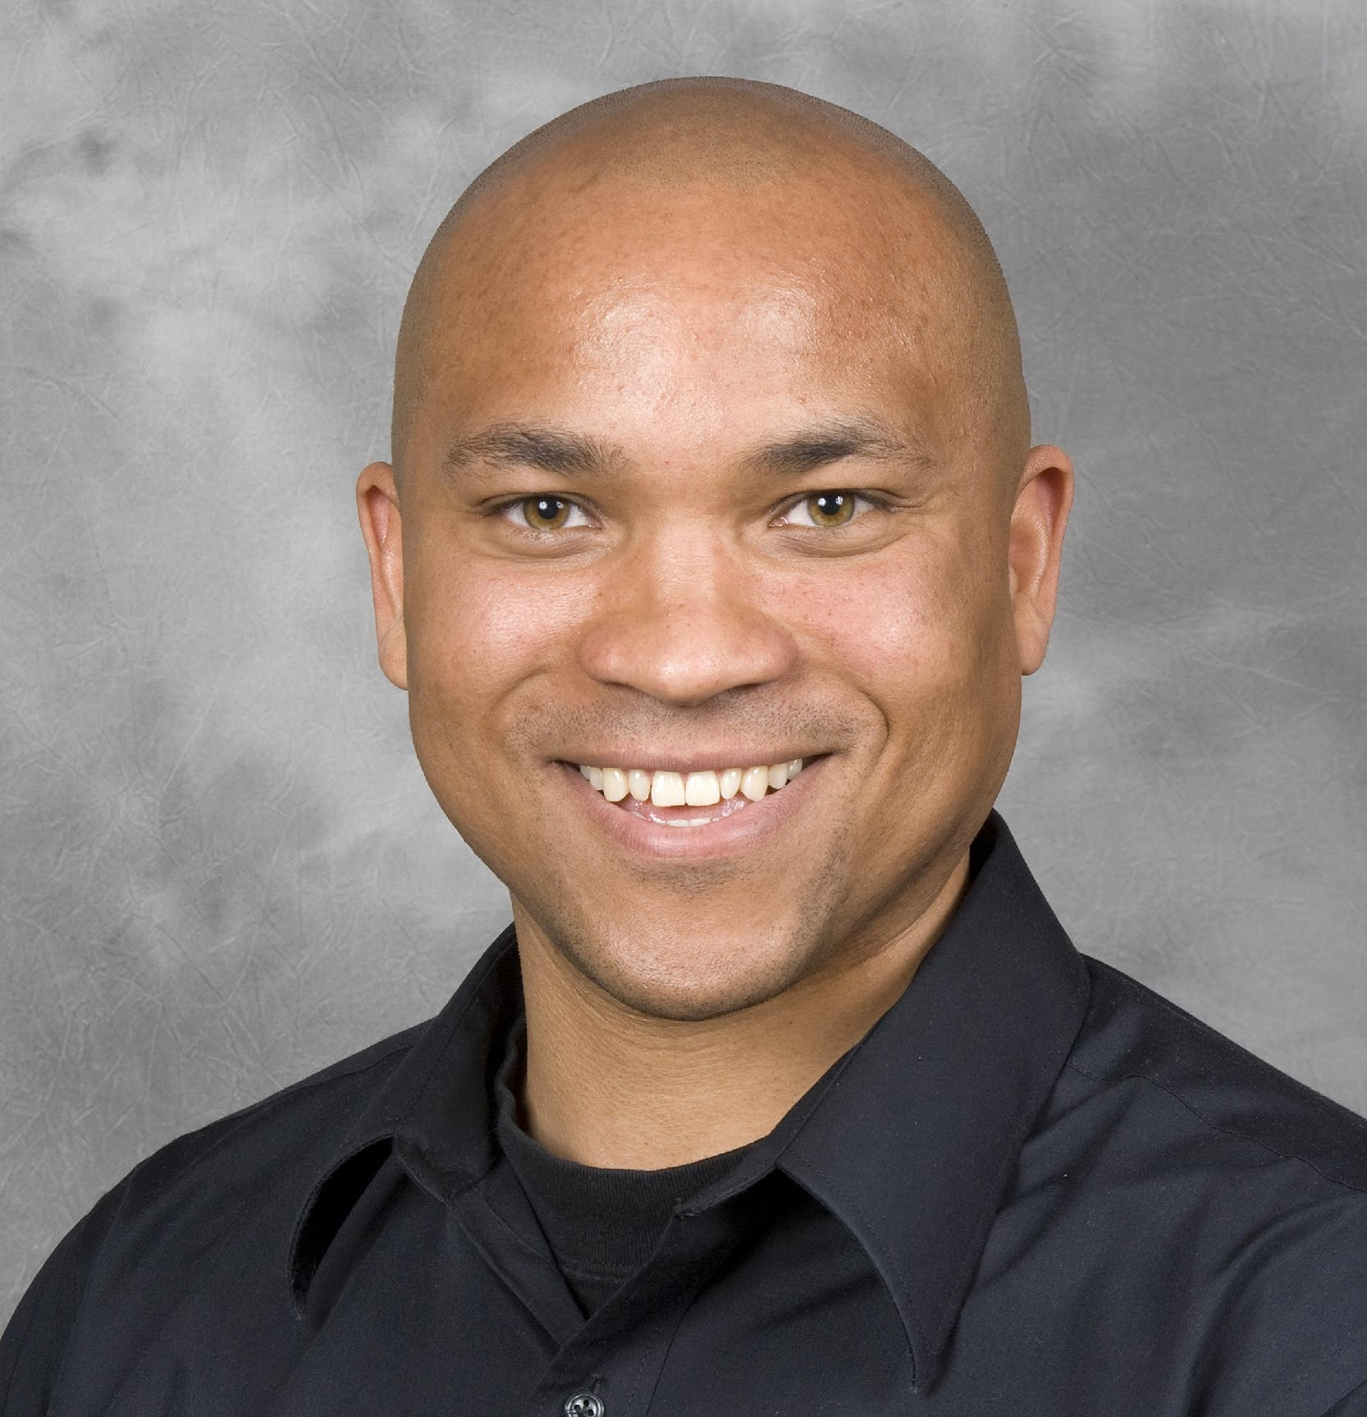
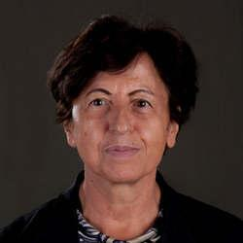
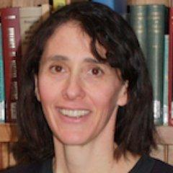
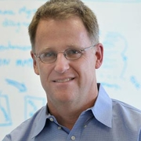
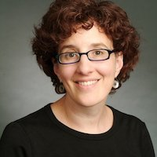
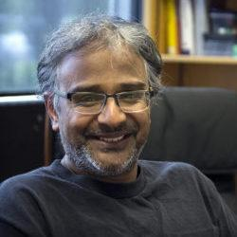
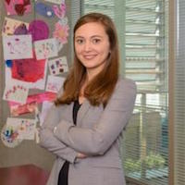
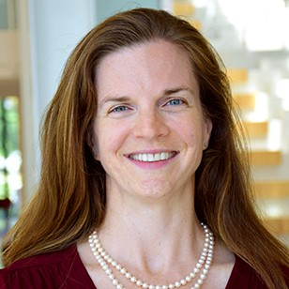
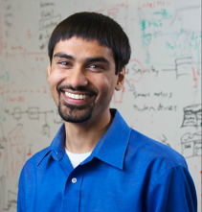
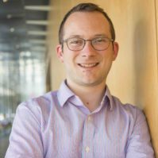
THE CCC COUNCIL
Chair: Liz Bradley, University of Colorado Boulder
Vice Chair: Dan Lopresti, Lehigh University
CCC Chair Emeritus: Mark Hill, University of Wisconsin, Madison
Terms ending June 2023
Nadya Bliss *, Arizona State
Kathleen Fisher, Tufts University
William D. Gropp, Illinois Urbana-Champaign
Brian LaMacchia, Microsoft Research
Melanie Moses, University of New Mexico
Helen Nissenbaum, Cornell Tech
Holly Yanco, University of Massachusetts Lowell
Terms ending June 2022
Sujata Banerjee, VMware
Elisa Bertino, Purdue University
Tom Conte, Georgia Tech
Maria Gini, University of Minnesota
Chad Jenkins, University of Michigan
Melanie Mitchell, Portland State University
Katie Siek, Indiana University
Terms ending June 2021
Ian Foster, University of Chicago
Ronitt Rubinfeld, MIT
Suresh Venkatasubramanian, Utah
David C. Parkes, Harvard
Shwetak Patel, Univ. Washington
Notes:
Full bios at https://cra.org/ccc/about/ccc-council-members/

