Slide 1
INTRODUCTION TO THE CCC AND
THE CCC COUNCIL
July 9, 2019
Notes:
Mark up first (through slide 16)

Slide 2
AN OVERVIEW OF THE
COMPUTING COMMUNITY CONSORTIUM
Established in 2006 as a standing committee of the Computing Research Association (CRA)
Funded by NSF under a Cooperative Agreement
  Third Award began in April 2018
Facilitates the development of a bold, multi-themed vision for computing research – and communicates this vision to stakeholders
Led by a broad-based Council
Staff based at CRA

Slide 3
WHAT WE’LL TRY TO COVER
Brief history
Role and mission of CCC
Organizational details
CCC Stakeholders
CCC Goals, Activities and Desired Outcomes
CCC Impact
Notes:
History and Role - Mark
Organizational and Stakeholders - Ann
Goals, Activities, Outcomes - Liz
Impact - ALL

Slide 4
PRE-HISTORY
In the mid-2000’s, NSF CISE leaders and computing research community leaders had similar concerns regarding:
  The Federal commitment to research in general, and to computing research in particular
  Public and policymaker perception that computer science is “yesterday’s news”
  Failure to articulate and coalesce around exciting research visions in computer science – research visions that would galvanize the public, policymakers, researchers, and students
  Need to groom leadership for the field
  Decrease in student interest
  GENI Project direction
This led to:
  Increased focus on these issues by NSF CISE and the computing research community
  Computing Community Consortium solicitation by NSF
  Eager response by a group of computing research community leaders under the auspices of the Computing Research Association
    Randy Bryant
    Susan Graham
    Anita Jones
    Dick Karp
    Ken Kennedy
    Ed Lazowska
    Peter Lee
    Jeff Vitter

Slide 5
INFORMAL MISSION
“A catalyst and enabler for the computing research community”
  Bring the community together to contribute to shaping the future of the field
  Provide leadership for the community, encouraging revolutionary, high-impact research
  Encourage the alignment of computing research with pressing national priorities and national challenges (many of which cross disciplines)
  Work with policymakers to facilitate the translation of these important research directions into funded programs
  Give voice to the community, communicating to a broad audience the many ways in which advances in computing will create a brighter future
  Grow new leaders for the computing
  research community

Slide 6
MAJOR ORGANIZATIONAL MILESTONES
NSF solicitation + CRA Proposal + Cooperative Agreement (2006)
Chair appointed (Winter 2007) + Council appointed (Spring 2007)
Vice-Chair position formalized: Fall 2007
Full-time Director (Erwin Gianchandani) joins: Spring 2010
Renewal proposal submitted: Spring 2011
Steady-state organizational structure defined: Fall 2012
Executive Committee launched: Winter 2013
Ann Schwartz joins as Director: Spring 2013
Regular Chair / Vice-Chair succession kicks in: Summer 2013
Proposal and Renewal (2017)
Third Award (2018)

Slide 7






CCC: CATALYZING I.T.’S VIRTUOUS CYCLE
Citizens
Industry
Government
Academia
Icons modified from Zlatko Najdenovski, Flaticon
Notes:
Established in 2006 as a standing committee of the Computing Research Association
Funded by NSF under a Cooperative Agreement
Facilitates the development of a bold, multi-themed vision for computing research – and communicates this vision to stakeholders
Led by a broad-based Council
Staffed by CRA

Slide 8
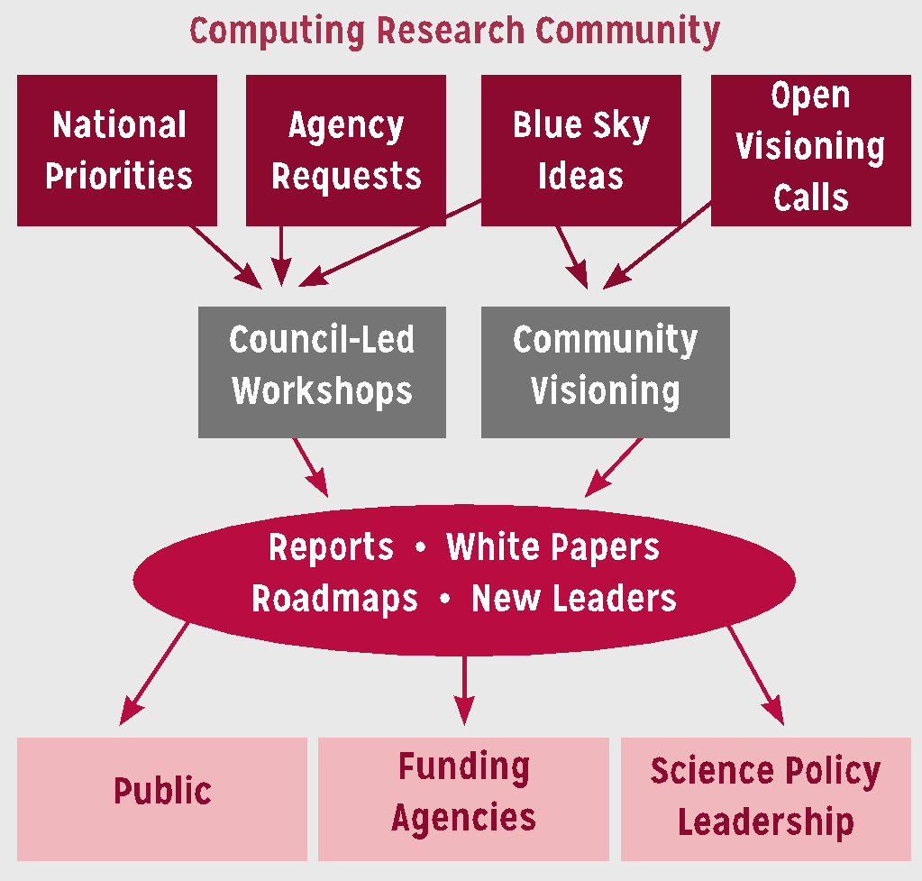
COMPUTING COMMUNITY CONSORTIUM
The mission of Computing Research Association's Computing Community Consortium (CCC) is to catalyze the computing research community and enable the pursuit of innovative, high-impact research.
Who
Council - 20members
CCC/CRA Staff
Chair, VC, & Director
Inputs: Bottom-up, Internal, & Top-Down
What:
Workshops & Conf. Blue Sky Tracks
Whitepapers & Social Media
Reports Out (esp. to government)
Biannual Symposium to DC’ers
Human Development
Early Career Workshops & Participation
Council Membership
Leadership w/ Gov’t (LISPI)
Notes:
Established in 2006 as a standing committee of the Computing Research Association
Funded by NSF under a Cooperative Agreement
Facilitates the development of a bold, multi-themed vision for computing research – and communicates this vision to stakeholders
Led by a broad-based Council
Staffed by CRA

Slide 9
ORGANIZATIONAL STRUCTURES

Slide 10
CCC ORGANIZATIONAL STRUCTURE
Chair, Vice-chair
  2 year non-staggered terms
  Vice-chair is presumptive chair
Director, Senior Program Associates (2), Program Associate
  Full-time paid positions
Executive Committee
  Chair, Vice-chair, Director
  3 at large drawn from Council for 1-year terms
  CRA Executive Director
Council
  20 members
  3 year terms, at most 2 consecutive terms
Support
  As needed, from CRA Staff

Slide 11
WHAT DOES EXECUTIVE COMMITTEE DO?
Each member has a major responsibility within the organization
Oversees the work of subcommittees and working groups
Guides the planning of new activities
Oversees the execution of the Strategic Plan and annual Implementation Plan
Meets biweekly by teleconference
Notes:
Executive committee provides grooming for future leadership

Slide 12
WHAT DO COUNCIL MEMBERS DO?
Shepherd visioning activities
Participate in topical task forces
  Examples: AI and Robotics, Healthcare, Privacy and Fairness
  Produce and curate relevant resources
  Monthly teleconferences
Develop and lead new activities
  Examples: CIFellows, LISPI, …
Engage with government agencies, industry, and sister organizations (NSF, ACM, Big Data Hubs…)
Write white papers and blog posts
Other requests as needed
Monthly teleconferences
Three face-to-face meetings each year

Slide 13
COUNCIL MEMBER EXPECTATIONS
Attend three, face to face council meetings annually.
Participate in monthly council calls.
Participate in a CCC task force, including monthly phone conferences.
Write 1-3 CCC blog posts annually.
Include a “learn about the CCC” meeting when visiting universities, research labs and agencies relevant to CCC’s mission.
Participate in agency visits.
Participate in biennial CCC activities such as the CCC Symposium and CRA’s Snowbird.
Work with CCC communication staff, including freelancers, to produce articles for general consumption.

Slide 14
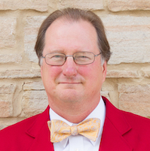
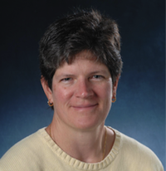
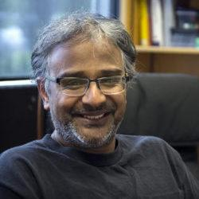
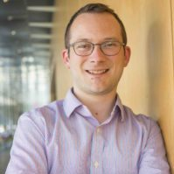
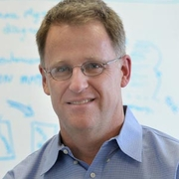
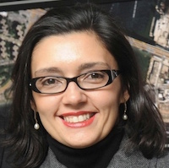
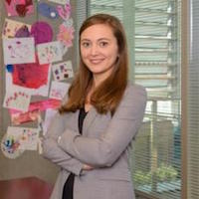
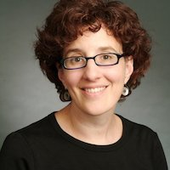
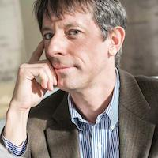
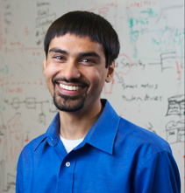

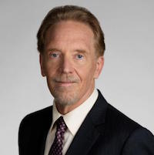
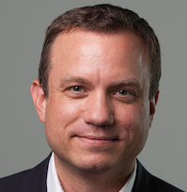

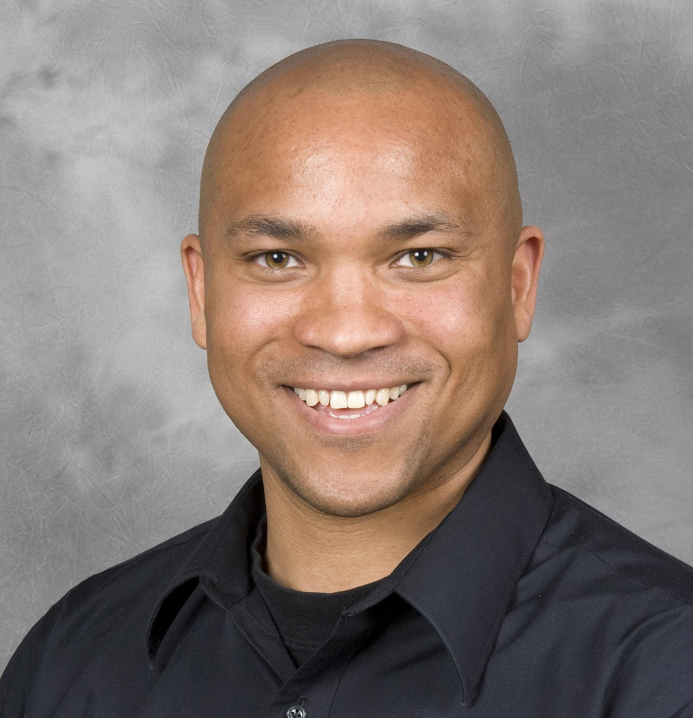
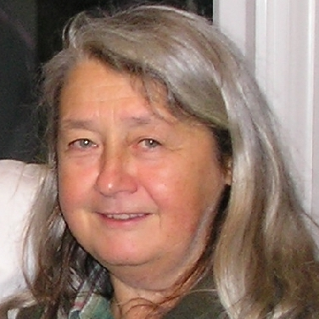
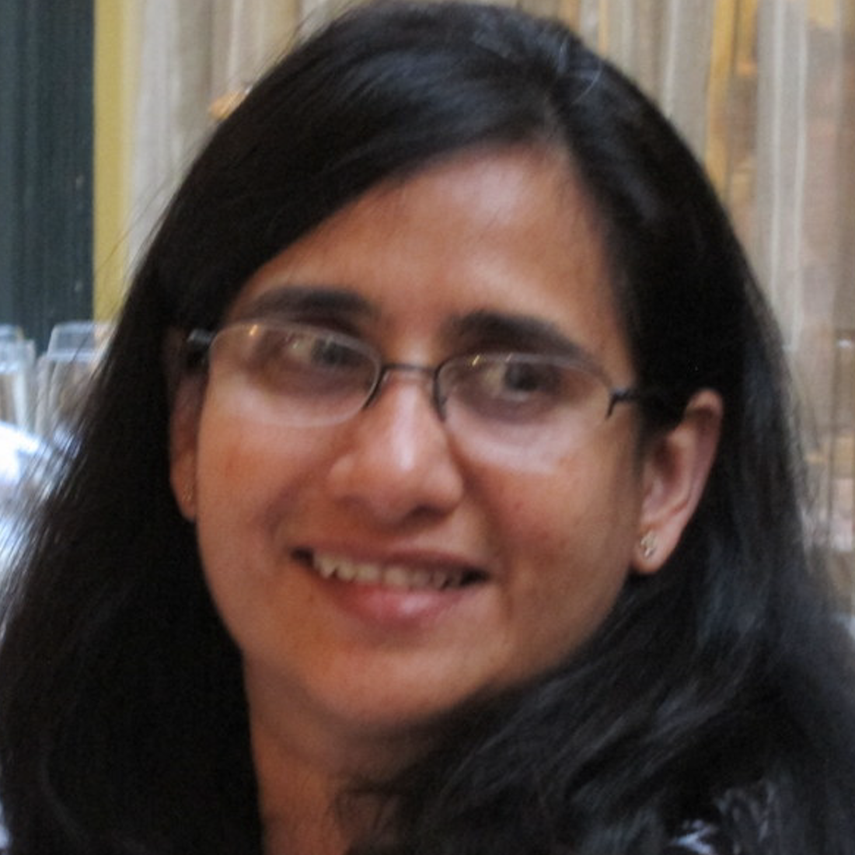
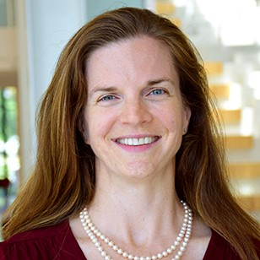
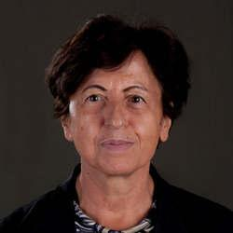
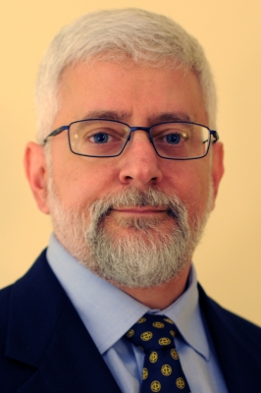
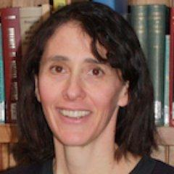
THE CCC COUNCIL
Chair: Mark Hill
Vice Chair: Liz Bradley
Terms ending June 2022
  Sujata Banerjee, VMware
  Elisa Bertino, Purdue University
  Tom Conte, Georgia Tech
  Maria Gini, University of Minnesota
  Chad Jenkins, University of Michigan
  Melanie Mitchell, Portland State University
  Katie Siek, Indiana University
Terms ending June 2021
  Ian Foster, University of Chicago
  Ronitt Rubinfeld, MIT
  Suresh Venkatasubramanian, Utah
  Daniel P. Lopresti, Lehigh University
  David C. Parkes, Harvard
  Shwetak Patel, Univ. Washington
Terms ending June 2020
  Nadya Bliss, Arizona State
  Juliana Freire, NYU
  Keith Marzullo, Maryland
  Greg Morrisett, Cornell
  Jennifer Rexford, Princeton
  Ben Zorn, Microsoft Research

Slide 15
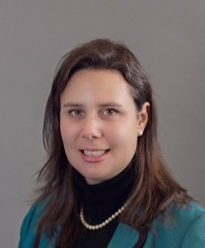
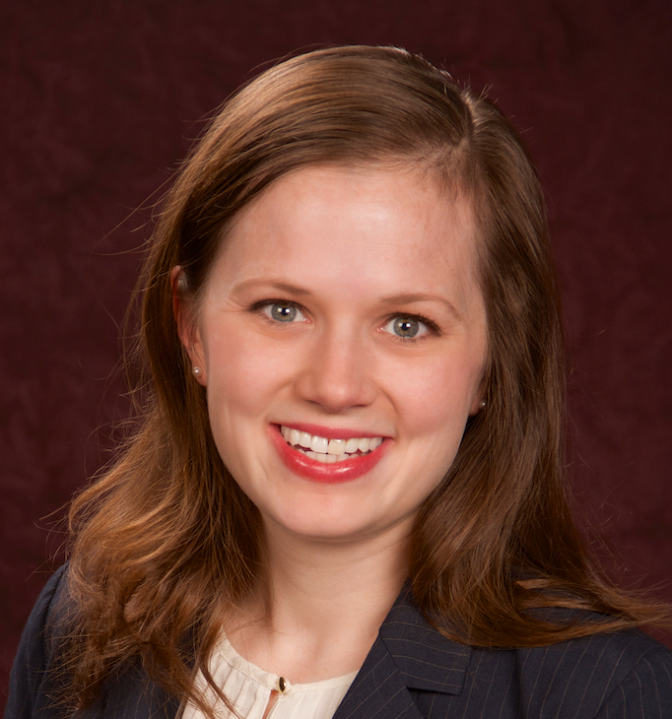

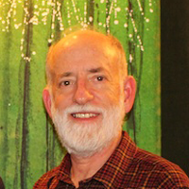



CRA STAFF
CCC Director: Ann Schwartz
Senior Program Associate for Communication: Helen Wright
Senior Program Associate for Engagement: Khari Douglas
Program Associate: TBD
CRA Executive Director: Andy Bernat
Other CRA Staff:
  Peter Harsha, Director of Government Affairs
  Sandra Corbett
  Sabrina Jacob

Slide 16
NSF INTERACTIONS
CISE Office of the Assistant Director
AD: James Kurose
DAD: Erwin P. Gianchandani
Office of Advanced Cyberinfrastructure (OAC)
DD: Manish Parashar
DDD: Amy Friedlander
Computing and Communications Foundations (CCF)
DD: Rance Cleaveland
DDD: Thyaga Nandagopal
Computer and Network Systems (CNS)
DD: Ken Calvert
DDD: Jeremy Epstein
Information and Intelligent Systems (IIS)
DD: Henry Kautz
DDD: Joydip Kundu
Data
Algorithmic Foundations
Computer Systems Research
Cyber Human Systems
High Performance Computing
Communications and Information Foundations
Networking and Technology Systems
Information Integration and Informatics
Networking / Cybersecurity
Software and Hardware Foundations
Robust Intelligence
Software
Program Officer: Nina Amla
Notes:
Bi-weekly telecon with Executive committee. We tell them what we’re working on. They tell us what they’d like us to do. Sometimes we have to push back…
MIGHT NEED TO UPDATE THIS COME JULY
HELEN FIX

Slide 17
RELATIONSHIP TO COMPUTING RESEARCH ASSOCIATION (CRA)
NSF cooperative agreement is with CRA
CCC is a standing committee of CRA
  Andy Bernat, CRA Executive Director, is an ex officio member of the CCC Executive Committee
  Mark Hill, the CCC Chair is a member of the CRA Board of Directors
  Ellen Zegura, the CRA chair must consent to CCC Council appointments
  Greg Morrisett, CCC Council member and member of the CRA Board of Directors
CCC staff are based in CRA
Notes:
Would be useful to mention other parts of CRA

Slide 18
CCC AND ITS STAKEHOLDERS
Notes:
Think of CCC is a bridge between the CS research community, the funders of that research, and the beneficiaries of that research. We work to promote the health of that enterprise.

Slide 19
MAJOR STAKEHOLDERS
Computing Research Community
  CRA
  CSTB (Computer Science and Telecommunications Board, part of National Research Council)
  Professional societies
  Academic units
  Research labs
Industry
  Computing industry, Major users of IT
Public
Government
  See following slides

Slide 20
GOVERNMENT STAKEHOLDERS
Agencies important to us
NSF – strong ties with CISE
NIH – growing ties with folks interested in Health IT
DARPA – ties come and go
DoE – ties with ASCR; interest in ARPA-E
Others that are relevant
NIST
HHS/ONC
IARPA
DoT
Notes:
Acronym soup will slowly start to make sense. Don’t sweat it.

Slide 21
GOVERNMENT STAKEHOLDERS
Networking and Information Technology R&D (NITRD)
  Legislatively mandated coordination among Federal R&D agencies
  National Coordinating Office (NCO) facilitates
    Interagency working groups
    Coordinating groups
    Senior steering groups
    Community of practice
  Director is Kamie Roberts

Slide 22
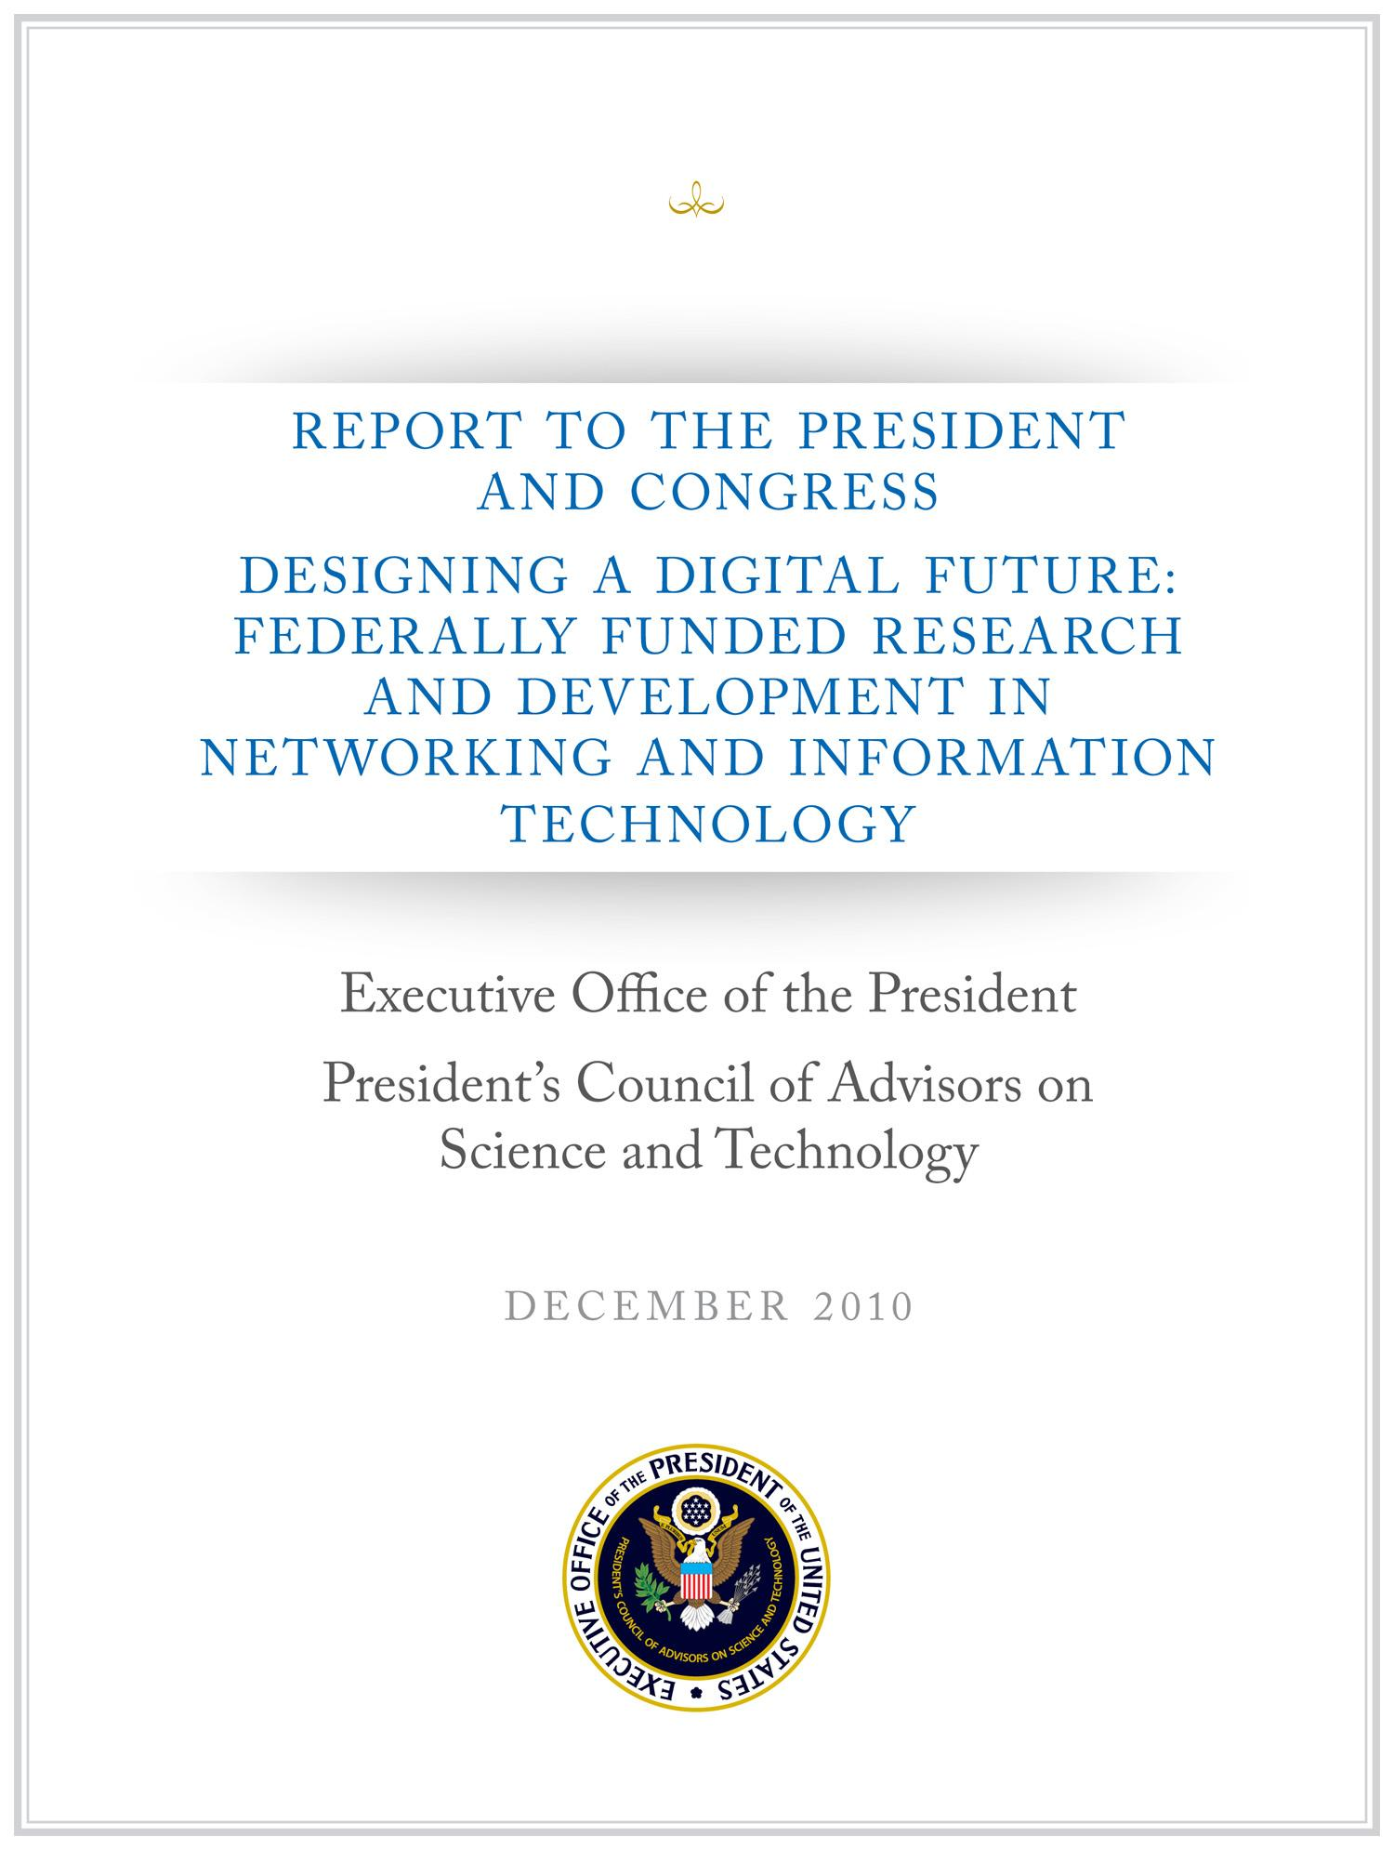
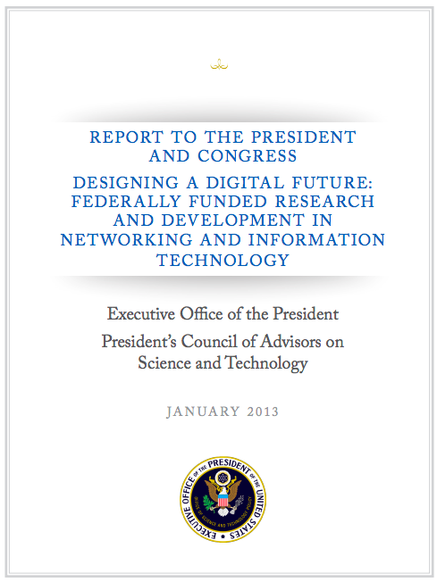
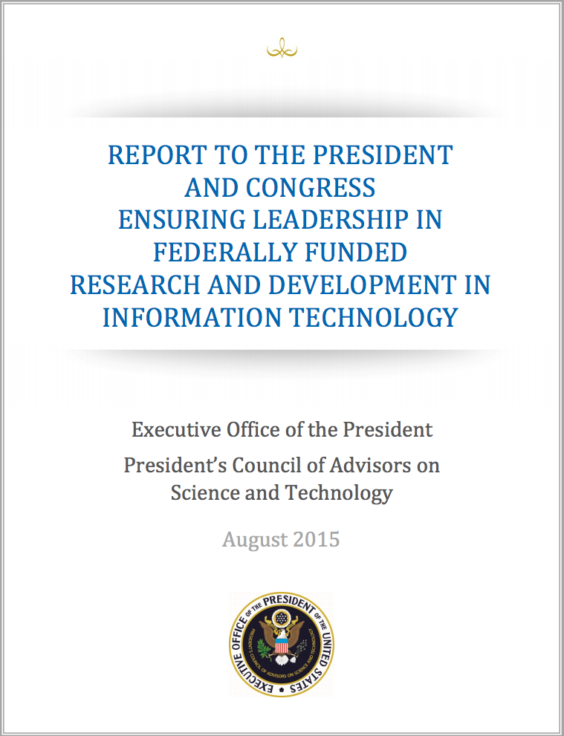
PCAST NITRD REPORT
2010
1/3 of the PCAST NITRD Working Group members were CCC Council Members
The report drew extensively on CCC White Papers
An excellent roadmap for the field
2013
¼ Contributing Members were CCC Council Members
An excellent review of progress from 2010 report
The challenge now: Continuing to translate it into action
2015
1/3 Contributing Members were CCC Council Members
An update to the 2013 report, including recommendations for Federal Agencies
The challenge now: restructuring NITRD
Notes:
Should explain what PCAST is

Slide 23
CCC GOALS AND ACTIVITIES

Slide 24
GOALS FOR CCC
Bring the computing research community together to envision audacious research challenges, and to articulate concrete pathways to enable pursuit of these challenges.
Communicate these challenges and opportunities to the broader national community.
Facilitate investment in these research challenges by key stakeholders.
Inculcate values of leadership and service by the computing research community.
Inform and influence early career researchers to
engage in these community-led research challenges.

Slide 25
DESIRED OUTCOMES
Create broad awareness of the role computing research will play in future science and technology advances within federal agencies, philanthropic organizations, and industry through concrete examples and products.
Facilitate broad engagement of the computing research community in identifying and articulating new directions for computing research, in shaping priorities for those new directions, and in responding to existing opportunities in the computing research ecosystem.
Create high-impact tangible resources that inform stakeholders as to the current and potential impact of computing research.
Sustain the CCC as a widely accepted catalyst and voice for the computing research community.
Grow leadership and community capacity to engage in and respond to national science policy needs.

Slide 26
Mapping CCC Strategic Goals to Priority Outcomes
 | Goal 1: Research Challenges | Goal 2: Communicate Broadly | Goal 3: Research Investments | Goal 4: Leadership | Goal 5: Influence Community
Outcome 1: Agency Awareness | ✔ | ✔ | ✔
Outcome 2: Community Engagement | ✔ | ✔ |  | ✔ | ✔
Outcome 3: Tangible Resources | ✔ | ✔ | ✔ |  | ✔
Outcome 4: CCC Role | ✔ | ✔ |  | ✔
Outcome 5: Leadership and Capacity | ✔ | ✔ | ✔ | ✔ | ✔

Slide 27
PLANNED ACTIVITIES
Envisioning Future Computing Research
Engaging and Aligning with National and Computing Research Priorities
Communicating Future Computing Research
Cultivating Computing Leadership and Community Capacity to Engage and Respond to National Priorities

Slide 28
ENVISIONING FUTURE COMPUTING RESEARCH
“The Computing Community Consortium (CCC) solicits proposals that will galvanize the community to define visions and agendas for exciting frontiers of computing research.”
Create a new community of researchers.
Inform a new funding initiative.
Help an extant community define a new trajectory.
Goals for next phase
Increase our outreach and participation
Increase the participation of industry leadership and early career researchers at Visioning Workshops
Notes:
Switch to Liz presenting (through slide 47, but with some chime-ins on health & architecture stuff)

Slide 29




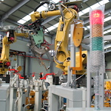
VISIONING PROCESSES
Periodic RFP for Community Initiated Activities
Average of 8 workshops per year in the last 3 years
Top-down (agency initiated)
Bottom-up (open call)
Sideways (council initiated, joint with other agencies,….)
Robotic Materials
Digital Computing Beyond Moore’s Law
Sociotechnical Interventions for Health Disparity Reduction
Sociotechnical Cybersecurity
Cybersecurity for Manufacturers
Notes:
Outline visioning and other activities over course of grant (2012-2014)
Make a point of discussing process a bit
Point out that we reach out widely to all directorates within NSF and other agencies.
Robotics, Automation, and Computer Science
Sponsored by Robotics-VO, NSF, OSTP, and CCC
Goal: frame concrete problems used to guide basic and applied research through the National Robotics Initiative
Point out how the processs works – we work with them

Slide 30
VISIONING ACTIVITIES
Workshop | Date
Early Career Researcher Symposium | August 1-2. 2018
Leadership in Embedded Security Workshop | August 12-13, 2018
Artificial Intelligence Roadmap Workshop 1- Integrated Intelligence | November 14-15, 2018
Thermodynamic Computing | January 3-5, 2019
Artificial Intelligence Roadmap Workshop 3- Self Aware Learning | January 17-18, 2019
Identifying Research Challenges in Post Quantum Cryptography Migration and Cryptographic Agility | January 31-February 1, 2019
Code 8.7: Using Computational Science and AI to End Modern Slavery | February 19-20, 2019
Misinformation Roundtable | March 26 2019
Economics and Fairness | May 22-23, 2019
Over 55 visioning activities in 10-year history
Average of 8 activities per year in the last 3 years
Research areas include:
  AI
  Post Quantum Cryptography
  Health
  Privacy by Design
  BRAIN Initiative
  Fairness
  Misinformation
  Thermodynamic Computing
20 workshop reports released
in past 5 years
36 white papers released
in past 5 years

Slide 31
SUCCESSFUL VISIONING ACTIVITIES
Engage the community and relevant stakeholders
Facilitate broad thinking with compelling examples
Create new avenues for (interdisciplinary) collaboration
Prepare and energize the community for future opportunities
Rapidly capture and synthesize ideas from the community.
Present ideas and engage possible funders and stakeholders
Articulate needs and barriers to research impact

Slide 32
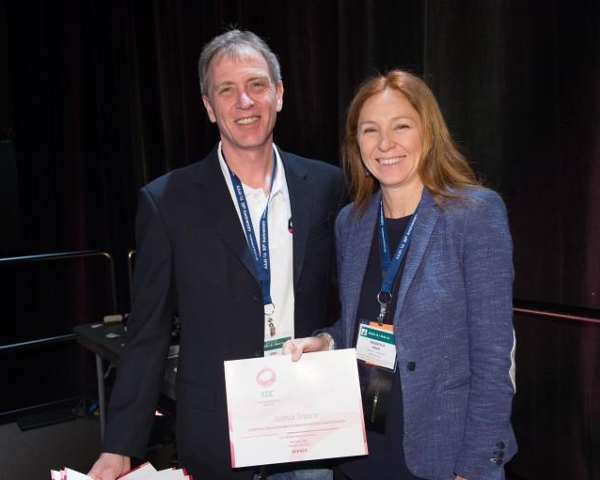
BLUE SKY
Goal - Help conferences reach out beyond the usual research papers. Papers are open-ended and possibly “outrageous” or “wacky.”
  18 different tracks at 12 different conferences in last 5 years
  On average, 13 papers submitted per track at a conference
  Winners are asked to submit Great Innovative Ideas
Past CCC Chair Gregory Hager with AAAI-16 Blue Sky award winner Francesca Rossi

Slide 33
BLUE SKY IDEAS CONFERENCE TRACKS
PAST
UPCOMING
Autonomous Agents and MultiAgent Systems (AAMAS-2014, AAMAS-2016, AAMAS-2017)
Foundations of Software Engineering (ACM SIGSOFT 2014)
Advancement of Artificial Intelligence (AAAI-15, AAAI-16, AAAI-17, AAAI-18, AAAI-19)
Advances in GIS (ACM SIGSPATIAL 2015, ACM SIGSPATIAL 2016, ACM SIGSPATIAL 2017, ACM SIGSPATIAL 2018)
Robotics: Science and Systems (RSS) 2015, 2017
International Conference on Software Engineering (ICSE 2016)
NAACL 2018 Student Research Workshop
ACM Conference on Hypertext and Social Media 2018
International Semantic Web Conference (ISWC) 2018
iConference 2019
NAACL 2019 Student Research Workshop
International Semantic Web Conference (ISWC) 2019

Slide 34
ENGAGING AND ALIGNING WITH NATIONAL AND COMPUTING RESEARCH PRIORITIES
Agility to respond to requests and ideas.
Outreach pulls together visioning with stakeholder needs and timely opportunities
Increase scale and capacity through CCC Task Forces
Increase engagement with industry, sister organizations and other relevant stakeholders (philanthropy)

Slide 35
CURRENT CCC TASK FORCES
CCC task forces are organized around national priorities, community needs, and council member interests. Our current* set of topics are:
Artificial Intelligence Working Group
Industry Working Group
Cybersecurity and Cybercrime
Health and Human Computer Interaction
Intelligent Infrastructure
Information Integrity and Provenance
Fairness and Accountability
Systems and Architecture
Goal is for CCC to be engaged in ongoing activities around these topics, to identify needs and opportunities in the topic area, and to identify actions (generating white papers, convening a workshop, publicizing information, etc.) that have the possibility of “moving the needle” for these topics.
Annual process to determine topics, membership and priorities. Informed by major stakeholders (NSF, OSTP, PCAST, NITRD, workshops and council members). * List likely to change after this summer’s meeting.

Slide 36

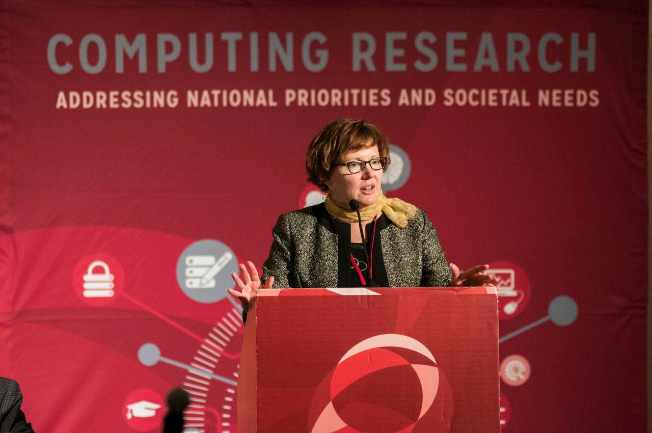
Held first National Symposium to Highlight the Impact of Computing Research in 2016. Held second one in October 2017.
Established a biennial Symposium to communicate the role of computing research to address national and societal priorities
Bring in early career researchers to connect them with and invigorate the community
Notes:
39 early career faculty
On average, 300 hits/day
Big Data is constant
Increase in interest for posts on other agencies (NIH, DARPA)
We track hits, reposts, etc.
Ann & Beth to chime in here too (esp since Beth’s image is on this slide!)

Slide 37


COMMUNICATING
Workshop Reports
White Papers
  CCC works with community to produce timely white papers that inform policymakers and the broader community on national priorities
CCC Blog
  Provides a continuous stream of information on advances in computing research
  Opportunities for community to get involved
  Forum for community discussion
Website
  Collection of Resources
Great Innovative Ideas
  A way to showcase the exciting new research and ideas generated by the computing community
Catalyzing Computing Podcast
Annual events
  CCC Symposium
  CRA Snowbird
Special Events
  Early Career Researcher Symposium
Biannual Computing Research Symposium
Early Career Researcher Symposium
2018
Notes:
Khari- would you mind adding the podcast logo?

Slide 38
NURTURING NEXT GENERATION OF LEADERS
Grow leadership and community capacity to engage in and respond to national science policy needs and identify new directions for computing research.
Leadership in Science Policy Institute
  Educates and trains computing researchers on how science policy in the U.S. is formulated and how to advocate for computing research
  Co-sponsored by CRA’s Government Affairs Committee
Industry – Academic Collaborations
  CCC collaborated with Big Data Regional Hubs
  Activities to enhance the research of early career faculty
Postdoc Best Practices
  Program to study institutional support structures for postdocs
  3 programs: University of Washington, NY ASCENT, Arizona
Computing Innovation Fellows (CIFellows) Project
  Rapidly created the CI Fellows program to preserve human capital when faculty positions became scarce with the financial crisis
Visioning Activities
  Cultivate leaders for the community through leadership / involvement in visioning activities

Slide 39
IMPACT

Slide 40


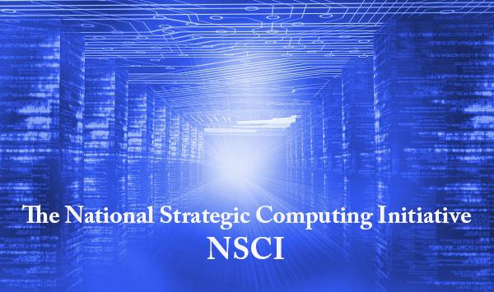
AMPLIFICATION
BRAIN Initiative launched in 2013.
CCC co-hosted the Brain Workshop with NSF in 2014.
CCC co-hosted the SA+TS workshop with SRC and NSF in 2013.
Produced Research Needs for Trustworthy, and Reliable Semiconductors
Report in 2015.
NSCI announced in July 2015.
CCC produced a series of blog posts on the topic, featuring one from Doug Burger, and the Systems and Architecture task force frequently overlaps with this topic.
Smart and Connected Health Program in NSF and NIH.
CCC has hosted several workshops on related topics, including: Aging in Place (2014), Inclusive Access (2015), and Smart and Pervasive Health (2016) and produced related reports and white papers.
Notes:
2004 – Ed was on PITAC under President Bush – Computational Science was one of the three sections of the report and Big Data was mentioned
2008 – CCC White Paper for the transition team
2008 – CCC Workshops
2010 – Series of White Papers, first PCAST Report
2012 – Presidential Initiative
2014 - Ubiquitous

Slide 41
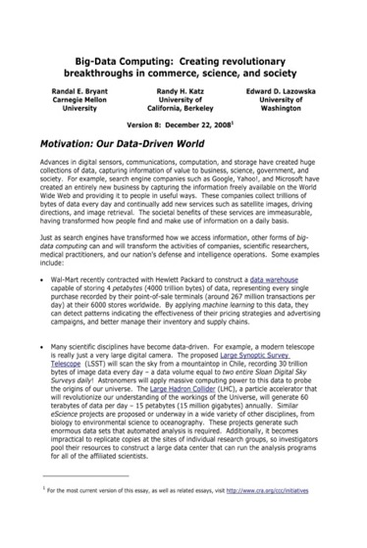
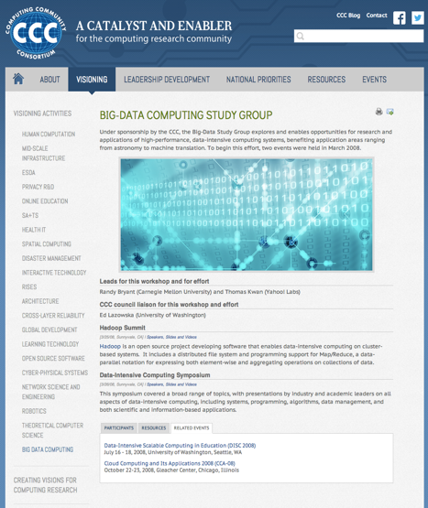
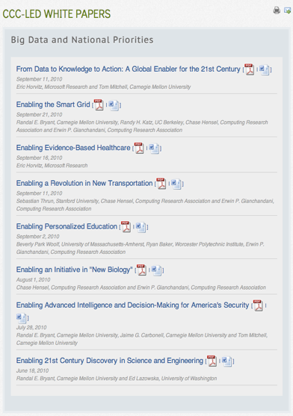
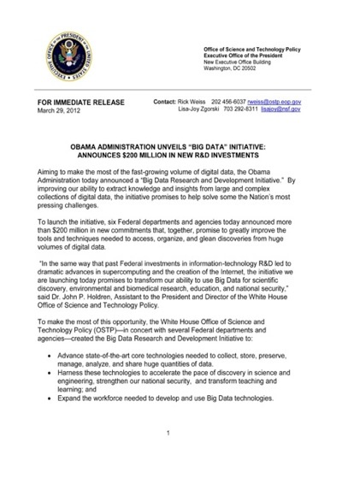

IMPACT: BIG DATA
2008
2008
2010
2012
2016
Notes:
2004 – Ed was on PITAC under President Bush – Computational Science was one of the three sections of the report and Big Data was mentioned
2008 – CCC White Paper for the transition team
2008 – CCC Workshops
2010 – Series of White Papers, first PCAST Report
2012 – Presidential Initiative
2014 - Ubiquitous

Slide 42
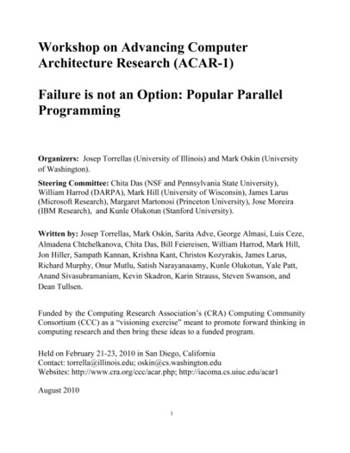
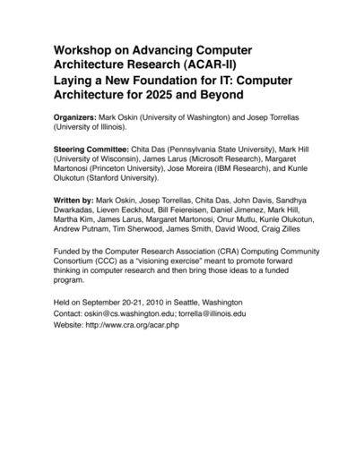
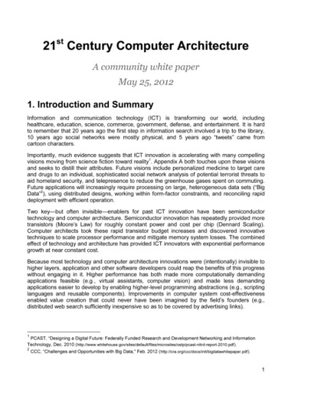
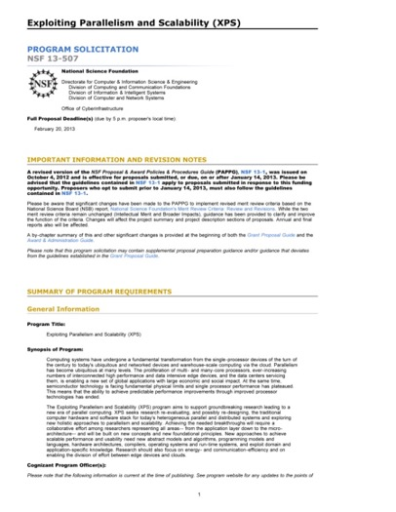
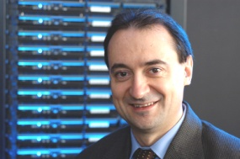
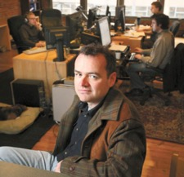
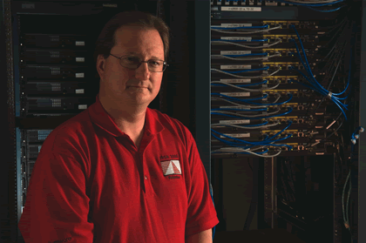
IMPACT: ARCHITECTURE
2010
2010
2012
2013
Josep Torrellas
UIUC
Mark Oskin
Washington
Mark Hill
Wisconsin
Notes:
Mark to present this & following one
2012 White Paper:
March – group forms(launched by CCC)
April – brainstorming, read related documents, outline
May – solicit feedback on drafts
May 25 – release report
February, 2013 – XPS solicitation quoting report

Slide 43
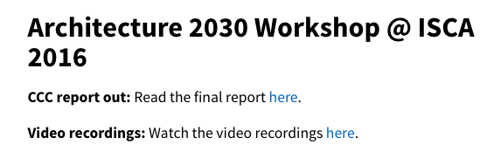

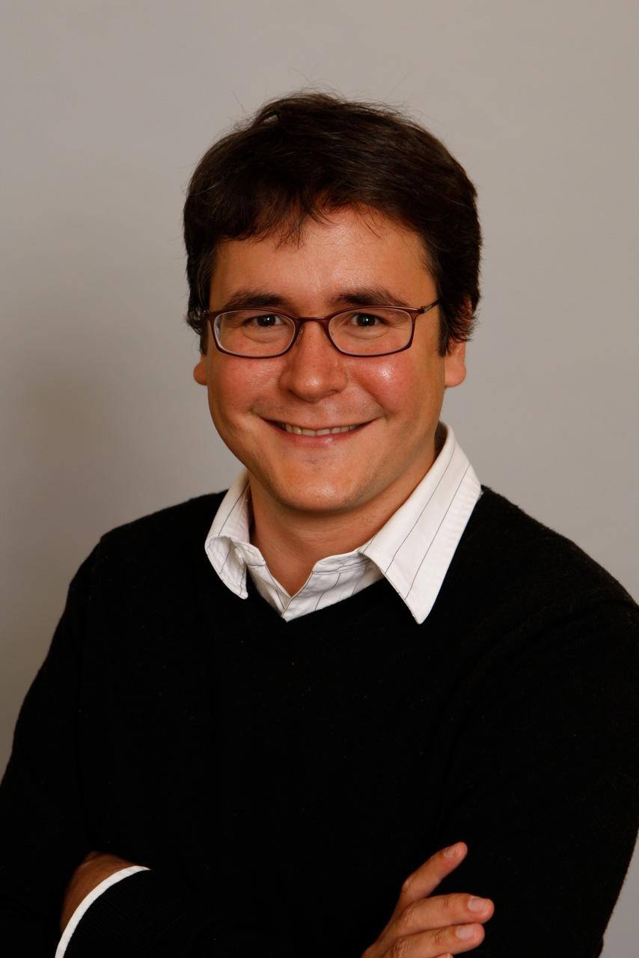
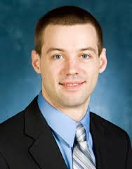
IMPACT: ARCHITECTURE
2013
2016
2016
Luis Ceze
Washington
Tom Wenisch
Michigan
Mark Hill
Wisconsin
Notes:
2012 White Paper:
March – group forms(launched by CCC)
April – brainstorming, read related documents, outline
May – solicit feedback on drafts
May 25 – release report
February, 2013 – XPS solicitation quoting report

Slide 44
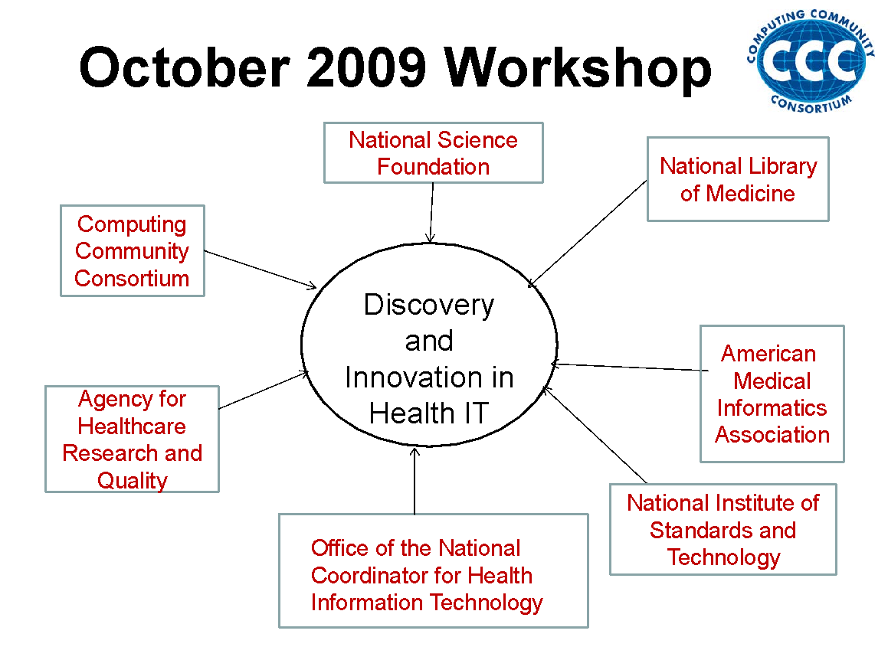

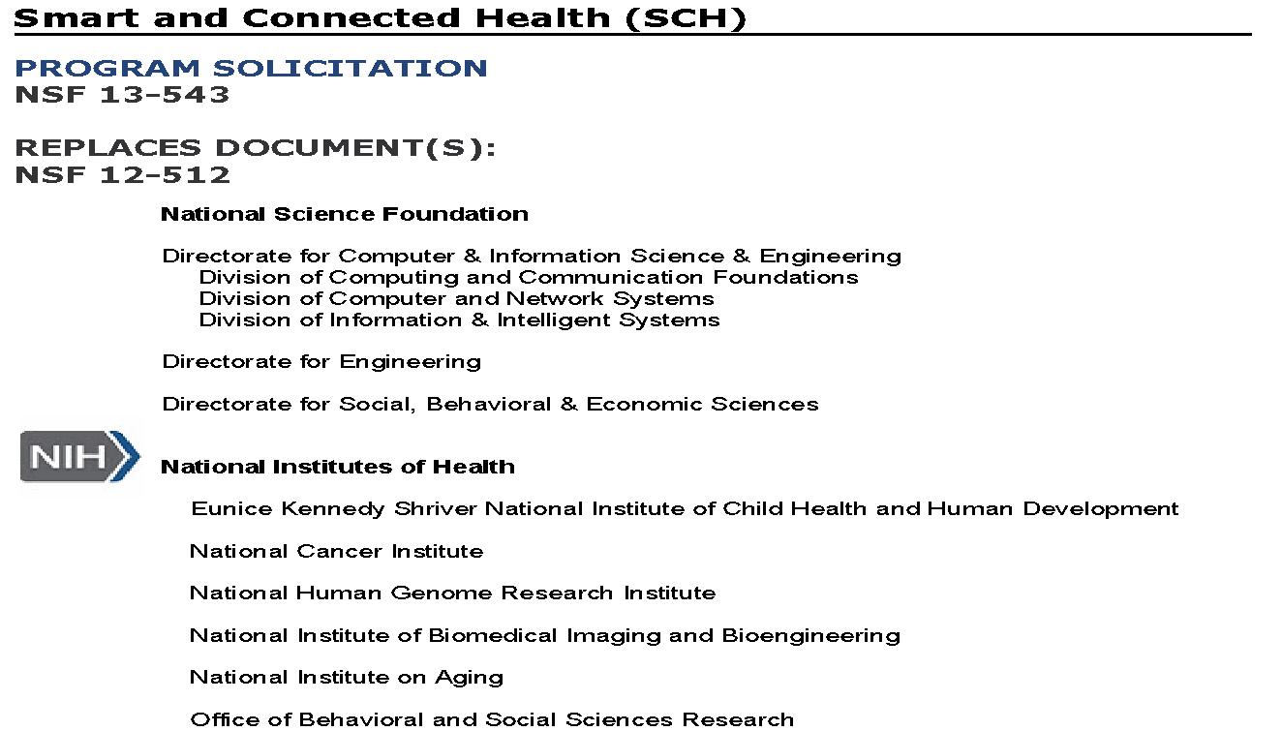
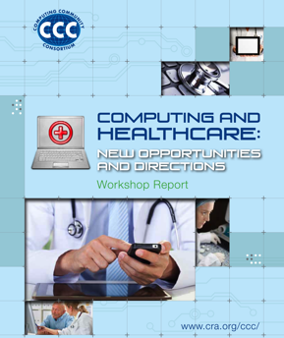
IMPACT: HEALTH IT
October 2012 Workshop
Notes:
Beth to present this and following one
SHW first in 2010, updated in 2013 as a joint initiative with NIH

Slide 45
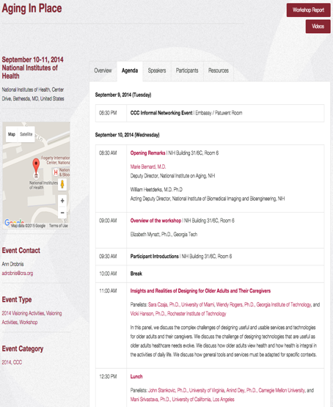
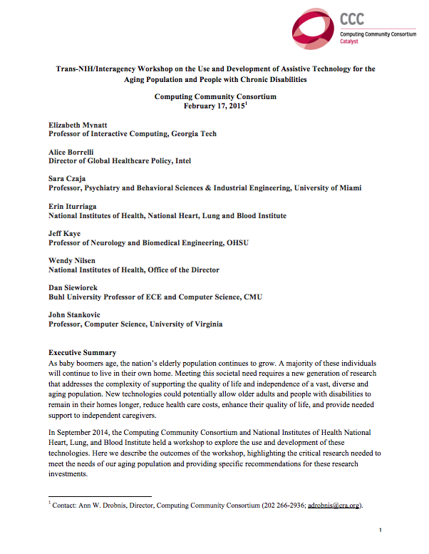
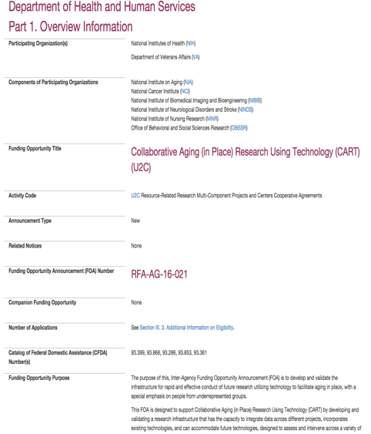

IMPACT: AGING IN PLACE
Joint NIH/CCC Meeting
September 2014
Produced Workshop Report
February 2015
NIH released new RFP informed by AIP Workshop
October 2015
PCAST Report
March 2016
Notes:
2004 – Ed was on PITAC under President Bush – Computational Science was one of the three sections of the report and Big Data was mentioned
2008 – CCC White Paper for the transition team
2008 – CCC Workshops
2010 – Series of White Papers, first PCAST Report
2012 – Presidential Initiative
2014 - Ubiquitous

Slide 46





IMPACT: ROBOTICS
2 meetings in Spring, 2016
Report and
Congressional Briefing in June, 2016
4 meetings during
summer 2008
Roadmap published
May 2009
Extensive discussions
between visioning
leaders & agencies
OSTP issues directive to all
agencies in summer 2010
to include robotics in
FY 12 budgets
National Robotics
Initiative announced
in summer 2011
Henrik Chistensen
Notes:
CCC had been working on a robotics White Paper (2007-2009) – Rodney Brooks
Henrik Christiansen, Sebastien Thrun and Robotics people came to CCC wanting help to get the robotics community on track (2008)
Tom Kalil was looking for a focus area
Henrik and CMU President (Jared Cohon) were instrumental in setting up the Robotics Caucus, using the Roadmap

Slide 47


IMPACT: ROBOTICS
2 meetings in Spring, 2016
Report and
Congressional Briefing in June, 2016
NRI 2.0 announced November 2016
Next Generation Robotics
published June, 2016
Henrik Chistensen
Notes:
CCC had been working on a robotics White Paper (2007-2009) – Rodney Brooks
Henrik Christiansen, Sebastien Thrun and Robotics people came to CCC wanting help to get the robotics community on track (2008)
Tom Kalil was looking for a focus area
Henrik and CMU President (Jared Cohon) were instrumental in setting up the Robotics Caucus, using the Roadmap

Slide 48








IMPACT: ARTIFICIAL INTELLIGENCE
White House announces interest in AI, asks CCC to lead 1 of 4 workshops
Winter, 2016
Symposium for 400 people
June, 2016
Report Released
Spring, 2017
CCC launches AI Roadmap with 3 Community Workshops
Fall, 2018
Several DC Meetings
Draft Report Released, Soliciting Community Input
Notes:
CCC had been working on a robotics White Paper (2007-2009) – Rodney Brooks
Henrik Christiansen, Sebastien Thrun and Robotics people came to CCC wanting help to get the robotics community on track (2008)
Tom Kalil was looking for a focus area
Henrik and CMU President (Jared Cohon) were instrumental in setting up the Robotics Caucus, using the Roadmap

Slide 49
DISCUSSION, QUESTIONS, IDEAS

