Slide 1





CCC: Catalyzing I.T.’s Virtuous Cycle
Citizens
Industry
Government
Academia
Icons modified from Zlatko Najdenovski, Flaticon

Slide 2
Computing Community Consortium
The mission of Computing Research Association's Computing Community Consortium (CCC) is to catalyze the computing research community and enable the pursuit of innovative, high-impact research.
Who
Council – 20 members
CCC/CRA Staff
Chair, VC, & Director
Inputs: Bottom-up, Internal, & Top-Down
What:
Workshops & Conf. Blue Sky Tracks
Whitepapers & Social Media
Reports Out (esp. to government)
Biannual Symposium
Professional Development
Early Career Workshops & Participation
Council Membership
Leadership w/ Gov’t (LISPI)

Slide 3
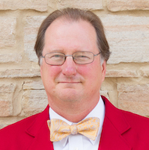
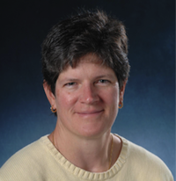
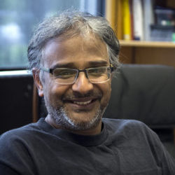
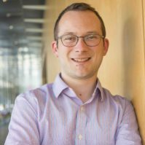
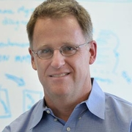
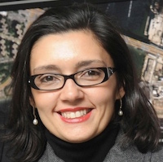
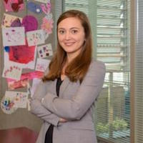
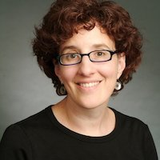
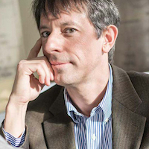
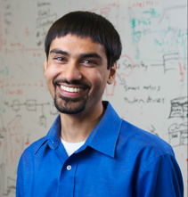

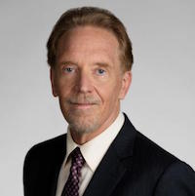
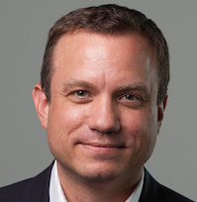

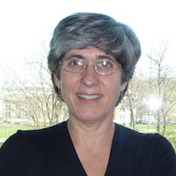
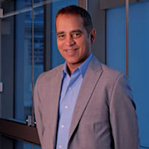
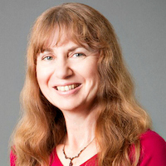
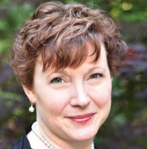
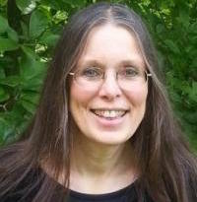
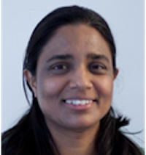
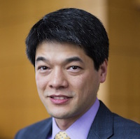
The CCC Council
Chair: Mark Hill
Vice Chair: Liz Bradley
Terms ending June 2021
  Ian Foster, University of Chicago
  Ronitt Rubinfeld, MIT
  Suresh Venkatasubramanian, Utah
  Daniel P. Lopresti, Lehigh University
  David C. Parkes, Harvard
  Shwetak Patel, Univ. Washington
Terms ending June 2020
  Nadya Bliss, Arizona State
  Juliana Freire, NYU
  Keith Marzullo, Maryland
  Greg Morrisett, Cornell
  Jennifer Rexford, Princeton
  Manuela Veloso, Carnegie Mellon
  Ben Zorn, Microsoft Research
Terms ending June 2019
  Sampath Kannan, UPenn
  Maja Mataric, USC
  Elizabeth Mynatt, Georgia Tech
  Nina Mishra, Amazon
  Holly Rushmeier, Yale
  Kevin Fu, Univ. Michigan

