Slide 1
The Computing Community Consortium (CCC)
NSF Presentation
November 15th, 2018

Slide 2
Talk Outline
Big Picture
Context, Members, Goals
Longitudinal Activities
Ongoing Work
Discussion

Slide 3
Computing Community Consortium
The mission of Computing Research Association's Computing Community Consortium (CCC) is to catalyze the computing research community and enable the pursuit of innovative, high-impact research.
Who
Council – 20 members
CCC/CRA Staff
Chair, VC, & Director
Inputs: Bottom-up, Internal, & Top-Down
What:
Workshops & Conf. Blue Sky Tracks
Whitepapers & Social Media
Reports Out (esp. to government)
Biannual Symposium
Professional Development
Early Career Workshops & Participation
Council Membership
Leadership w/ Gov’t (LISPI)
Notes:
Established in 2006 as a standing committee of the Computing Research Association
Funded by NSF under a Cooperative Agreement
Facilitates the development of a bold, multi-themed vision for computing research – and communicates this vision to stakeholders
Led by a broad-based Council
Staffed by CRA
cat·a·lyst
a substance that increases the rate of a chemical reaction without itself undergoing any permanent chemical change.
a person or thing that precipitates an event.

Slide 4





CCC: Catalyzing I.T.’s Virtuous Cycle
Citizens
Industry
Government
Academia
Icons modified from Zlatko Najdenovski, Flaticon
Notes:
Established in 2006 as a standing committee of the Computing Research Association
Funded by NSF under a Cooperative Agreement
Facilitates the development of a bold, multi-themed vision for computing research – and communicates this vision to stakeholders
Led by a broad-based Council
Staffed by CRA

Slide 5
Talk Outline
Big Picture
Context, Members, Goals
Longitudinal Activities
Ongoing Work
Discussion

Slide 6
An Overview of the
Computing Community Consortium
Established in 2006 as a standing committee of the Computing Research Association (CRA)
Funded by NSF under a Cooperative Agreement
  Third award began in April 2018
Facilitates the development of a bold, multi-themed vision for computing research – and communicates this vision to stakeholders
Led by a broad-based Council
Staffed by CRA
Notes:
Mark

Slide 7
Major Stakeholders
Computing Research Community
  CRA members
  CSTB (Computer Science and Telecommunications Board, part of National Research Council)
  Professional societies
  Academic units
  Research labs
Industry
  Computing industry, Major users of IT
Public
Government
Notes:
Mark

Slide 8
Government Stakeholders
Agencies that are particularly important to us
NSF – strong ties with CISE
NIH – growing ties with folks interested in Health IT
DARPA – ties come and go
DoE – ties with ASCR; interest in ARPA-E
NITRD – entre to interagency working groups
Others that are relevant
NIST
HHS/ONC
IARPA
DoT
DHS
OSTP
Notes:
Mark
Mark’s Fall 2017 Visits:
"Whitman, Lloyd J. EOP/OSTP" & Jack Wilmer OSTP
Lyn Millet & Jon Eisenberg CSTB
Patty Brennan NLM
Bryan Biegel NITRD
Brian Pierce DARPA
Hava Seigelmann DARPA
Bill Chappell MTO
Chris Greer NIST
Edward (Ed) Griffor NIST
Erwin, Nina, Ken, Jim Kurose, "Qualters, Irene M.“, "Kosaraju, Rao“ NSF

Slide 9
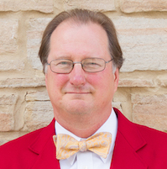
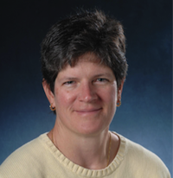
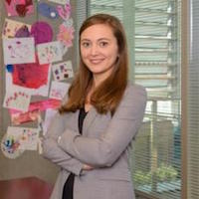
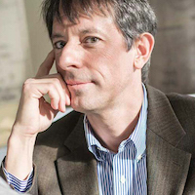
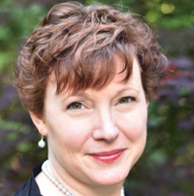
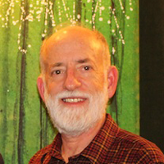
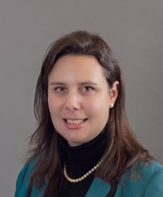

The CCC Council – executive committee
Members:
  Mark Hill, University of Wisconsin, Madison
  (Chair)
  Liz Bradley, University of Colorado Boulder (Vice Chair)
  Nadya Bliss, Arizona State University
  Dan Lopresti, University of Lehigh
  Beth Mynatt, Georgia Tech (Past Chair)
  Ben Zorn, Microsoft Research
  Ann Drobnis, Director
  Andy Bernat, CRA Executive Director

Slide 10
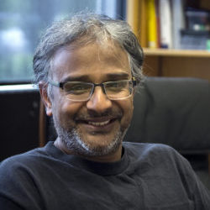
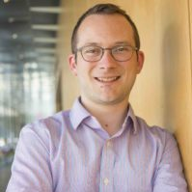
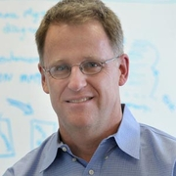
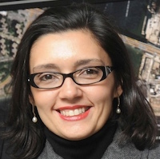
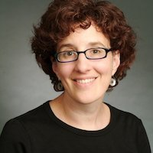
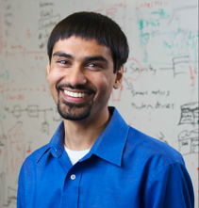

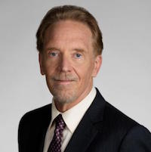
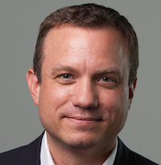

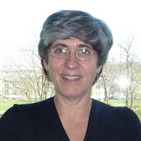
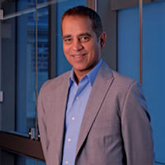
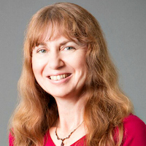
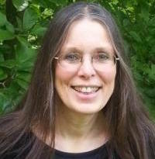
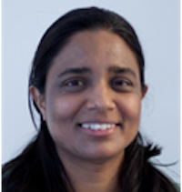
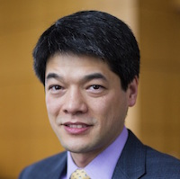
The CCC Council
Chair: Mark Hill
Vice Chair: Liz Bradley
Terms ending June 2021
  Ian Foster, University of Chicago
  Ronitt Rubinfeld, MIT
  Suresh Venkatasubramanian, Utah
  Daniel P. Lopresti, Lehigh University
  David C. Parkes, Harvard
  Shwetak Patel, Univ. Washington
Terms ending June 2020
  Nadya Bliss, Arizona State
  Juliana Freire, NYU
  Keith Marzullo, Maryland
  Greg Morrisett, Cornell
  Jennifer Rexford, Princeton
  Manuela Veloso, Carnegie Mellon
  Ben Zorn, Microsoft Research
Terms ending June 2019
  Sampath Kannan, UPenn
  Maja Mataric, USC
  Elizabeth Mynatt, Georgia Tech
  Nina Mishra, Amazon
  Holly Rushmeier, Yale
  Kevin Fu, Univ. Michigan

Slide 11
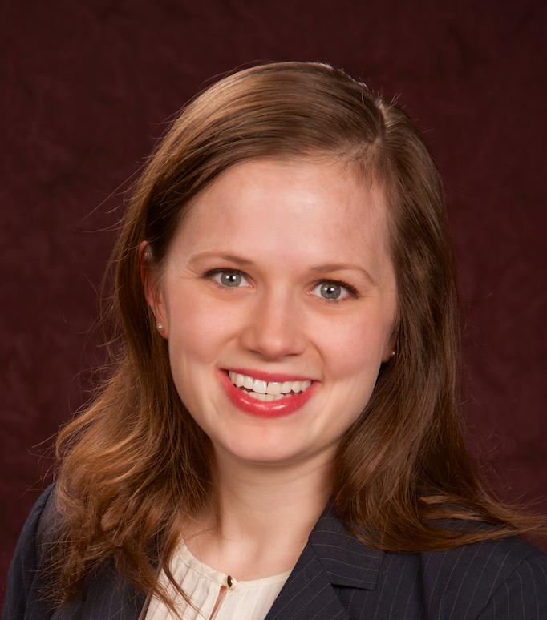
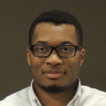
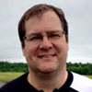


CRA Staff with CCC responsibilities
CCC Director: Ann Drobnis
CCC Deputy Director: TBD
Senior Program Associate: Helen Wright
Program Associate: Khari Douglas
CRA Executive Director: Andy Bernat
Additional CRA Staff:
  Peter Harsha, Director of Government Affairs
  Sandra Corbett
  Sabrina Jacob

Slide 12
Goals For CCC
Bring the computing research community together to envision audacious research challenges, and to articulate concrete pathways to enable pursuit of these challenges.
Communicate these challenges and opportunities to the broader national community.
Facilitate investment in these research challenges by key stakeholders.
Inculcate values of leadership and service by the computing research community.
Inform and influence early career researchers to
engage in these community-led research challenges.

Slide 13
Desired Outcomes
Create broad awareness of the role computing research will play in future science and technology advances within federal agencies, philanthropic organizations, and industry through concrete examples and products.
Facilitate broad engagement of the computing research community in identifying and articulating new directions for computing research, in shaping priorities for those new directions, and in responding to existing opportunities in the computing research ecosystem.
Create high-impact tangible resources that inform stakeholders as to the current and potential impact of computing research.
Sustain the CCC as a widely accepted catalyst and voice for the computing research community.
Grow leadership and community capacity to engage in and respond to national science policy needs.

Slide 14
Talk Outline
Big Picture
Context, Members, Goals
Longitudinal Activities
Ongoing Work
Discussion

Slide 15
Activities
Events for the Community
  Visioning Workshops
  Blue Sky Ideas Conference Tracks
Aligning with National Priorities
  Short Reports / White Papers
  Task Forces
Website Features
  CCC Blog (http://cccblog.org)
  Great Innovative Ideas
Leadership Opportunities
  Industry – Academic Collaborations
  Leadership in Science Policy Institute (LiSPI)

Slide 16




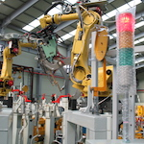
Visioning: Processes
Periodic RFP for community-initiated activities
Top-down (agency initiated)
Bottom-up (open call)
Sideways (council initiated, joint with other agencies,….)
Average of seven workshops/year over the last three years
Robotic Materials
Digital Computing Beyond Moore’s Law
Sociotechnical Interventions for Health Disparity Reduction
Sociotechnical Cybersecurity
Cybersecurity for Manufacturers
Notes:
Point out that we reach out widely to all directorates within NSF and other agencies.
Robotics, Automation, and Computer Science
Sponsored by Robotics-VO, NSF, OSTP, and CCC
Goal: frame concrete problems used to guide basic and applied research through the National Robotics Initiative

Slide 17
VISIONING Activities
Workshop | Date
Cyber-Social Learning Systems Workshop 3 | January 24-25, 2017
Cyber Security for Manufacturers Workshop | March 14-15, 2017
Sociotechnical Cybersecurity Workshop 2 | August 8-9, 2017
Fair Representations and Fair Interactive Learning | March 18-19, 2018
Sociotechnical Interventions for Health Disparity Reduction | April 9-10, 2018
Robotic Materials | April 23-24, 2018
Digital Computing Beyond Moore’s Law | May 3-4, 2018
Next Steps in Quantum Computing: Computer Science’s Role | May 22-23, 2018
Leadership in Embedded Security | August 13, 2018
Over 45 visioning activities in 11-year history
Nine since 1 January 2017 ==>
Research areas include:
  Smart and Pervasive Health
  Beyond Moore’s Law
  Robotic Materials
  Privacy by Design
  BRAIN Initiative
  Fairness
  Personalized Education
13 workshop reports and 20 additional white papers released in past four years
Over 300 community members annually participate in visioning workshops
Notes:
Some examples…

Slide 18


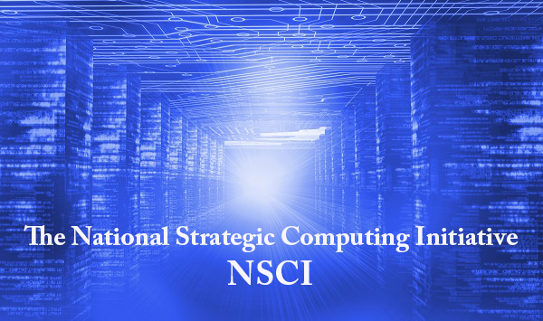
Amplification
BRAIN Initiative launched in 2013.
CCC co-hosted the Brain Workshop with NSF in 2014.
CCC co-hosted the SA+TS workshop with SRC and NSF in 2013.
Produced Research Needs for Trustworthy, and Reliable Semiconductors
Report in 2015.
NSCI announced in July 2015.
CCC produced a series of blog posts on the topic, featuring one from Doug Burger, and the Convergence of Data and Computing task force frequently overlaps with this topic.
Smart and Connected Health Program in NSF and NIH.
CCC has hosted several workshops on related topics, including: Aging in Place (2014), Inclusive Access (2015), and Smart and Pervasive Health (2016).
Notes:
2004 – Ed was on PITAC under President Bush – Computational Science was one of the three sections of the report and Big Data was mentioned
2008 – CCC White Paper for the transition team
2008 – CCC Workshops
2010 – Series of White Papers, first PCAST Report
2012 – Presidential Initiative
2014 - Ubiquitous

Slide 19
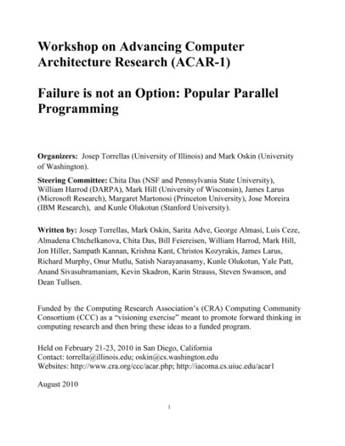
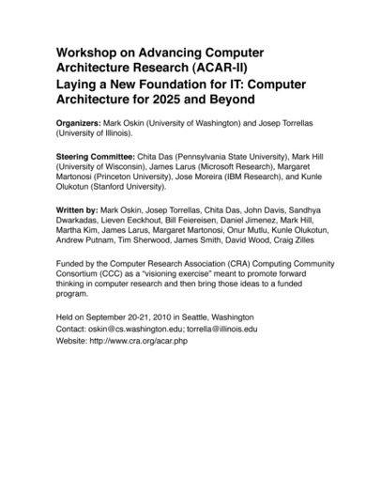
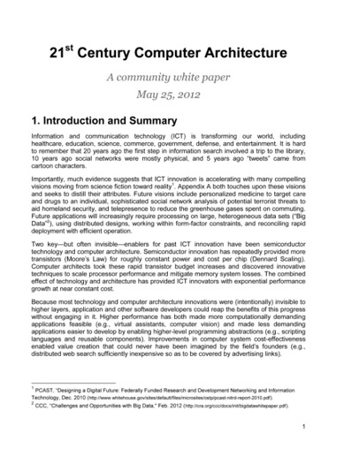
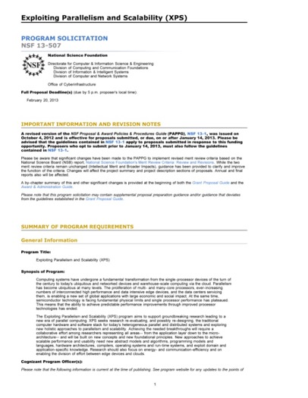
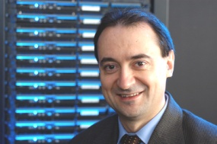
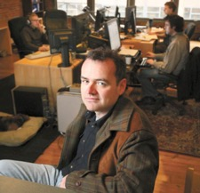
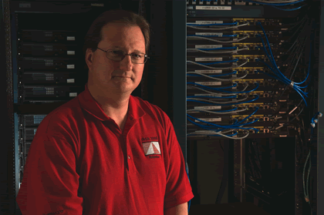
Impact: architecture
2010
2010
2012
2013
Josep Torrellas
UIUC
Mark Oskin
Washington
Mark Hill
Wisconsin
Notes:
2012 White Paper:
March – group forms(launched by CCC)
April – brainstorming, read related documents, outline
May – solicit feedback on drafts
May 25 – release report
February, 2013 – XPS solicitation quoting report

Slide 20
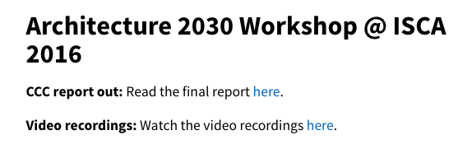

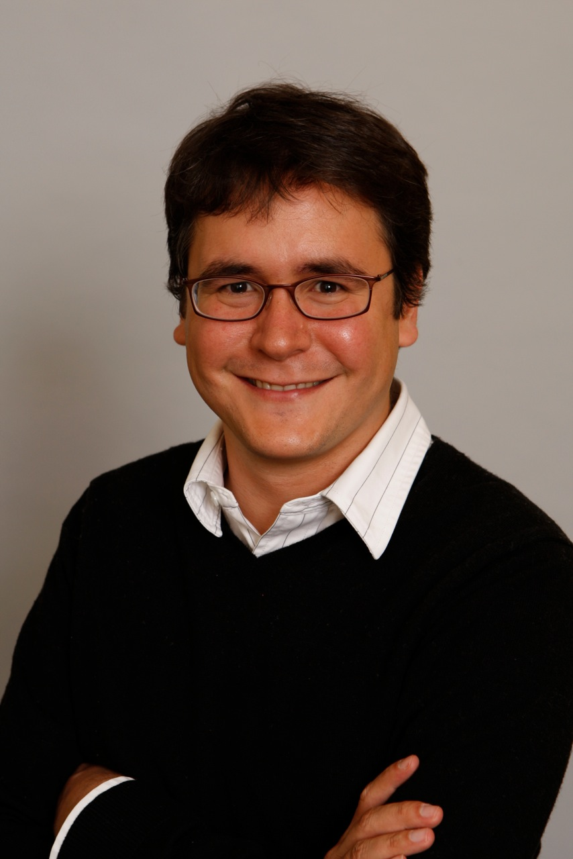
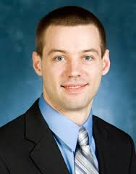
Impact: architecture
2013
2016
2016
Luis Ceze
Washington
Tom Wenisch
Michigan
Mark Hill
Wisconsin
Notes:
2012 White Paper:
March – group forms(launched by CCC)
April – brainstorming, read related documents, outline
May – solicit feedback on drafts
May 25 – release report
February, 2013 – XPS solicitation quoting report

Slide 21
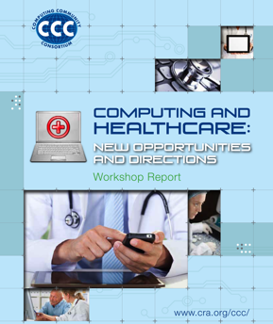
impact: Health IT
October 2012 Workshop
Notes:
SHW first in 2010, updated in 2013 as a joint initiative with NIH

Slide 22
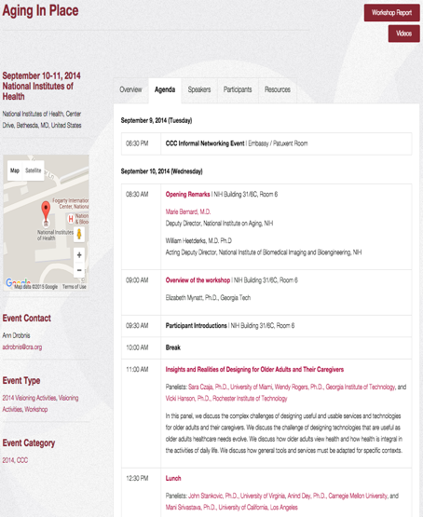
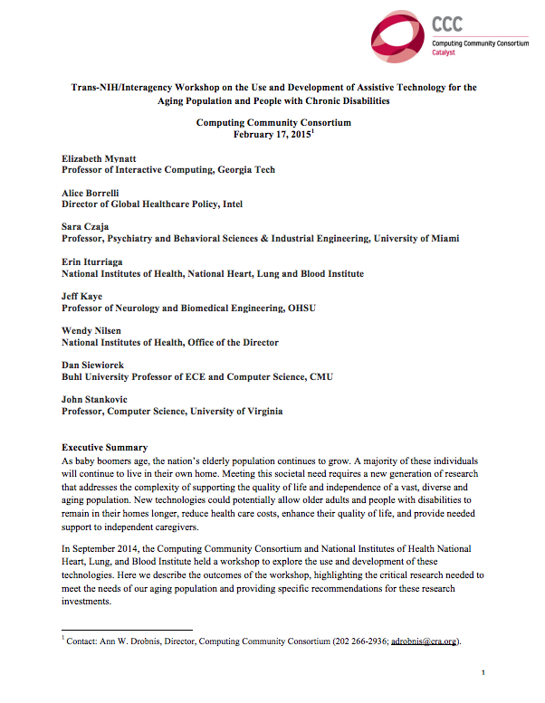
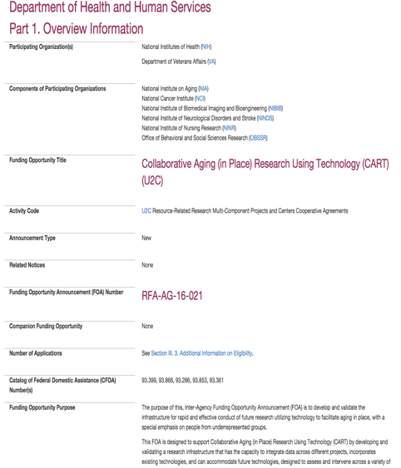
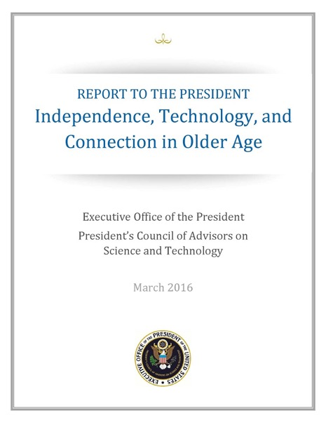
Impact: Aging in Place
Joint NIH/CCC Meeting
September 2014
Produced Workshop Report
February 2015
NIH released new RFP informed by AIP Workshop
October 2015
PCAST Report
March 2016
Notes:
2004 – Ed was on PITAC under President Bush – Computational Science was one of the three sections of the report and Big Data was mentioned
2008 – CCC White Paper for the transition team
2008 – CCC Workshops
2010 – Series of White Papers, first PCAST Report
2012 – Presidential Initiative
2014 - Ubiquitous

Slide 23
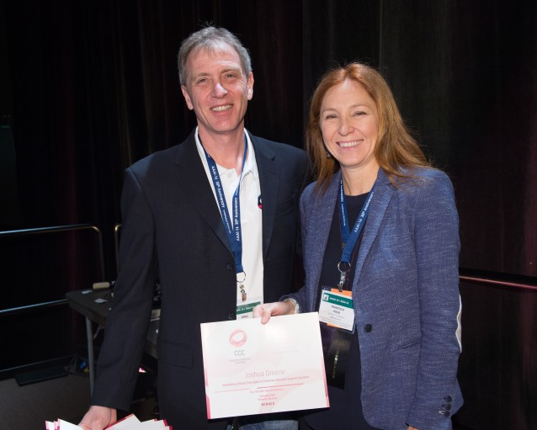
Blue Sky
Goal - Help conferences reach out beyond the usual research papers. Papers are opened ended and possibly “outrageous” or “wacky.”
  17 different tracks at ten different conferences in the last four years
  On average, 13 papers submitted per track at a conference
  Winners are asked to submit Great Innovative Ideas
Past CCC Chair Gregory Hager with AAAI-16 Blue Sky award winner Francesca Rossi

Slide 24


Methods of COMMUNICATING: current
Workshop Reports
White Papers
  CCC works with the community to produce timely white papers that inform policymakers about pressing issues and national priorities
CCC Blog
  Provides a continuous stream of information about advances in computing research
  Opportunities for community to get involved
Great Innovative Ideas
  A way to showcase the exciting new research and ideas generated by the computing community
Special Events
  CCC Symposium
  CRA Snowbird
Computing Research
2017
AI for Social Good
2016

Slide 25
Nurturing next generation of leaders
Grow leadership and community capacity to engage in and respond to national science policy needs and identify new directions for computing research.
Leadership in Science Policy Institute
  Educates and trains computing researchers on how science policy in the U.S. is formulated and how to advocate for computing research
  Co-sponsored by CRA’s Government Affairs Committee
Industry – Academic Collaborations
  CCC collaborated with Big Data Regional Hubs
  Activities to enhance the research of early career faculty
Postdoc Best Practices
  Program to study institutional support structures for postdocs
  3 programs: University of Washington, NY ASCENT, Arizona
Computing Innovation Fellows (CIFellows) Project
  Rapidly created the CI Fellows program to preserve human capital when faculty positions became scarce with the financial crisis

Slide 26
Industry – academic collaborations
With NSF Big Data Regional Innovation Hubs
Northeast: Young Innovator Internships, Knowledge Exchange Lecture Series, Data Science Best Practices Workshop
South: Data Start Internships, PEPI Early Career Exchange Visits
Midwest: Early Career Big Data Summit, Data Quality and Informal Data- An Oxymoron Workshop, Travel Grants
West: Collaboratory Faire, Workshop on Data Hackathon Best Practices, Tools of the Data Journalism Trade Workshop

Slide 27
Talk Outline
Big Picture
Context, Members, Goals
Longitudinal Activities
Ongoing Work
Discussion

Slide 28
CCC working groups & Task Forces
Goal is for CCC to be engaged in ongoing activities around these topics, to identify needs and opportunities in each topic area, and to take actions (generating white papers, convening a workshop, publicizing information, etc.) that have the possibility of “moving the needle” for these topics.
Task forces, which include Council members and others from the community, meet on a regular basis and report at every Council meeting.
These provide a key mechanism to enable parallelism and expand CCC’s reach
Pioneered a few years ago
Includes some non-CCC members
Five task forces in 2017-18 ➔ six task forces + two working groups in 2018-19
Expect smaller task forces to increase participant engagement
Notes:
Mark
We have outside members on our task force.
We have continue to experiment with the task forces (smaller, more agile, more parallel work) as well as the task forces are partnering more with external organizations to increase the scale and impact of our reach.
Number of Task Forces this year (2018-2019)- 6
Number of Task Forces last year (2017-2018)- 6
Number of Task Forces 2016-2017- 5
Create targeted white papers to help inform agency-initiated investments in computing
Create new visioning activities that bridge the research needs of our computing with the mission needs of agencies
Example: discussions of needed research infrastructure for smart cities with NIST or briefings regarding IoT safety and security concerns with the FDA and FCC

Slide 29
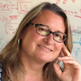

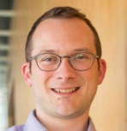
Artificial intelligence roadmap working group
Chairs: Yolanda Gil and Bart Selman
Context:
NSF & others encouraged
on tight timetable
Like Robotics Roadmap,
but industry all over ML
Yolanda Gil
University of Southern California
Bart Selman
Cornell University
Current Members:
Recent Activities:
WS #1-Integrated Intelligence
Marie desJardins (Simmons) & Ken Forbus (Northwestern University)
Liz Bradley
University of Colorado, Boulder
Maja Matarić
University of Southern California
Upcoming Activities:
WS #2- Interaction
Kathy McKeown (Columbia University) & Dan Weld (University of Washington)
WS #3- Learning and Robotics
Fei Fei Li (Stanford) & Tom Dietterich (Oregon State)
Nina Mishra
Amazon
David Parkes
Harvard
University
Notes:
Mark

Slide 30
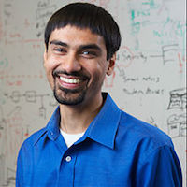
Industry working group: Transportation / Autonomous Vehicles
Chair: Ben Zorn
Context:
University/industry interaction is crucial, CCC round-table in 2015
Questions: Is this interaction changing? If so, how?
Approach: Consider one vertical closely this year –
Autonomous Vehicles / Transportation
Learn & move forward next year
Ben Zorn
Microsoft Research
Current Members:
Shwetak Patel
University of Washington
Jennifer Rexford
Princeton University
Recent Activities:
Ongoing discussions with academics, industry (nuTonomy), DoT FHWA
Greg Morrisett
Cornell University
Upcoming Activities:
Preparing preliminary white paper
Possible workshop in Spring
Notes:
Mark
In the segue to this slide, should hark back to our mission of responding quickly to pressing needs. One way we do that is to spin up working groups. Not the same as our task forces; those are ongoing and these are stood up for specific period to carry out a specific task.
Talk to dual focus: transportation and institutional

Slide 31
Cybersecurity and cybercrime
Task Force
Chairs: Kevin Fu and Keith Marzullo
Recent Activities:
Sociotechnical Cybersecurity workshop series (2016-2017)
Leadership in Embedded Security Workshop (2018)
Kevin Fu
University of Michigan
Keith Marzullo
University of Maryland
Current Members:
Nadya Bliss
Arizona State University
Daniel Lopresti
Lehigh University
Upcoming Activities:
Developing partnerships for UN workshops and followup on application of AI to fight against human trafficking (CCC, UNU Delta 8.7, Alan Turning Institute, Tech Against Trafficking)
White Papers:
Safety, Security, and Privacy Threats Posed by Accelerating Trends in IoT
System Computing Challenges in the IoT
Notes:
dan

Slide 32
Health and human computer interaction task force
Chair: Maja Matarić and Shwetak Patel
Recent Activities:
Response to NITRD draft Federal Health Information Technology Research and Development Strategic Framework
Maja Matarić
University of Southern California
Shwetak Patel
University of Washington
Current Members:
Keith Marzullo
University of Maryland
Beth Mynatt
Georgia Tech
Upcoming Activities:
Working on content creation for training (future of work)
Developing potential workshops such as opioid abuse and eldercare
Holly Rushmeier
Yale
Nina Mishra
Amazon
White Papers:
Information Technology Research Challenges for Healthcare: From Discovery to Delivery
Trans-NIH/Interagency Workshop on the Use and Development of Assistive Technology for the Aging Population and People with Chronic Disabilities

Slide 33
Information Integrity and provenance task force
Chairs: Nadya Bliss and Juliana Freire
Recent Activities:
New Task Force!
Nadya Bliss
Arizona State University
Juliana Freire
New York University
Upcoming Activities:
Charting the research agenda for this area
Current Members:
Beth Mynatt
Georgia Institute of Technology
Greg Morrisett
Cornell University
Keith Marzullo
University of Maryland
Notes:
Mark : Response to community interest in Kate Starbird

Slide 34
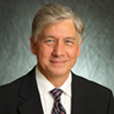
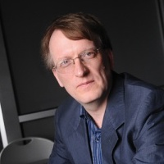
Intelligent infrastructure
Task Force
Chair: Dan Lopresti and Beth Mynatt
Recent Activities:
Intelligent Infrastructure white paper series (2017)
Dan Lopresti
Lehigh University
Beth Mynatt
Georgia Tech
Upcoming Activities:
Collaboration with the NIST
GCTC Meeting at the end of October, 2018
Likely joint workshop between CCC and NIST GCTC Public Safety SuperCluster in Spring
Companion CCC whitepaper to NIST GCTC Public Safety Blueprint for 2019
Current Members:
Michael Dunaway
University of Louisiana at Lafayette
Henning Schulzrinne
Columbia University
Ben Zorn
Microsoft Research

Slide 35

Fairness and accountability
Task Force
Chairs: Liz Bradley and Sampath Kannan
Recent Activities:
March 2018 workshop on Fairness; draft report in preparation for CACM
Liz Bradley
University of Colorado, Boulder
Sampath Kannan
University of Pennsylvania
Current Members:
Upcoming Activities:
Planning a workshop on Economics and Fairness
Support of and input to the AI Roadmapping working group
Ronitt Rubinfeld
MIT
Suresh Venkatasubramanian
University of Utah
David Parkes
Harvard
University
White Papers:
Big Data, Data Science, and Civil Rights
Privacy-Preserving Data Analysis for the Federal Statistical Agencies
Towards a Privacy Research Roadmap for the Computing Community
Notes:
mark

Slide 36
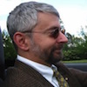

Systems and architecture
Task Force
Chairs: Mark Hill and Jen Rexford
Recent Activities:
Two workshops (Next Steps in Quantum Computing: Computer Science’s Role and Digital Computing Beyond Moore’s Law) completed in Spring 2018
Mark Hill
University of Wisconsin, Madison
Jennifer Rexford
Princeton Unversity
Current Members:
Upcoming Activities:
Thermodynamic Computing Workshop: January, 2019
Deploying Post-Quantum Crypto systems Workshop
Talking about four possible new areas for a workshop (such as self driving systems or distributed databases)
Tom Conte
Georgia Tech
Juliana Freire
New York University
Ian Foster
Argonne National
Lab
White Papers:
The Opportunities and Challenges for Next Generation Computing
Challenges to Keeping the Computing Industry Centered in the US
Notes:
Mark: external (Tom)
Workshop current and upcoming

Slide 37
CCC Visioning Workshop:
Next Steps in Quantum Computing:
Computer Science’s Role
Prof. Margaret Martonosi
Dept. of Computer Science
Princeton University
Dr. Martin Roetteler
Microsoft Research

Slide 38
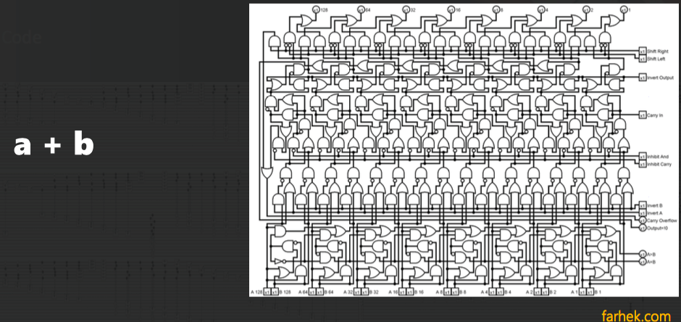
Takeaways
(Efficient) Abstraction: Must mitigate systems complexity while still allowing information flow algorithms <-> devices
  a + b

Slide 39
How can you get involved?
Reach out to the CCC with your ideas!
  Email Ann (adrobnis@cra.org)
  Come to a CCC visioning workshop
  (See upcoming events: https://cra.org/ccc/events/)
  Come to a CCC council meeting
Tell your community about CCC!
  RFP posted at the beginning of each year, please share
  Have a colleague who you would recommend for a visioning workshop? Let Ann know!
  Read and share our blog (http://www.cccblog.org)

Slide 40
Computing Community Consortium
The mission of Computing Research Association's Computing Community Consortium (CCC) is to catalyze the computing research community and enable the pursuit of innovative, high-impact research.
Who
Council – 20 members
Chair, VC, & Director
CCC/CRA Staff
Inputs: Bottom-up, Internal, & Top-Down
What:
Workshops & Conf. Blue Sky Tracks
Whitepapers & Social Media
Reports Out (esp. to government)
Biannual Symposium in DC
Talent Development
Early Career Workshops & Participation
Council Membership
Leadership w/ Gov’t (LISPI)
Notes:
Mark

