Slide 1
Introduction to the CCC and the CCC Council
July 19, 2016

Slide 2
An Overview of the
Computing Community Consortium
Established in 2006 as a standing committee of the Computing Research Association (CRA)
Funded by NSF under a Cooperative Agreement
  Second Award began in 2012,
  completed Reverse Site Visit (2014)
Facilitates the development of a bold, multi-themed vision for computing research – and communicates this vision to stakeholders
Led by a broad-based Council
Staff based at CRA

Slide 3
What We’ll try to cover
Brief history
Role and mission of CCC
Organizational details
CCC Stakeholders

Slide 4
Pre-history
In the mid-2000’s, NSF CISE leaders and computing research community leaders had similar concerns regarding:
  The Federal commitment to research in general,
  and to computing research in particular
  Public and policymaker perception that computer science is “yesterday’s news”
  Failure to articulate and coalesce around exciting research visions in computer science – research visions that would galvanize the public, policymakers, researchers, and students
  Need to groom leadership for the field
  Decrease in student interest
  GENI Project direction

Slide 5
Pre-history (cont’d.)
This led to:
  Increased focus on these issues by NSF CISE and the computing research community
  Computing Community Consortium solicitation by NSF
  Eager response by a group of computing research community leaders under the auspices of the Computing Research Association
    Randy Bryant
    Susan Graham
    Anita Jones
    Dick Karp
    Ken Kennedy
    Ed Lazowska
    Peter Lee
    Jeff Vitter

Slide 6
Informal mission
“A catalyst and enabler for the computing research community”
  Bring the community together to contribute to shaping the future of the field
  Provide leadership for the community, encouraging revolutionary, high-impact research
  Encourage the alignment of computing research with pressing national priorities and national challenges (many of which cross disciplines)
  Work with policymakers to facilitate the translation of these important research directions into funded programs
  Give voice to the community, communicating to a broad audience the many ways in which advances in computing will create a brighter future
  Grow new leaders for the computing
  research community

Slide 7
Major organizational milestones
NSF solicitation: Winter 2006
CRA proposal: Spring 2006
Cooperative Agreement: Fall 2006
Interim Council appointed: Fall 2006
Chair appointed: Winter 2007
Council appointed: Spring 2007

Slide 8
Major organizational milestones (cont’d.)
Vice-Chair position formalized: Fall 2007
Annual Council rotation: Winter 2009 (then Winters of 2010, 2011, 2012, => Summer 2013 and thereafter)
Major self-assessment conducted: Summer 2009
Mid-term NSF review: Winter 2010
Full-time Director (Erwin Gianchandani) joins: Spring 2010
SRI International assessment completed: Fall 2010
Renewal proposal submitted: Spring 2011
Reverse site visit: Winter 2012
Cooperative Agreement: Summer 2012
Erwin Gianchandani departs CCC
to return to NSF: Fall 2012

Slide 9
Major organizational milestones (cont’d.)
Steady-state organizational structure defined: Fall 2012
Executive Committee launched: Winter 2013
Ann Drobnis joins as Director: Spring 2013
Regular Chair / Vice-Chair succession kicks in: Summer 2013
Evaluation: Summer 2016
New Proposal: to be submitted Fall 2016

Slide 10
The Rapidly Expanding world of computing
Medicine and Global Health
Energy and
Sustainability
Education
Mobile
Natural Language Process
Security and
Privacy
Scientific Discovery
HCI
CORE
CSE
Machine Learning
Technology for
Development
Transportation
Sensors
Cloud
Computing
Neural
Engineering
Big Data
Interacting with the Physical World
Elder Care
Graphic: Lazowska
Accessibility
Notes:
I’d just like to take a few minutes to frame the talks this evening and help you understand how they fit into the bigger picture of what the CCC is attempting to accomplish.
Grady Booch
Peter Swire
We live in a world of remarkable innovation and remarkable opportunity.
This is a slide you saw at this morning’s talk due to Lazowska – it demosntrates the opportunites and challenges that today’s comptuing research poses – we’re in a world of enormous opportunity, but one that is constantly changing and evolving.
Perhaps more importnatly, to pick up a theme from peter swire’s talk, where we as computer scientists are playing an ever larger role in addressing key national priorities such as healthcare, transporation, scientific discovery, sustainability and education. Addressing these issues takes new ideas, new constellations of investigators, and new sources of funding.

Slide 11
Why Have a CCC?
Research Beneficiaries
General Public
Computing
Research Community
CCC
Investments in Computing Research
Notes:
Think of CCC is a bridge between the CS research community, the funders of that research, and the beneficiaries of that research. We work to promote the health of that ecosystem.

Slide 12
Computing Community Consortium
The mission of Computing Research Association's Computing Community Consortium (CCC) is to catalyze the computing research community and enable the pursuit of innovative, high-impact research.
Promote Audacious Thinking:
  Community Initiated Visioning Workshops
  Blue Sky Ideas tracks at conferences
Inform Science Policy:
  Outputs of visioning activities
  Task Forces – Health IT, Data Analytics
Communicate to the Community:
  CCC Blog - http://cccblog.org/
  Great Innovative Ideas
  White Papers
Promote Leadership and Service:
  Industry – Academic Collaborations
  Leadership in Science Policy Institute
  Postdoc Best Practices
Notes:
Established in 2006 as a standing committee of the Computing Research Association
Funded by NSF under a Cooperative Agreement
Facilitates the development of a bold, multi-themed vision for computing research – and communicates this vision to stakeholders
Led by a broad-based Council
Staffed by CRA

Slide 13
NSF Interactions
CISE Office of the Assistant Director
AD: James Kurose
DAD: Erwin P. Gianchandani
Advanced Cyberinfrastructure (ACI)
DD: Irene Qualters
DDD: Amy Friedlander
Data
Computing and Communications Foundations (CCF)
DD: Rao Kosajaru
DDD:
High Performance Computing
Networking / Cybersecurity
Software
Communications and Information Foundations
Software and Hardware Foundations
Computer and Network Systems (CNS)
DD: Ken Calvert
DDD:
Computer Systems Research
Networking and Technology Systems
Information Integration and Informatics
Robust Intelligence
Information and Intelligent Systems (IIS)
DD: Lynne E. Parker
Acting DDD: James Donlon
Cyber Human Systems
Algorithmic Foundations
Program Officer: Nina Amla
Notes:
Bi-weekly telecon with Executive committee. We tell them what we’re working on. They tell us what they’d like us to do

Slide 14
Relationship to Computing Research Association (CRA)
NSF cooperative agreement is with CRA
CCC is a standing committee of CRA
  Andy Bernat, CRA Executive Director, is an ex officio member of the CCC Executive Committee
  Beth Mynatt, the CCC Chair is a member of the CRA Board of Directors
  Susan B. Davidson, the CRA chair must consent to CCC Council appointments (and is a former Council member)
  Greg Hager, Past Chair is an elected member of the CRA Board of Directors
CCC staff are based in CRA

Slide 15
CCC Organizational Structure
Chair, Vice-chair
  2 year non-staggered terms
  Vice-chair is presumptive chair
Director, Program Associates (2)
  Full-time paid positions
Executive Committee
  Chair, Vice-chair, Director
  3 at large drawn from Council for 1-year terms
  CRA Executive Director
Council
  20 members
  3 year terms, at most 2 consecutive terms
Support
  As needed, from CRA Staff

Slide 16
What Does Executive Committee Do?
Each member has a major responsibility within the organization
Oversees the work of subcommittees and working groups
Guides the planning of new activities
Oversees the execution of the Strategic Plan and annual Implementation Plan
Meets biweekly by teleconference
Meets biweekly with NSF by teleconference
Notes:
Executive committee provides grooming for future leadership

Slide 17
What Do Council Members Do?
Shepherd visioning activities
Participate in topical subcommittees
  Examples: Health IT, AI, Robotics, Big Data
Develop new activities
  Examples: CIFellows, LISPI, Post-doc Best Practices
Engage with related groups (CISE AC, CSTB, ACM …)
Other requests as needed
  Example: short turnaround white papers
Bi-weekly teleconferences
Three face-to-face meetings each year

Slide 18
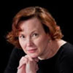
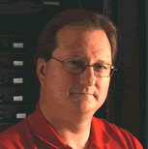


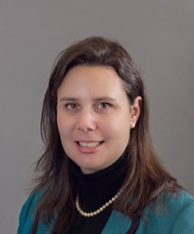
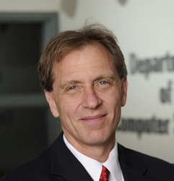

The CCC Council – executive committee
Beth Mynatt, Georgia Tech (Chair)
Mark Hill, University of Wisconsin, Madison
(Vice Chair)
Greg Hager, Johns Hopkins Univ. (Past Chair)
Ben Zorn, Microsoft Research
Jennifer Rexford, Princeton
Ann Drobnis, Director
Andy Bernat, CRA Executive Director

Slide 19
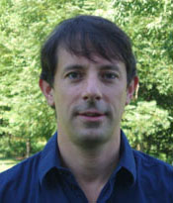
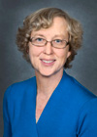
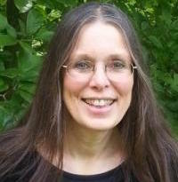
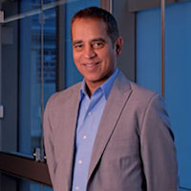
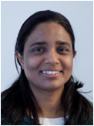
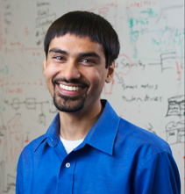
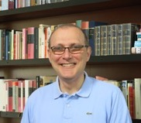
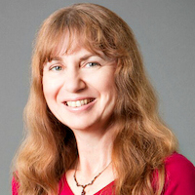

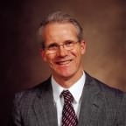
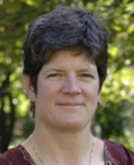
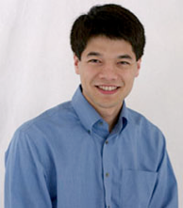


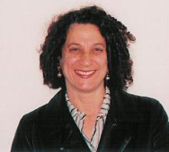
The CCC Council
Terms ending June 2019
  Sampath Kannan, UPenn
  Maja Mataric, USC
  Nina Mishra, Amazon
  Holly Rushmeier, Yale
Terms ending June 2018
  Liz Bradley, (CU Boulder)
  Cynthia Dwork, Microsoft Research
  Kevin Fu, Univ. Michigan (Leave)
  Daniel P. Lopresti, Lehigh University
  Shwetak Patel, Univ. Washington
  Katherine Yelick, UC Berkeley
Terms ending June 2017
  Lorenzo Alvisi, UT Austin
  Randy Bryant, CMU
  Vasant Honavar, Penn State
  Jennifer Rexford, Princeton
  Debra Richardson, UC Irvine
  Klara Nahrstedt, UIUC
  Ben Zorn, Microsoft Research

Slide 20
The CCC Council — Past Members
  Greg Andrews, Univ. Arizona
  Debra Crawford, Drexel
  Susan Davidson, Univ. PA
  Joseph Evans, Univ. KS
  Bill Feiereisen, LANL
  Limor Fix, Intel
  Stephanie Forrest, Univ. New Mexico
  Lance Fortnow, Georgia Tech
  Susan Graham, UC Berkeley
  Eric Horvitz, Microsoft Research
  Chris Johnson, Univ. Utah
  Anita Jones, UVA
  Frans Kaashoek, MIT
  Dave Kaeli, Northeastern
  Dick Karp, UC Berkeley
  John King, Univ. Michigan
  Hank Korth, Lehigh
  Ed Lazowska, Univ. of Washington, CCC Founding Chair
  Peter Lee, Carnegie Mellon
  Ran Libeskind-Hadas, Harvey Mudd
  Andrew McCallum, UMass
  John Mitchell, Stanford
  Robin Murphy, Texas A&M
  Tal Rabin, IBM Research
  Daniela Rus, MIT
  Fred Schneider, Cornell
  Margo Seltzer, Harvard
  Shashi Shekhar, Univ. MN
  Bob Sproull, Formally Oracle
  Karen Sutherland, Augsburg College
  David Tennenhouse, New Venture Partners
  Josep Torrellas, UIUC
  Dave Waltz, Columbia
  Ross Whitaker, Univ. Utah

Slide 21

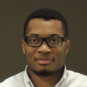



CRA Staff
CCC Director: Ann Drobnis
  100% CCC, responsible for day-to-day management of the Organization
Senior Program Associate: Helen Wright
  100% CCC, responsible for promoting the CCC mission through the website, blog, and social media
Program Associate: Khari Douglas
  100% CCC, responsible for supporting CCC special programs, workshops, and communications
CRA Executive Director: Andy Bernat
  20% CCC, responsible for general oversight
Other CRA Staff:
  Peter Harsha, Director of Government Affairs
  Sandra Corbett
  Sabrina Jacob

Slide 22
CCC and its stakeholders
Notes:
Think of CCC is a bridge between the CS research community, the funders of that research, and the beneficiaries of that research. We work to promote the health of that enterprise.

Slide 23
Major Stakeholders
Computing Research Community
  CRA, CSTB (Computer Science and Telecommunications Board, part of National Research Council), Professional societies,
  Academic units, Research labs
Industry
  Computing industry, Major users of IT
Public
Government
  See summary, next

Slide 24
Government Stakeholders
Office of Science and Technology Policy (OSTP)
  In White House Executive Office of the President
  Our primary contacts are
    Director: John P. Holdren (Harvard)
    U.S. Chief Technology Officer: Megan Smith
    Deputy Director for Technology and Innovation: Tom Kalil
    Deputy Chief Technology Officer: Ed Felten (Princeton)
Notes:
Both funders and beneficiaries. Government employees

Slide 25
Government Stakeholders 2
President's Council of Advisors on Science and Technology (PCAST)
  Co-chaired by John Holdren and Eric Lander
  (MIT and Harvard)
  Members with professional computing-related roles are
    Susan Graham (Berkeley, CCC past chair)
    Eric Schmidt (Google)
    Mark Gorenberg (Zetta Venture Partners)
    Craig Mundie (Microsoft)
    Executive Director: Ashley Predith
Notes:
External advisors on science and engineering

Slide 26
Government Stakeholders 3
Networking and Information Technology R&D (NITRD)
  Legislatively mandated coordination among Federal R&D agencies
  National Coordinating Office (NCO) facilitates
    Interagency working groups
    Coordinating groups
    Senior steering groups
    Community of practice
  Director is Keith Marzullo*

Slide 27
Government Stakeholders 4
Agencies important to us
NSF – strong ties with CISE
NIH – growing ties with folks interested in Health IT
DARPA – ties come and go
DoE – ties with ASCR; interest in ARPA-E
Others that are relevant
NIST
HHS/ONC

Slide 28
Questions?

Slide 29
CCC Activities
July 19, 2016

Slide 30
CCC Activities
CCC GOALS | Visioning | Connecting | Leadership | Communication
Establish the CCC as a widely accepted catalyst and voice for the computing research community. | Workshops and Blue Sky | Workshops | LiSPI, Postdocs, Council Members | CCC Blog, Great Innovative Ideas, Twitter, Facebook
Bring the computing research community together to envision our future research needs and thrusts. | Workshops and Blue Sky | Workshops
Communicate these challenges, needs and thrusts to the broader national community. |  | White Papers and Workshop Reports | Council, Visioning Leadership | CCC Blog, Great Innovative Ideas
Create within the computing research community more audacious thinking. | Workshops and Blue Sky | Workshops
See the ideas developed in the second and fourth points above turned into funded research programs. | Workshops | Agency Engagement
Increase the excitement within computing research and use that excitement to attract students. |  | CI Fellows |  | CCC Blog, Great Innovative Ideas
Inculcate values of leadership and service. |  | Committee Memberships | LiSPI
Beth Mynatt
July 22, 2014

Slide 31
Activities
Visioning
  Workshops
  Blue Sky Ideas Conference Tracks
Outreach
  Outputs of Visioning Activities
  Short Reports / White Papers
  Task Forces
Communicating
  CCC Blog (http://cccblog.org)
  Great Innovative Ideas
  Computing Research: Addressing National Priorities and Societal Needs
Nurturing next generation of leaders
  Postdoc Best Practices
  Industry – Academic Collaborations
  Computing Innovation Fellows (CIFellows) Project
  Leadership in Science Policy Institute

Slide 32
VISIONING
Workshops
Cyber Social Learning Systems August 29-30, November 2-3, January
  Beth Mynatt
Nanotechnology-inspired August 31 – Sept. 1
Information Processing Systems
Workshop
  Randy Bryant, Mark Hill
Sociotechnical Cybersecurity
  Lorenzo Alvisi
Blue Sky
24th ACM SIGSPATIAL- International Conference on Advances in Geographic Information Systems
  October 31st- November 3rd in San Francisco, CA

Slide 33
Outreach
Outputs of Visioning Activities
  CCC held four robotics workshops in 2008, Led to National Robotics Initiative (NRI)
  At recent 5th Anniversary of NRI
    Congressional Briefing with demonstrations
    CCC released follow-up report, Next Generation Robotics
  CCC and NIH held an Aging in Place Workshop in 2014, led to new grant called Collaborative Aging (in Place) Research Using Technology
Short Reports / White Papers
Task Forces
  Computing in the Physical World
  Convergence of Data and Computing
  Healthcare
  Industry
  Privacy
  Education
  Artificial Intelligence

Slide 34
COMMUNICATING
White Papers
  CCC works with community to produce timely white papers that inform policymakers and the broader community on national priorities
CCC Blog
  Provides a continuous stream of information on advances in computing research
  Opportunities for community to get involved
  Forum for community discussion
Great Innovative Ideas
  A way to showcase the exciting new research and ideas generated by the computing community

Slide 35
Nurturing next generation of leaders
Postdoc Best Practices
  To develop, assess, and institutionalize best practice for supporting postdocs
  Shares these ideas widely for adoption at all institutions
Industry – Academic Collaborations
  CCC collaborated with Big Data Regional Hubs
  Activities will enhance the research of early career faculty
Computing Innovation Fellows (CIFellows) Project
  A short-term program that would provide postdoctoral positions
Leadership in Science Policy Institute
  Educates computing researchers on how science policy in the U.S. is formulated
  Co-sponsored by CRA’s Government Affairs Committee
  Trains Computing Researchers on how to advocate for computing research policy

Slide 36
visioning

Slide 37
Creating Visions for Computing Research
“The Computing Community Consortium (CCC) solicits proposals that will galvanize the community to define visions and agendas for exciting frontiers of computing research.”
Create a new community of researchers.
Justify a new funding initiative.
Help an extant community define a new trajectory.

Slide 38





Visioning Processes
Periodic RFP for Community Initiated Activities
Historically 3-7 workshops per year
Top-down (agency initiated)
Bottom-up (open call)
Sideways (council initiated, joint with other agencies,….)
Spatial
Computing
Online
Education
Privacy R&D
Uncertainty in
Computation
Robotics
Notes:
Outline visioning and other activities over course of grant (2012-2014)
Make a point of discussing process a bit
Point out that we reach out widely to all directorates within NSF and other agencies.
Robotics, Automation, and Computer Science
Sponsored by Robotics-VO, NSF, OSTP, and CCC
Goal: frame concrete problems used to guide basic and applied research through the National Robotics Initiative
Point out how the processs works – we work with them

Slide 39
Past Visioning activities
2008
Cyber-Physical Systems Summit
From Internet to Robotics: The Next Transformative Technology
Network Science and Engineering (NetSE)
Theoretical Computer Science
2009
Discovery and Innovation in Health Information Technology
Cross-layer Reliability (RelXLayer)
Global Development
Learning Technologies
Free/Open Source Software (FOSS)
2010
Advancing Computer Architecture Research (ACAR)
2011
Role of Information Sciences and Engineering in Sustainability (RISES)

Slide 40
Past Visioning Activities
2012
Computing for Disaster Management
Next Generational Financial Cyberinfrastructre Workshop
From GPS and Virtual Globes to Spatial Computing – 2020
Computing and Healthcare: New Opportunities and Directions
  2013
Convergence of Software Assurance Methodologies and Trustworthy Semiconductor Design and Manufacture (SA+TS)
Multidisciplinary Research for Online Education
Privacy R&D Workshop (with ITIF)
Extreme Scale Design Automation 2 (with ACM)
Visions of Theory of Computing (with Simons Institute)
Robotics, Automation, and Computer Science (with NSF, OSTP)
  2014
Extreme Scale Design Automation 3 (with ACM)
Computing Visions 2025: Interacting with the Computers All Around Us (with CISE)
Computing Visions 2025: The New Making Renaissance: Programmable Matter and Things (with CISE)
Human Computation Roadmap Summit Workshop
Aging in Place
Uncertainty in Computation
BRAIN
Notes:
Spatial Computing Outcomes: Shashi visited NIH/NCI and made presentations at workshops of NIST as well as USDOE/ANL as detailed at
http://www.cs.umn.edu/~shekhar/ccc/
The report (From GPS and Virtual Globes to Spatial Computing – 2020: The Next Transformative Technology) was also distributed to 300+ attendees of ACM SIG-Spatial annual meeting in Nov. 2013.
Shashi met with Dr. Rao Kosaraju, Dr. Maria Zemankova and Dr. Erwin Gianchandani to get guidance on next steps last week.
We also submitted a paper summarizing the report to Communications of the ACM. It was accepted with revisions and we submitted revised version recently.

Slide 41
Past Visioning activities
2015
Extensible Distributed Systems
Privacy by Design- State of Research and Practice
Privacy by Design- Privacy Enabling Design
Theoretical Foundations for Social Computing
Industry Roundtable
Privacy by Design – Engineering Privacy
Inclusive Access
Computer-Aided Personalized Education
2016
Privacy by Design – Catalyzing Privacy by Design
Robotics

Slide 42
Successful Visioning Activities
Engage the community and relevant stakeholders
Facilitate broad thinking with compelling examples
Create new avenues for (interdisciplinary) collaboration
Prepare and energize the community for future opportunities
Rapidly capture and synthesize ideas from the community.
Present ideas and engage possible funders and stakeholders
Articulate needs and barriers to research impact

Slide 43
Visioning Proposal Pitfalls: Who
PI’s or proposed attendees do not include key members from
  relevant research communities
  public sector
  private sector
  all manner of diversity
PI’s are unlikely to succeed in orchestrating the discussion, delivering outputs, or other follow-thru.
Flawed process for identifying / soliciting community participation in workshops
Insufficient involvement from the “customer”
  possible funding agencies
  other federal agencies that will benefit from the output

Slide 44
Visioning Proposal Pitfalls: What
Ignorance of relevant prior efforts
No discussion of what constitutes success and how to measure it.
Suitable written outputs are not discussed
No plan to evangelize new proposed activity, such as
  Meetings with relevant Federal officials
  Discussions with the broad research community

Slide 45
Details
Project description: at most 6 pages
Budget: $10K - $200K
  Funds expenses in connection with meetings.
    Typically 1 – 3 meetings
    Covers participant support and meeting expenses
    (CRA / CCC) handles all logistic al support
  Funds may not by used to support salary for PI’s or participants

Slide 46
Proposal Review Process
Visioning Chair (VC) or delegate iterates with PI’s to produce a plausible proposal.
Proposal sent to entire CCC.
  All return short-fuse (ie 2 weeks) comments.
VC synthesizes feedback and creates the case: yes/no/revise:
  Includes all reviews, but with identifying information deleted plus a short summary
VC sends the case to CCC.
VC leads a discussion by CCC of the case.
VC sends response to PI’s, including
  anonymized reviews
  discussion of required changes
  name of CCC liaison for the case

Slide 47
CCC Liaison for a Visioning activity
Available to PI’s when planning workshops
  Tracks the logistics
  Provides “adult supervision”
Attends workshops (as an observer)
Provides feedback on outputs as they are being produced
Exerts pressure when outputs are not being produced.

Slide 48
Deliverables
[funding + 1 week]: 1 page vision statement / text for website
[end of workshop + 2 weeks]: 1 page summary of key findings for cccblog
[end of workshop + …]: Workshop report that will be posted on CCC web site and used in dissemination efforts.

Slide 49
Visioning Activities: Upcoming
Cyber Social Learning Systems
(from Open Solicitation)
Nanotechnology-inspired Information Processing Systems Workshop
(from Open Solicitation)
Sociotechnical Cybersecurity
(from Open Solicitation)
Notes:
Focus on aging in place …

Slide 50
Blue sky ideas Conference Tracks
Special “Blue Sky Ideas” tracks at leading conferences
  Reach beyond usual papers
CCC provides prize money for top 3 papers
  Papers should be:
    open-ended
    “outrageous” or “wacky”
    Present new problems, new application domains or new methodologies
    Relatively short (4 pages)
    Published after the conference

Slide 51
Details
Conference Organizers write a proposal, indicating how papers will be solicited and reviewed
Blue Sky Chair and Director read proposals and determine viability
Once Track is approved, a CCC liaison is assigned
VC Chair or liaison may attend the Conference to present information about the CCC and the awards

Slide 52
Blue Sky Ideas
Conference Tracks
^{BuildSys 2012}
Computational Sustainability Track @ AAAI 2013
Computational Sustainability Award @ CHI 2013
Robotics: Science and Systems 2013
Conference on Innovation Data Systems Research (CIDR-2013)
Autonomous Agents and MultiAgent Systems (AAMAS-2014)
Foundations of Software Engineering (ACM SIGSOFT 2014)
Advancement of Artificial Intelligence (AAAI-15 and AAAI-16)
Advances in GIS (ACM SIGSPATIAL 2015)
Robotics: Science and Systems (RSS) 2015
Advancement of Artificial Intelligence (AAAI-15 and AAAI-16)
International Conference on Software Engineering (ICSE 2016)
^{Upcoming:}
  Advances in GIS (ACM SIGSPATIAL 2016)

Slide 53
outreach

Slide 54
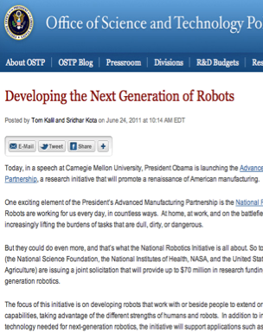
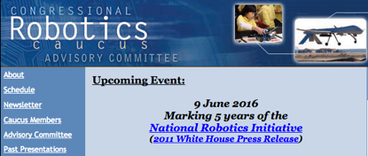
outreach: Robotics
2 meetings in Spring, 2016
Report and
Congressional Briefing in June, 2016
4 meetings during
summer 2008
Roadmap published
May 2009
Extensive discussions
between visioning
leaders & agencies
OSTP issues directive to all
agencies in summer 2010
to include robotics in
FY 12 budgets
National Robotics
Initiative announced
in summer 2011
Henrik Chistensen
Georgia Tech
Notes:
CCC had been working on a robotics White Paper (2007-2009) – Rodney Brooks
Henrik Christiansen, Sebastien Thrun and Robotics people came to CCC wanting help to get the robotics community on track (2008)
Tom Kalil was looking for a focus area
Henrik and CMU President (Jared Cohon) were instrumental in setting up the Robotics Caucus, using the Roadmap

Slide 55
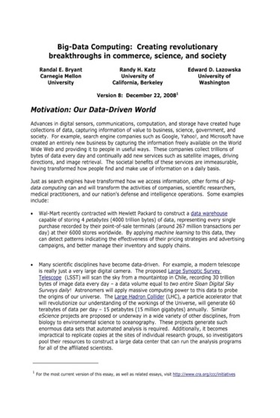
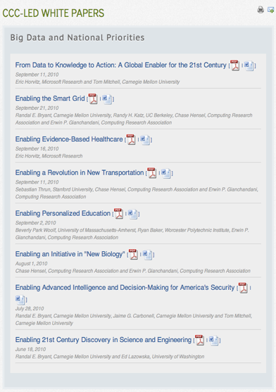
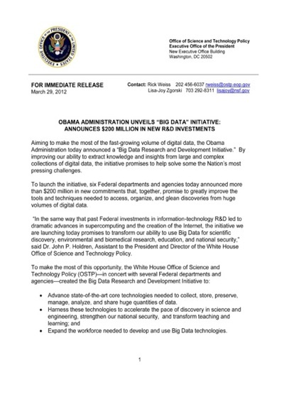

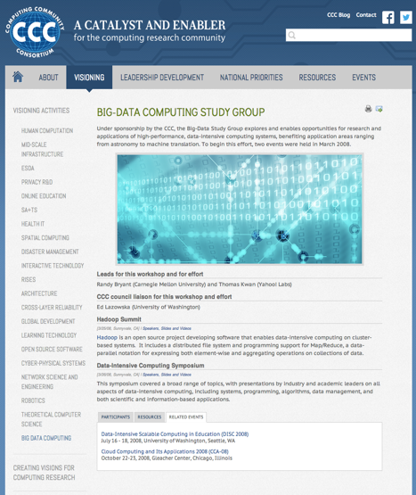
outreach: Big Data
2008
2008
2010
2012
2016
Notes:
2004 – Ed was on PITAC under President Bush – Computational Science was one of the three sections of the report and Big Data was mentioned
2008 – CCC White Paper for the transition team
2008 – CCC Workshops
2010 – Series of White Papers, first PCAST Report
2012 – Presidential Initiative
2014 - Ubiquitous

Slide 56
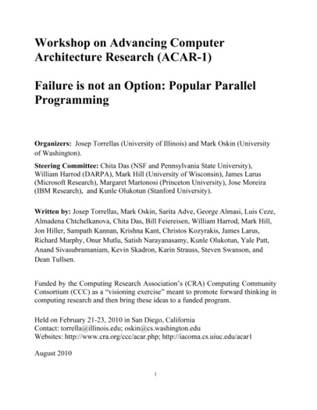
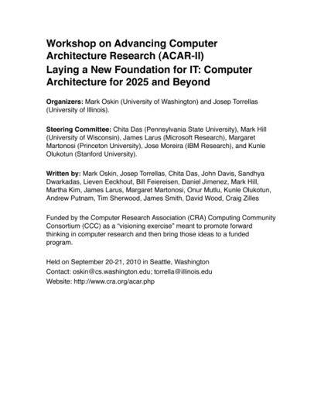
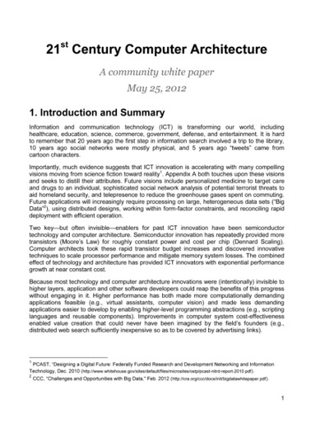
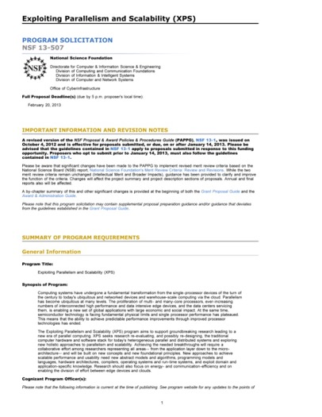
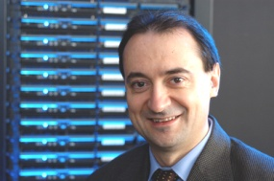
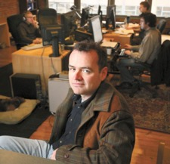
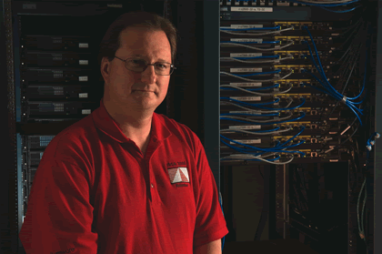
Outreach: architecture
2010
2010
2012
2013
Josep Torrellas
UIUC
Mark Oskin
Washington
Mark Hill
Wisconsin
Notes:
2012 White Paper:
March – group forms(launched by CCC)
April – brainstorming, read related documents, outline
May – solicit feedback on drafts
May 25 – release report
February, 2013 – XPS solicitation quoting report

Slide 57
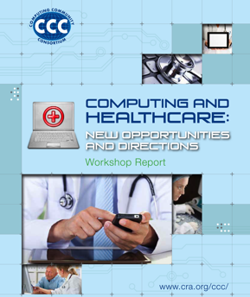
outreach: Health IT
October 2012 Workshop
Notes:
SHW first in 2010, updated in 2013 as a joint initiative with NIH

Slide 58
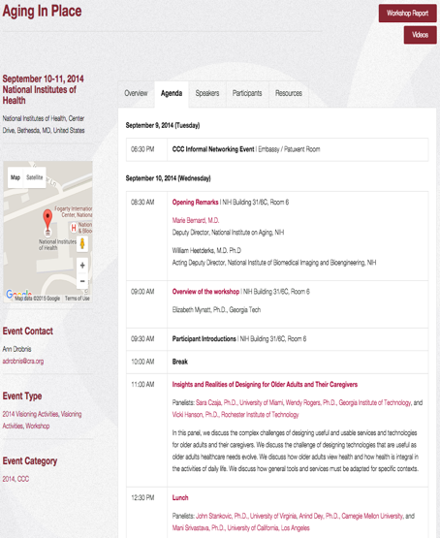
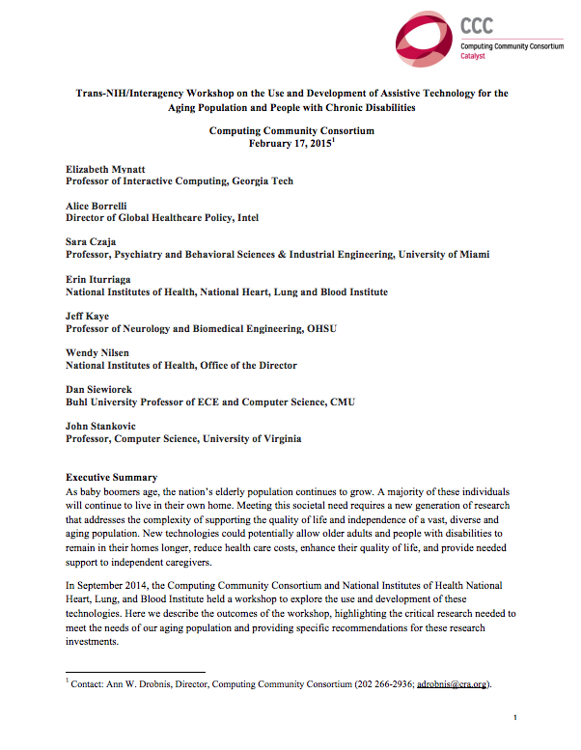
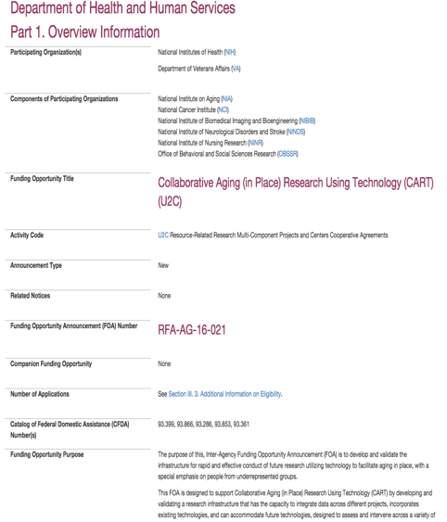
Catalyzing and Enabling: Aging in Place
Joint NIH/CCC Meeting
September 2014
Produced Workshop Report
February 2015
NIH released new RFP informed by AIP Workshop
October 2015

Slide 59
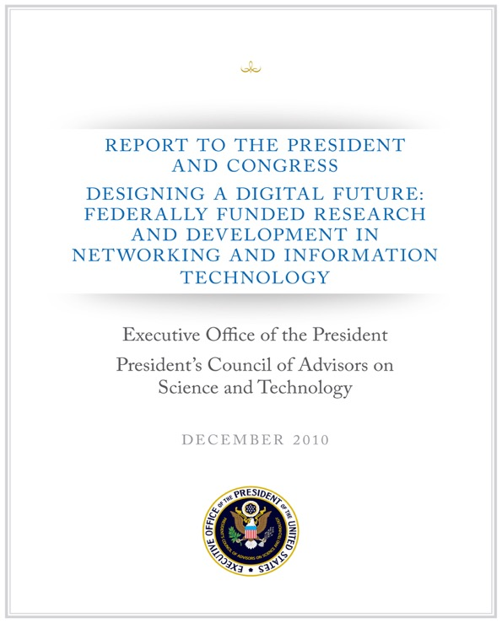
outreach: 2010 PCAST NITRD Report
1/3 of the PCAST NITRD Working Group members were CCC Council Members
The report drew extensively on CCC White Papers
An excellent roadmap for the field

Slide 60
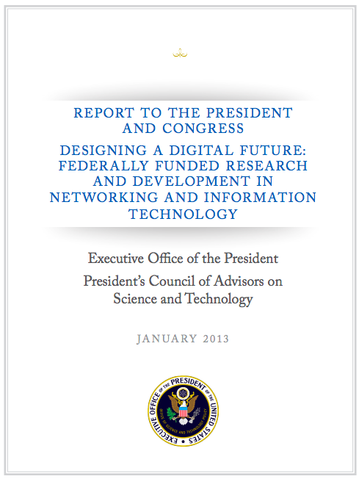
outreach: 2013 PCAST NITRD Report
¼ Contributing Members were CCC Council Members
An excellent review of progress from 2010 report
The challenge now: Continuing to translate it into action

Slide 61
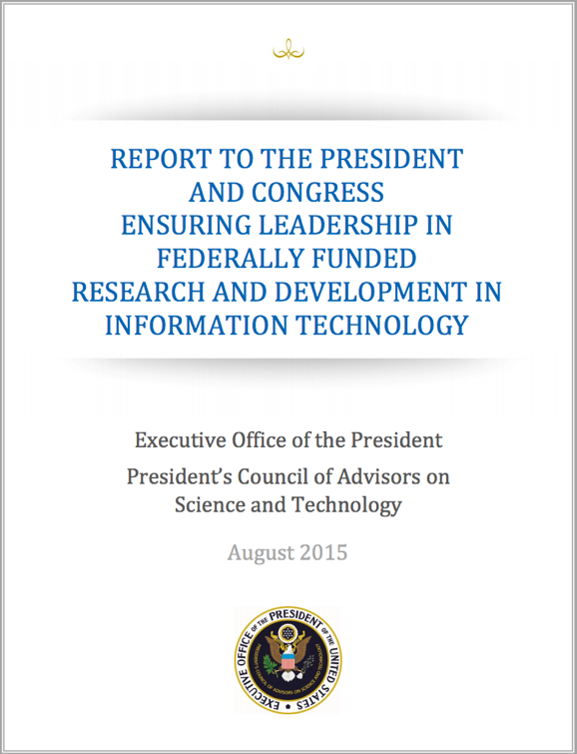
outreach: 2015 PCAST NITRD Report
1/3 Contributing Members were CCC Council Members
An update to the 2013 report, including recommendations for Federal Agencies
The challenge now: restructuring NITRD

Slide 62
communicating

Slide 63
CCC Blog
Top 10 Posts in the Past Year
Where the Jobs Are- 2016 Edition
What Computer Science Can Teach Us About Robotics
Another Perspective on the White House NSCI Workshop
National Academy of Sciences Elects New Members
White House National Strategic Computing Initiative Workshop
Great Innovative Idea- Python Tutor
Check out our new website!
CCC White Paper- Systems Computing Challenges in the Internet of Things
Understanding the Google computer, and making it better
First Person: “Life as a NSF Program Director”
Notes:
On average, 300 hits/day
Big Data is constant
Increase in interest for posts on other agencies (NIH, DARPA)
We track hits, reposts, etc.

Slide 64

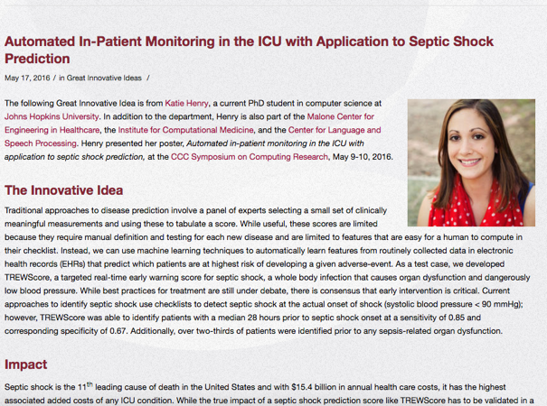
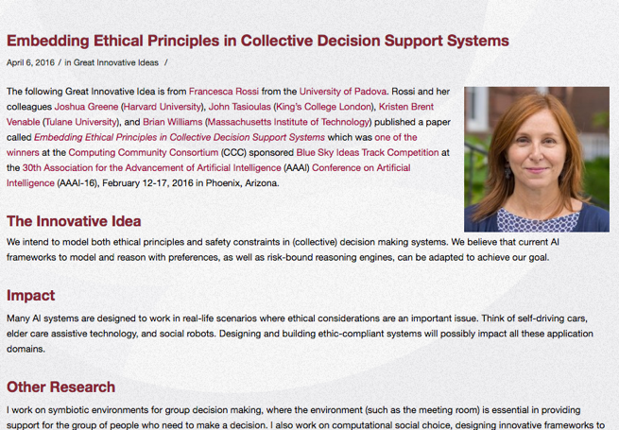
Showcasing the exciting new research and ideas generated by the computing community
Notes:
On average, 300 hits/day
Big Data is constant
Increase in interest for posts on other agencies (NIH, DARPA)
We track hits, reposts, etc.

Slide 65

National Symposium to Highlight the Impact of Computing Research:
Computing in the Physical World
Computing Enhancing Our Lives
Privacy
Partnerships
Notes:
On average, 300 hits/day
Big Data is constant
Increase in interest for posts on other agencies (NIH, DARPA)
We track hits, reposts, etc.

Slide 66
Nurturing future leaders

Slide 67
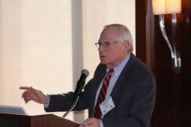
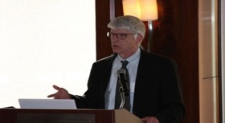
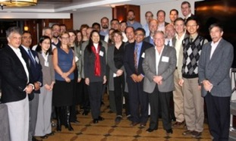
Leadership in Science Policy Institute (LiSPI)
To educate a cadre of computing researchers on how science policy in the U.S. is formulated and how our government works
November, 2011
34 attendees;
7 women
19 received financial aid
24 institutions represented
23 participants from public institutions; 7 from private; 4 from industry;
April, 2013
53 attendees;
12 women
6 received financial aid
47 institutions represented
40 participants from public institutions; 12 from private; 1 from industry
Henry Kelly, DoE
Milt Corn, NIH
April, 2015
32 attendees;
5 women
4 received financial aid
27 institutions represented
22 from public; 6 from private; 3 from industry
Attendees

Slide 68
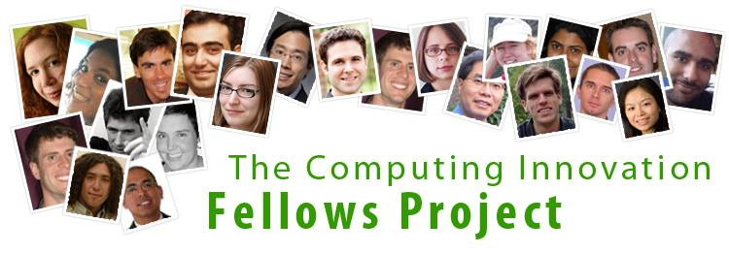
CI Fellows
Computing Innovation Fellows:
Retaining PhD graduates in the research pipeline during the economic downturn
  2009: 60 Fellows, 50 have permanent research positions
  (33 academic, 16 industry, 1 government)
  2010: 47 Fellows, all have permanent positions in research
  (27 academic, 20 industry)
  2011: 20 Fellows, 19 have permanent research positions
  (15 academic, 3 industry, 1 government)
CERP’s CI Fellows Evaluation Report – April 2014
CI Fellows Workshop – May 22-23, 2014

Slide 69
CI Fellows Evaluation –
Key Findings
Compared to Non-fellow Postdocs, CI Fellows
Experienced greater independence during their postdoc
Were more satisfied with how their postdoc prepared them for balancing work-life responsibilities
Received higher postdoc salaries that made it easier to live and relocate
Had higher salaries at the time of the survey
Postdoc programs in general:
Were rated positively in terms of support, opportunities, and skills preparation
Could be improved to reduce negative impact of relocating
Could be more accommodating of personal and family responsibilities

Slide 70
The Changing Computing COMMUNITY

Slide 71
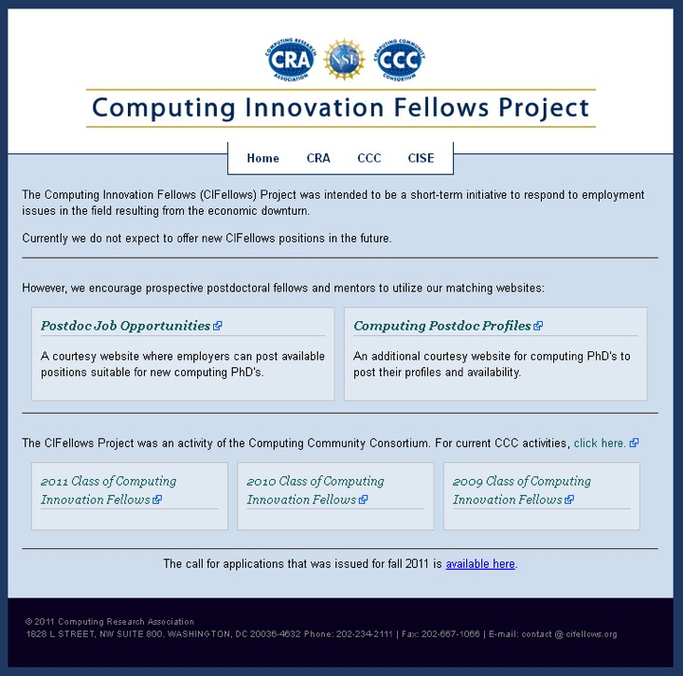
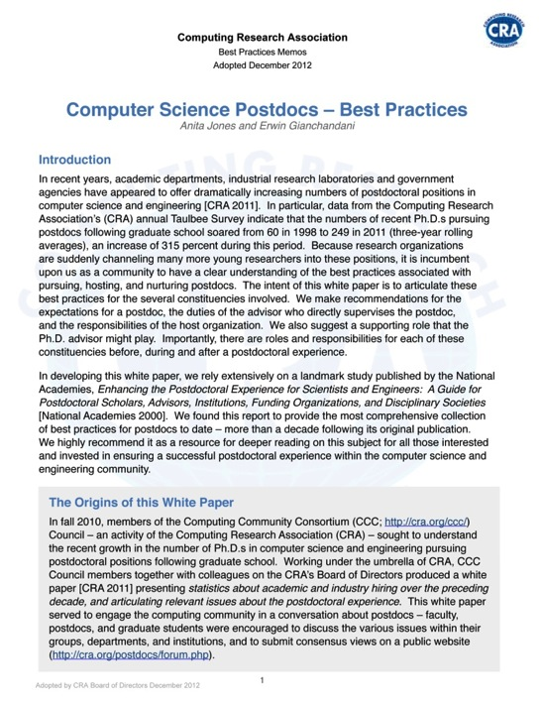

Computing Innovation Fellows Project -> Postdoc Best Practices

Slide 72
Postdoc Best Practices
3 Projects began in April, 2014 for 3 years
  ASCENT: Advancing computer Science Careers through Enhanced Networking and Training
    Columbia, Cornell, CUNY, NYU, Teacher’s College
  Taking Collective Responsibility for the Postdoc Experience
    University of Washington
  A Foundational Model for Postdoctoral Programs in Computer Science & Engineering at Large Universities
    Arizona State University, with University of Arizona and Northern Arizona University

Slide 73
Industry – academic collaborations
With Big Data Regional Innovation Hubs
Northeast: Young Innovator Internships, Knowledge Exchange Lecture Series, Data Science Best Practices Workshop
South: Data Start Internships, PEPI Early Career Exchange Visits
Midwest: Early Career Big Data Summit, Data Quality and Informal Data- An Oxymoron Workshop, Travel Grants
West: Collaboratory Faire, Workshop on Data Hackathon Best Practices, Tools of the Data Journalism Trade Workshop

Slide 74
Discussion, questions, ideas

Slide 75
Research “Ecosystem”
4 Year & International
Universities
Research Beneficiaries
General Public
Computing
Research Community
Research Universities
CCC
Industry
Investments in Computing Research
National Labs
Potential
Students

Slide 76

Research “Ecosystem”
Communication
4 Year & International
Universities
Research Beneficiaries
General Public
Computing
Research Community
Research Universities
CCC
Industry
Workshops
Whitepapers
Big Data Industry Collaboration
Investments in Computing Research
(Agencies, Industry_
National Labs
Potential
Students
CI Fellows
Catalyze faculty, students

Slide 77
Your Ideas?
What are we doing we might do better/differently?
What aren’t we doing that we should?
Are we missing big pieces of the picture entirely?

