Slide 1
The Computing Community Consortium (CCC)

Slide 2
Computing Community Consortium
The mission of Computing Research Association's Computing Community Consortium (CCC) is to catalyze the computing research community and enable the pursuit of innovative, high-impact research.
Promote Audacious Thinking:
  Community Initiated Visioning Workshops
  Blue Sky Ideas tracks at conferences
Communicate to the Community:
  CCC Blog - http://cccblog.org/
  Great Innovative Ideas
  White Papers and Workshop Reports
  Social Media
  Council member presentations
Facilitate Investment:
  Outputs of visioning activities
  Task Forces – Health, AI, Privacy etc.
  Engage with federal agencies and industry
Inculcate Leadership and Service:
  Engage with CCC Alumni and Sister Organizations
  Biennial Symposia series
Influence Early Career Researchers:
  Industry – Academic Collaborations
  Leadership in Science Policy Institute
  Postdoc Best Practices
Notes:
Established in 2006 as a standing committee of the Computing Research Association
Funded by NSF under a Cooperative Agreement
Facilitates the development of a bold, multi-themed vision for computing research – and communicates this vision to stakeholders
Led by a broad-based Council
Staffed by CRA

Slide 3
The Rapidly Expanding world of computing
Medicine and Global Health
Energy and
Sustainability
Education
Mobile
Natural Language Process
Security and
Privacy
Scientific Discovery
HCI
CORE
CSE
Machine Learning
Technology for
Development
Transportation
Sensors
Cloud
Computing
Neural
Engineering
Big Data
Interacting with the Physical World
Elder Care
Graphic: Lazowska
Accessibility
Notes:
I’d just like to take a few minutes to frame the talks this evening and help you understand how they fit into the bigger picture of what the CCC is attempting to accomplish.
Grady Booch
Peter Swire
We live in a world of remarkable innovation and remarkable opportunity.
This is a slide you saw at this morning’s talk due to Lazowska – it demonstrates the opportunities and challenges that today’s computing research poses – we’re in a world of enormous opportunity, but one that is constantly changing and evolving.
Perhaps more importantly, to pick up a theme from peter swire’s talk, where we as computer scientists are playing an ever larger role in addressing key national priorities such as healthcare, transportation, scientific discovery, sustainability and education. Addressing these issues takes new ideas, new constellations of investigators, and new sources of funding.

Slide 4
An Overview of the
Computing Community Consortium
Established in 2006 as a standing committee of the Computing Research Association (CRA)
Funded by NSF under a Cooperative Agreement
Facilitates the development of a bold, multi-themed vision for computing research – and communicates this vision to stakeholders
Led by a broad-based Council
Staff based at CRA

Slide 5
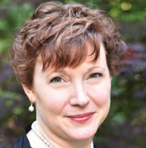
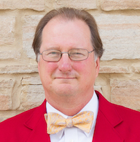


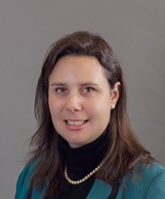
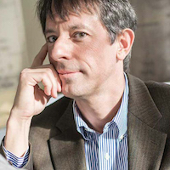
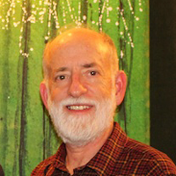
The CCC Council – executive committee
Beth Mynatt, Georgia Tech (Chair)
Mark Hill, University of Wisconsin, Madison
(Vice Chair)
Dan Lopresti, Lehigh University
Ben Zorn, Microsoft Research
Jennifer Rexford, Princeton
Ann Drobnis, Director
Andy Bernat, CRA Executive Director

Slide 6
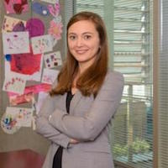
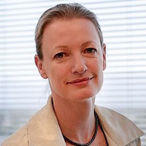
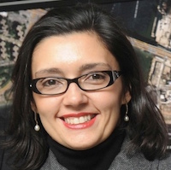
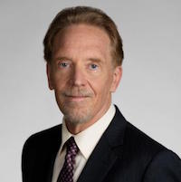
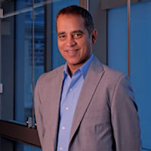
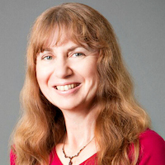
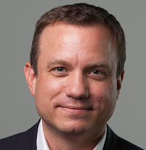
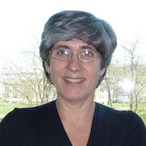
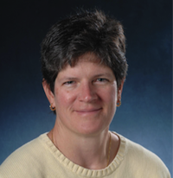
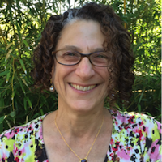
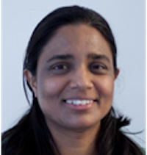
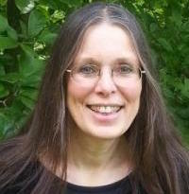
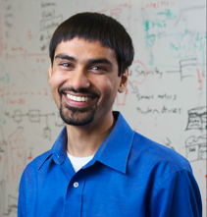
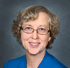
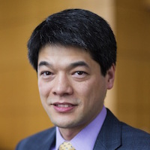
The CCC Council
Terms ending June 2020
  Nadya Bliss, Arizona State
  Elizabeth Churchill, Google
  Juliana Freire, NYU
  Keith Marzullo, Maryland
  Greg Morrisett, Cornell
  Manuela Veloso, Carnegie Mellon
Terms ending June 2019
  Sampath Kannan, UPenn
  Maja Mataric, USC
  Nina Mishra, Amazon
  Holly Rushmeier, Yale
Terms ending June 2018
  Liz Bradley, CU Boulder
  Cynthia Dwork, Microsoft Research
  Kevin Fu, Univ. Michigan (Leave)
  Daniel P. Lopresti, Lehigh University
  Shwetak Patel, Univ. Washington
  Katherine Yelick, UC Berkeley
  Jennifer Rexford, Princeton
  Ben Zorn, Microsoft Research

Slide 7

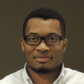



CRA Staff
CCC Director: Ann Drobnis
  100% CCC, responsible for day-to-day management of the Organization
Senior Program Associate: Helen Wright
  100% CCC, responsible for promoting the CCC mission through the website, blog, and social media
Program Associate: Khari Douglas
  100% CCC, responsible for supporting CCC special programs, workshops, and communications
CRA Executive Director: Andy Bernat
  10% CCC, responsible for general oversight
Other CRA Staff:
  Peter Harsha, Director of Government Affairs
  Sandra Corbett
  Sabrina Jacob

Slide 8
Goals For CCC
Bring the computing research community together to envision audacious research challenges, and to articulate concrete pathways to enable pursuit of these challenges.
Communicate these challenges and opportunities to the broader national community.
Facilitate investment in these research challenges by key stakeholders.
Inculcate values of leadership and service by the computing research community.
Inform and influence early career researchers to
engage in these community-led research challenges.

Slide 9
Desired Outcomes
Create broad awareness of the role computing research will play in future science and technology advances within federal agencies, philanthropic organizations, and industry through concrete examples and products.
Facilitate broad engagement of the computing research community in identifying and articulating new directions for computing research, in shaping priorities for those new directions, and in responding to existing opportunities in the computing research ecosystem.
Create high-impact tangible resources that inform stakeholders as to the current and potential impact of computing research.
Sustain the CCC as a widely accepted catalyst and voice for the computing research community.
Grow leadership and community capacity to engage in and respond to national science policy needs.

Slide 10




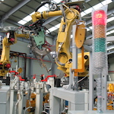
Visioning Processes
Periodic RFP for Community Initiated Activities
6 workshops per year in the last 3 years
Top-down (agency initiated)
Bottom-up (open call)
Sideways (council initiated, joint with other agencies,….)
Cyber Social Learning Systems
Nanotechnology-inspired Information Processing Systems
Smart Health
Sociotechnical Cybersecurity
Cybersecurity for Manufacturers
Notes:
Outline visioning and other activities over course of grant (2012-2014)
Make a point of discussing process a bit
Point out that we reach out widely to all directorates within NSF and other agencies.
Robotics, Automation, and Computer Science
Sponsored by Robotics-VO, NSF, OSTP, and CCC
Goal: frame concrete problems used to guide basic and applied research through the National Robotics Initiative
Point out how the processs works – we work with them

Slide 11
VISIONING Activities
Workshop | Date
Privacy by Design – Catalyzing Privacy by Design | January 6-7, 2016
Robotics | March 5 and 11, 2016
Cyber-Social Learning Systems Workshop 1 | August 29-30, 2016
Nanotechnology-Inspired Information Processing Systems of the Future | August 31-September 1, 2016
Cyber-Social Learning Systems Workshop 2 | November 2-3, 2016
Discovery and Innovation in Smart and Pervasive Health | December 5-6, 2016
Sociotechnical Cybersecurity Workshop 1 | December 12-13, 2016
Cyber-Social Learning Systems Workshop 3 | January 24-25, 2017
Cyber Security for Manufacturers | March 14-15, 2017
Over 40 visioning activities in 10-year history
Average of 6 activities per year in the last 4 years
Research areas include:
  Smart and Pervasive Health
  Nanotechnology-inspired Information Processing Systems
  Cyber Social Learning Systems
  Privacy by Design
  BRAIN Initiative
  Inclusive Access
  Personalized Education
13 workshop reports released
in past 4 years
20 white papers released
in past 4 years

Slide 12
Recent VISIONING WORKSHOPS
Cyber Social Learning Systems Aug 29-30, 2016
          Nov 2-3, 2016
          Jan 23-24, 2017
AAAI Symposium on Accelerating Science Nov 17-19, 2016
A Grand Challenge for AI
Smart Health and Health IT Dec 5-6, 2016
Sociotechnical Cybersecurity Dec 12-13, 2016
Aug 8-9, 2017
Cyber Security for Manufacturers Workshop Mar 14-15, 2017
  Joint with MForeSight
AAAI Symposium on AI for Social Good Mar 27-29, 2017

Slide 13
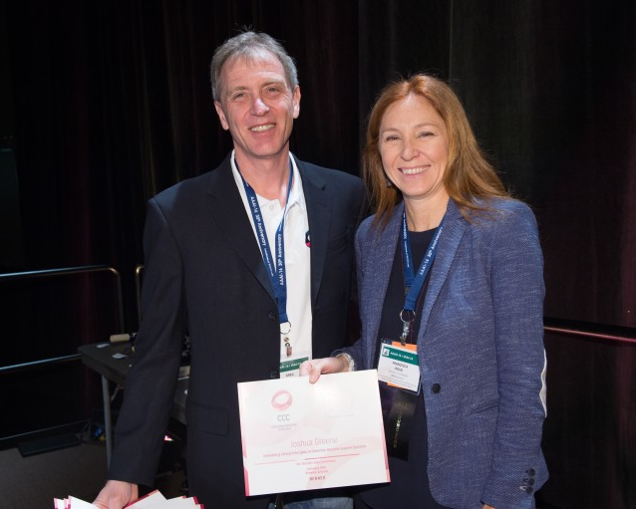
Blue Sky
Goal - Help conferences reach out beyond the usual research papers. Papers are opened ended and possibly “outrageous” or “wacky.”
  8 different tracks at 6 different conferences in last 4 years
  On average, 13 papers submitted per track at a conference
  Winners are asked to submit Great Innovative Ideas
Past CCC Chair Gregory Hager with AAAI-16 Blue Sky award winner Francesca Rossi

Slide 14
CCC Task Forces
CCC task forces are organized around national priorities, community needs, and council member interests. Our current set of topics are:
Computing in the Physical World
Convergence of Data and Computing
Artificial Intelligence and Robotics
Healthcare
Privacy and Fairness
Goal is for CCC to be engaged in ongoing activities around these topics, to identify needs and opportunities in the topic area, and to identify actions (generating white papers, convening a workshop, publicizing information, etc.) that have the possibility of “moving the needle” for these topics.
Annual process to determine topics, membership and priorities. Informed by major stakeholders (NSF, OSTP, PCAST, NITRD, workshops and council members)

Slide 15

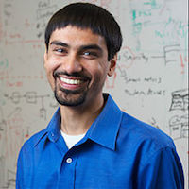




Computing in the physical world
Task Force
Chairs: Ben Zorn and Shwetak Patel
Recent Activities:
Intelligent Infrastructure white paper series
Response to NITRD Smart Cities and Community Strategic Plan
Ben Zorn
Microsoft Research
Shwetak Patel
University of Washington
Current Members:
Kevin Fu
University of Michigan
Daniel Lopresti
Lehigh University
White Papers:
Safety, Security, and Privacy Threats Posed by Accelerating Trends in IoT
Embedding Computing Innovations into our Cities and Communities (in process)
Beth Mynatt
Georgia Tech
Klara Nahrstedt
UIUC
Jennifer Rexford
Princeton University
Debra Richardson
UC - Irvine
Greg Morrisett
Cornell University

Slide 16
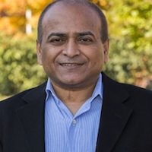

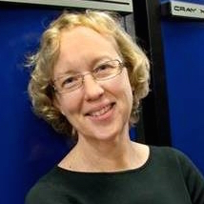
Convergence of Data and Computing task force
Chair: Vasant Honavar
Recent Activities:
Accelerating Science:
A Computing Research Agenda white paper
Co-sponsor of the AAAI Symposium on Accelerating Science: A Grand Challenge for AI
Discussions with DARPA
White papers and coordination with PCAST
Vasant Honavar
Penn State
Current Members:
Tom Conte
Georgia Tech
Mark Hill
Wisconsin, Madison
White Papers:
Challenges to Keeping the Computer Industry Centered in the US
Democratizing Design for Future Computing Platforms
Holly Rushmeier
Yale
Kathy Yelick
UC - Berkeley
Klara Nahrstedt
Illinois, Urbana-Champaign

Slide 17

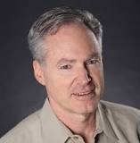
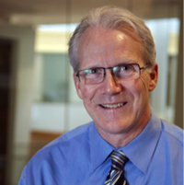
AI and Robotics task force
Chairs: Greg Hager and Eric Horvitz
Recent Activities:
AI for Social Good workshop report
Intelligence Require Progress Across all of Computer Science white paper
Discussions with Partnership on AI
Gregory Hager
Johns Hopkins
Eric Horvitz
Microsoft Research
Current Members:
Randy Bryant
Carnegie Mellon
Vasant Honavar
Penn State
White Papers In Process:
An Actionable Agenda for AI
Work Through Human Augmentation
White Paper on Safe AI
Maja Matarić
USC

Slide 18
Healthcare
Task Force
Chair: Beth Mynatt
Recent Activities:
Discovery and Innovation in Smart and Pervasive Health December, 2016 Workshop Report
Response to NITRD draft Federal Health Information Technology Research and Development Strategic Framework
Beth Mynatt
Georgia Tech
Current Members:
Gregory Hager
Johns Hopkins
Kevin Fu
University of Michigan
White Papers In Process
Population Health Surveillance and Response
Transforming Aging
Shwetak Patel
University of Washington
Nina Mishra
Amazon
Maja Matarić
Penn State

Slide 19
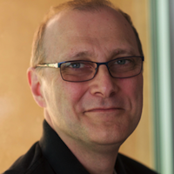
Privacy and Fairness
Task Force
Chairs: Cynthia Dwork and Sampath Kannan
Recent Activities:
Published a white paper called Privacy-Preserving Data Analysis for the Federal Statistical Agencies (joint with the Census Bureau)
Visioning Workshop on Sociotechnical Cybersecurity- December, 2016
Cynthia Dwork
Harvard University
Sampath Kannan
University of Pennsylvania
Current Members:
Lorenzo Alvisi
University of Texas, Austin
Elizabeth Bradley
University of Colorado, Boulder
White Papers In Process
An Ontology for Fairness
Vasant Honavar
Penn State

Slide 20

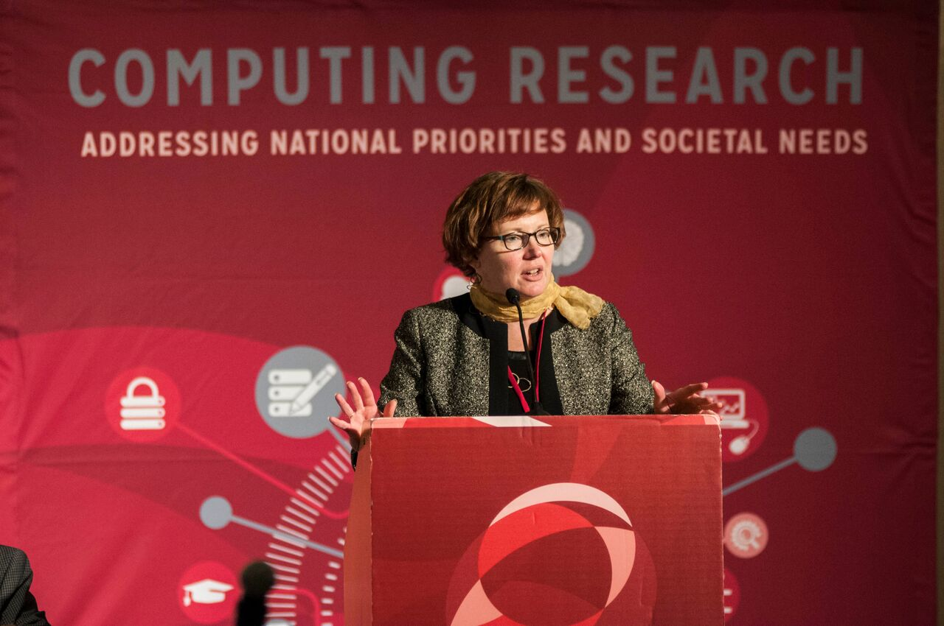
Held first National Symposium to Highlight the Impact of Computing Research in 2016
Establish a biennial Symposium to communicate the role of computing research to address national and societal priorities
Bring in early career researchers to connect them with and invigorate the community
  2017 Symposium October 23-24th in Washington, DC
Notes:
39 early career faculty
On average, 300 hits/day
Big Data is constant
Increase in interest for posts on other agencies (NIH, DARPA)
We track hits, reposts, etc.

Slide 21


COMMUNICATING
Workshop Reports
White Papers
  CCC works with community to produce timely white papers that inform policymakers and the broader community on national priorities
CCC Blog
  Provides a continuous stream of information on advances in computing research
  Opportunities for community to get involved
  Forum for community discussion
Great Innovative Ideas
  A way to showcase the exciting new research and ideas generated by the computing community
Annual events
  CCC Symposium
  CRA Snowbird
Special Events
Computing Research
2016
AI for Social Good
2016

Slide 22
Nurturing next generation of leaders
Grow leadership and community capacity to engage in and respond to national science policy needs and identify new directions for computing research.
Leadership in Science Policy Institute
  Educates and trains computing researchers on how science policy in the U.S. is formulated and how to advocate for computing research
  Co-sponsored by CRA’s Government Affairs Committee
Industry – Academic Collaborations
  CCC collaborated with Big Data Regional Hubs
  Activities to enhance the research of early career faculty
Postdoc Best Practices
  Program to study institutional support structures for postdocs
  3 programs: University of Washington, NY ASCENT, Arizona
Computing Innovation Fellows (CIFellows) Project
  Rapidly created the CI Fellows program to preserve human capital when faculty positions became scarce with the financial crisis

Slide 23


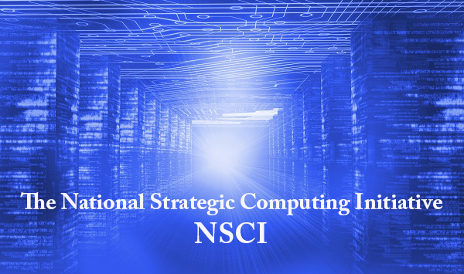
Amplification
BRAIN Initiative launched in 2013.
CCC co-hosted the Brain Workshop with NSF in 2014.
CCC co-hosted the SA+TS workshop with SRC and NSF in 2013.
Produced Research Needs for Trustworthy, and Reliable Semiconductors
Report in 2015.
NSCI announced in July 2015.
CCC produced a series of blog posts on the topic, featuring one from Doug Burger, and the Convergence of Data and Computing task force frequently overlaps with this topic.
Smart and Connected Health Program in NSF and NIH.
CCC has hosted several workshops on related topics, including: Aging in Place (2014), Inclusive Access (2015), and Smart and Pervasive Health (2016) and produced related reports and white papers.
Notes:
2004 – Ed was on PITAC under President Bush – Computational Science was one of the three sections of the report and Big Data was mentioned
2008 – CCC White Paper for the transition team
2008 – CCC Workshops
2010 – Series of White Papers, first PCAST Report
2012 – Presidential Initiative
2014 - Ubiquitous

Slide 24
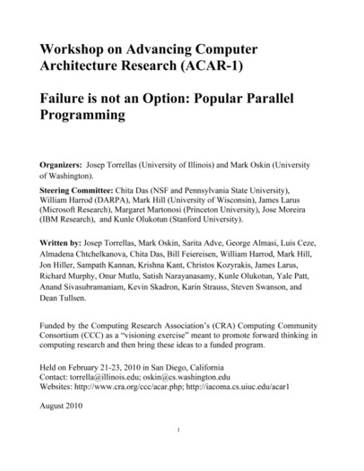
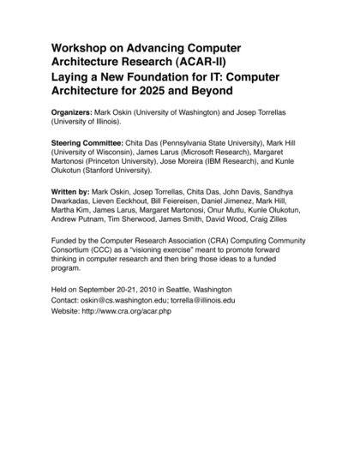
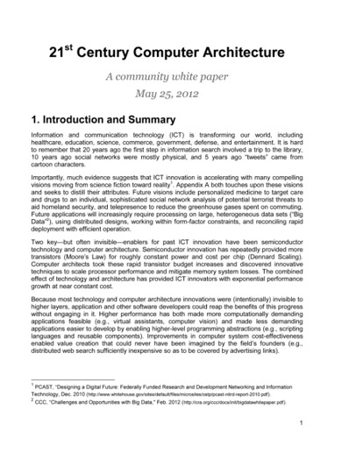
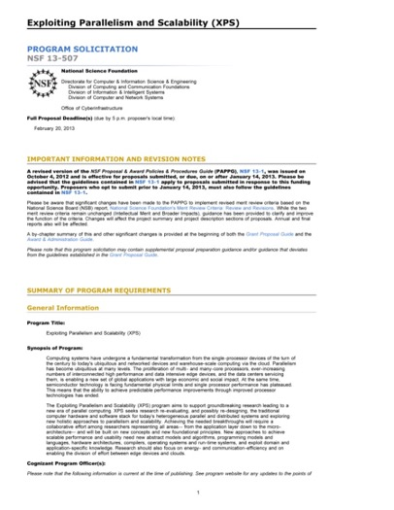
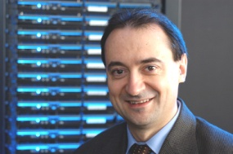
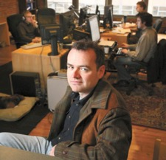
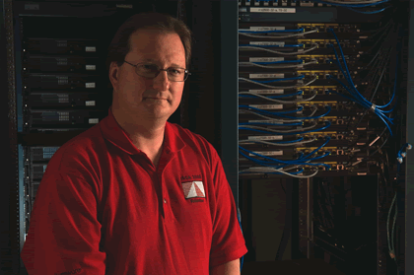
Impact: architecture
2010
2010
2012
2013
Josep Torrellas
UIUC
Mark Oskin
Washington
Mark Hill
Wisconsin
Notes:
2012 White Paper:
March – group forms(launched by CCC)
April – brainstorming, read related documents, outline
May – solicit feedback on drafts
May 25 – release report
February, 2013 – XPS solicitation quoting report

Slide 25
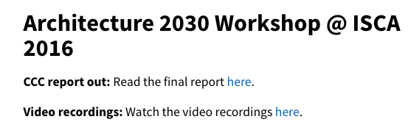

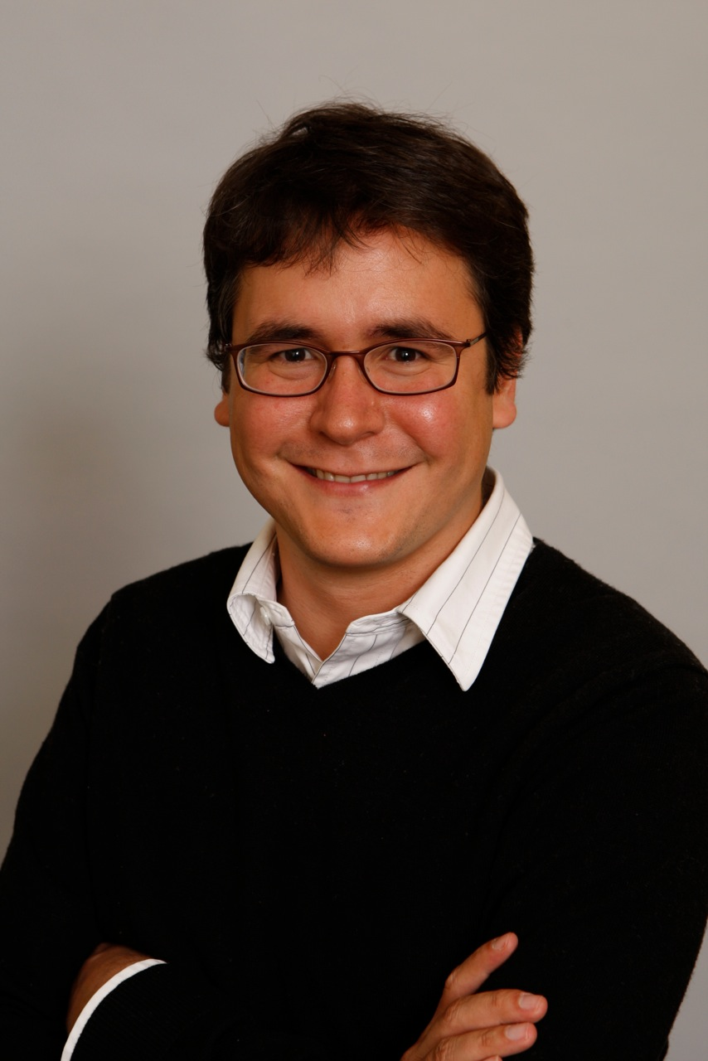
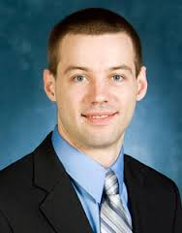
Impact: architecture
2013
2016
2016
Luis Ceze
Washington
Tom Wenisch
Michigan
Mark Hill
Wisconsin
Notes:
2012 White Paper:
March – group forms(launched by CCC)
April – brainstorming, read related documents, outline
May – solicit feedback on drafts
May 25 – release report
February, 2013 – XPS solicitation quoting report

Slide 26
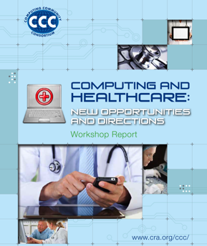
impact: Health IT
October 2012 Workshop
Notes:
SHW first in 2010, updated in 2013 as a joint initiative with NIH

Slide 27
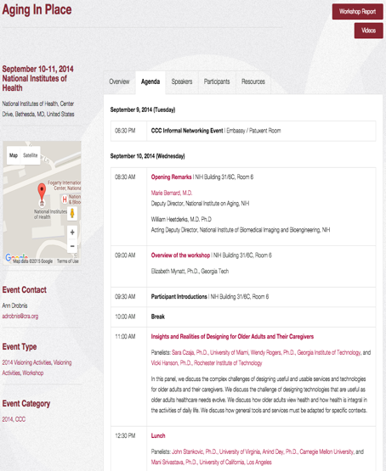
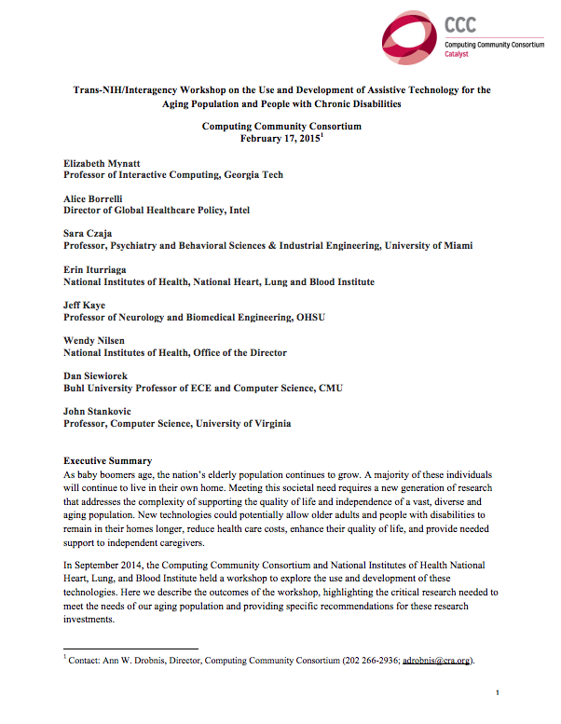
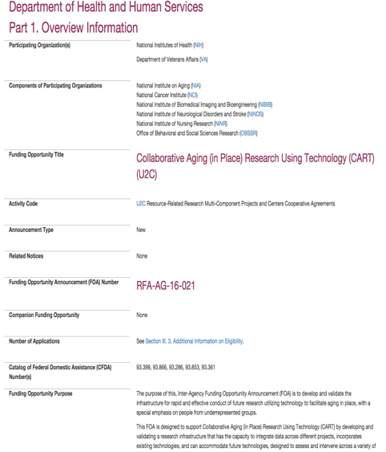
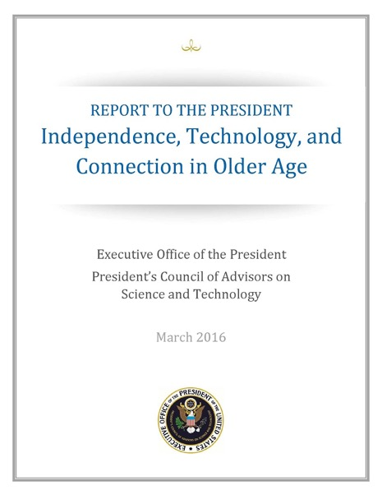
Impact: Aging in Place
Joint NIH/CCC Meeting
September 2014
Produced Workshop Report
February 2015
NIH released new RFP informed by AIP Workshop
October 2015
PCAST Report
March 2016
Notes:
2004 – Ed was on PITAC under President Bush – Computational Science was one of the three sections of the report and Big Data was mentioned
2008 – CCC White Paper for the transition team
2008 – CCC Workshops
2010 – Series of White Papers, first PCAST Report
2012 – Presidential Initiative
2014 - Ubiquitous

Slide 28
Computing Community Consortium
The mission of Computing Research Association's Computing Community Consortium (CCC) is to catalyze the computing research community and enable the pursuit of innovative, high-impact research.
Promote Audacious Thinking:
  Community Initiated Visioning Workshops
  Blue Sky Ideas tracks at conferences
Communicate to the Community:
  CCC Blog - http://cccblog.org/
  Great Innovative Ideas
  White Papers and Workshop Reports
  Social Media
  Council member presentations
Facilitate Investment:
  Outputs of visioning activities
  Task Forces – Health, AI, Privacy etc.
  Engage with federal agencies and industry
Inculcate Leadership and Service:
  Engage with CCC Alumni and Sister Organizations
  Biennial Symposia series
Influence Early Career Researchers:
  Industry – Academic Collaborations
  Leadership in Science Policy Institute
  Postdoc Best Practices
Notes:
Established in 2006 as a standing committee of the Computing Research Association
Funded by NSF under a Cooperative Agreement
Facilitates the development of a bold, multi-themed vision for computing research – and communicates this vision to stakeholders
Led by a broad-based Council
Staffed by CRA

