Slide 1
Introduction to the CCC and the CCC Council
June 20, 2017

Slide 2
An Overview of the
Computing Community Consortium
Established in 2006 as a standing committee of the Computing Research Association (CRA)
Funded by NSF under a Cooperative Agreement
  Third Award begins in 2017,
  completed Reverse Site Visit (April 2017)
Facilitates the development of a bold, multi-themed vision for computing research – and communicates this vision to stakeholders
Led by a broad-based Council
Staff based at CRA

Slide 3
What We’ll try to cover
Brief history
Role and mission of CCC
Organizational details
CCC Stakeholders
CCC Goals, Activities and Desired Outcomes
CCC Impact

Slide 4
Pre-history
In the mid-2000’s, NSF CISE leaders and computing research community leaders had similar concerns regarding:
  The Federal commitment to research in general, and to computing research in particular
  Public and policymaker perception that computer science is “yesterday’s news”
  Failure to articulate and coalesce around exciting research visions in computer science – research visions that would galvanize the public, policymakers, researchers, and students
  Need to groom leadership for the field
  Decrease in student interest
  GENI Project direction
This led to:
  Increased focus on these issues by NSF CISE and the computing research community
  Computing Community Consortium solicitation by NSF
  Eager response by a group of computing research community leaders under the auspices of the Computing Research Association
    Randy Bryant
    Susan Graham
    Anita Jones
    Dick Karp
    Ken Kennedy
    Ed Lazowska
    Peter Lee
    Jeff Vitter

Slide 5
Informal mission
“A catalyst and enabler for the computing research community”
  Bring the community together to contribute to shaping the future of the field
  Provide leadership for the community, encouraging revolutionary, high-impact research
  Encourage the alignment of computing research with pressing national priorities and national challenges (many of which cross disciplines)
  Work with policymakers to facilitate the translation of these important research directions into funded programs
  Give voice to the community, communicating to a broad audience the many ways in which advances in computing will create a brighter future
  Grow new leaders for the computing
  research community

Slide 6
Major organizational milestones
NSF solicitation + CRA Proposal + Cooperative Agreement (2006)
Chair appointed (Winter 2007) + Council appointed (Spring 2007)
Vice-Chair position formalized: Fall 2007
Full-time Director (Erwin Gianchandani) joins: Spring 2010
Renewal proposal submitted: Spring 2011
Steady-state organizational structure defined: Fall 2012
Executive Committee launched: Winter 2013
Ann Drobnis joins as Director: Spring 2013
Regular Chair / Vice-Chair succession kicks in: Summer 2013
Proposal and Renewal (in process, 2017)

Slide 7
The Rapidly Expanding world of computing
Medicine and Global Health
Energy and
Sustainability
Education
Mobile
Natural Language Process
Security and
Privacy
Scientific Discovery
HCI
CORE
CSE
Machine Learning
Technology for
Development
Transportation
Sensors
Cloud
Computing
Neural
Engineering
Big Data
Interacting with the Physical World
Elder Care
Graphic: Lazowska
Accessibility
Notes:
I’d just like to take a few minutes to frame the talks this evening and help you understand how they fit into the bigger picture of what the CCC is attempting to accomplish.
Grady Booch
Peter Swire
We live in a world of remarkable innovation and remarkable opportunity.
This is a slide you saw at this morning’s talk due to Lazowska – it demonstrates the opportunities and challenges that today’s computing research poses – we’re in a world of enormous opportunity, but one that is constantly changing and evolving.
Perhaps more importantly, to pick up a theme from peter swire’s talk, where we as computer scientists are playing an ever larger role in addressing key national priorities such as healthcare, transportation, scientific discovery, sustainability and education. Addressing these issues takes new ideas, new constellations of investigators, and new sources of funding.

Slide 8
Computing Community Consortium
The mission of Computing Research Association's Computing Community Consortium (CCC) is to catalyze the computing research community and enable the pursuit of innovative, high-impact research.
Promote Audacious Thinking:
  Community Initiated Visioning Workshops
  Blue Sky Ideas tracks at conferences
Communicate to the Community:
  CCC Blog - http://cccblog.org/
  Great Innovative Ideas
  White Papers and Workshop Reports
  Social Media
  Council member presentations
Facilitate Investment:
  Outputs of visioning activities
  Task Forces – Health, AI, Privacy etc.
  Engage with federal agencies and industry
Inculcate Leadership and Service:
  Engage with CCC Alumni and Sister Organizations
  Biennial Symposia series
Influence Early Career Researchers:
  Industry – Academic Collaborations
  Leadership in Science Policy Institute
  Postdoc Best Practices
Notes:
Established in 2006 as a standing committee of the Computing Research Association
Funded by NSF under a Cooperative Agreement
Facilitates the development of a bold, multi-themed vision for computing research – and communicates this vision to stakeholders
Led by a broad-based Council
Staffed by CRA

Slide 9
Organizational structures
June 20, 2017

Slide 10
CCC Organizational Structure
Chair, Vice-chair
  2 year non-staggered terms
  Vice-chair is presumptive chair
Director, Program Associates (2)
  Full-time paid positions
Executive Committee
  Chair, Vice-chair, Director
  3 at large drawn from Council for 1-year terms
  CRA Executive Director
Council
  20 members
  3 year terms, at most 2 consecutive terms
Support
  As needed, from CRA Staff

Slide 11
What Does Executive Committee Do?
Each member has a major responsibility within the organization
Oversees the work of subcommittees and working groups
Guides the planning of new activities
Oversees the execution of the Strategic Plan and annual Implementation Plan
Meets biweekly by teleconference
Meets biweekly with NSF by teleconference
Notes:
Executive committee provides grooming for future leadership

Slide 12
What Do Council Members Do?
Shepherd visioning activities
Participate in topical task forces
  Examples: AI and Robotics, Healthcare, Privacy and Fairness
  Produce and curate relevant resources
  Monthly teleconferences
Develop new activities
  Examples: CIFellows, LISPI, Post-doc Best Practices, Big Data Hub Industry-Academia Collaboration
Engage with government agencies, industry, and sister organizations (NSF, ACM, Big Data Hubs…)
Write white papers and blog posts
Other requests as needed
Monthly teleconferences
Three face-to-face meetings each year

Slide 13
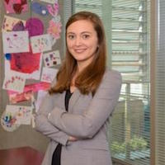
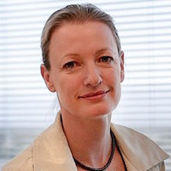
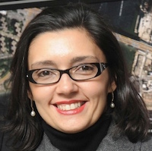

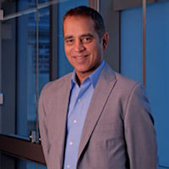
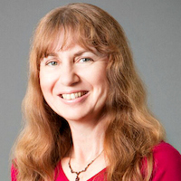
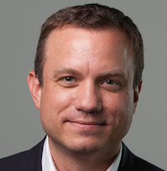
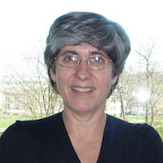
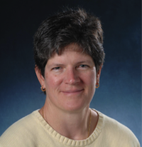
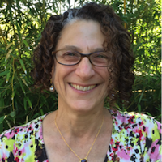
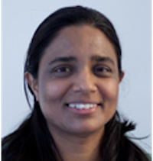
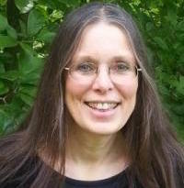
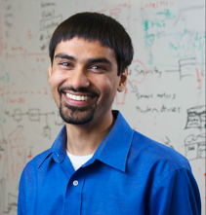

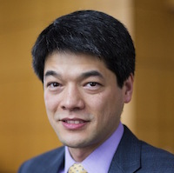
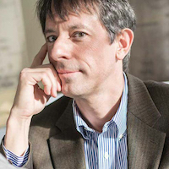
The CCC Council
Terms ending June 2020
  Nadya Bliss, Arizona State
  Elizabeth Churchill, Google
  Juliana Freire, NYU
  Keith Marzullo, Maryland
  Greg Morrisett, Cornell
  Manuela Veloso, Carnegie Mellon
Terms ending June 2019
  Sampath Kannan, UPenn
  Maja Mataric, USC
  Nina Mishra, Amazon
  Holly Rushmeier, Yale
Terms ending June 2018
  Liz Bradley, CU Boulder
  Cynthia Dwork, Microsoft Research
  Kevin Fu, Univ. Michigan (Leave)
  Daniel P. Lopresti, Lehigh University
  Shwetak Patel, Univ. Washington
  Katherine Yelick, UC Berkeley
  Jennifer Rexford, Princeton
  Ben Zorn, Microsoft Research

Slide 14

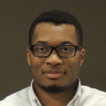



CRA Staff
CCC Director: Ann Drobnis
  100% CCC, responsible for day-to-day management of the Organization
Senior Program Associate: Helen Wright
  100% CCC, responsible for promoting the CCC mission through the website, blog, and social media
Program Associate: Khari Douglas
  100% CCC, responsible for supporting CCC special programs, workshops, and communications
CRA Executive Director: Andy Bernat
  10% CCC, responsible for general oversight
Other CRA Staff:
  Peter Harsha, Director of Government Affairs
  Sandra Corbett
  Sabrina Jacob

Slide 15
NSF Interactions
CISE Office of the Assistant Director
AD: James Kurose
DAD: Erwin P. Gianchandani
Advanced Cyberinfrastructure (ACI)
DD: Irene Qualters
DDD: Amy Friedlander
Data
Computing and Communications Foundations (CCF)
DD: Rao Kosajaru
Acting DDD: Anindya Banerjee
High Performance Computing
Networking / Cybersecurity
Software
Communications and Information Foundations
Software and Hardware Foundations
Computer and Network Systems (CNS)
DD: Ken Calvert
DDD: Jeremy Epstein
Computer Systems Research
Networking and Technology Systems
Information Integration and Informatics
Robust Intelligence
Information and Intelligent Systems (IIS)
Acting DD: Howard Wactlar
DDD: Joydip Kundu
Cyber Human Systems
Algorithmic Foundations
Program Officer: Nina Amla
Notes:
Bi-weekly telecon with Executive committee. We tell them what we’re working on. They tell us what they’d like us to do

Slide 16
Relationship to Computing Research Association (CRA)
NSF cooperative agreement is with CRA
CCC is a standing committee of CRA
  Andy Bernat, CRA Executive Director, is an ex officio member of the CCC Executive Committee
  Beth Mynatt, the CCC Chair is a member of the CRA Board of Directors
  Susan B. Davidson, the CRA chair must consent to CCC Council appointments (and is a former Council member)
  Greg Hager, past CCC Chair and member of the CRA Board of Directors
  Greg Morrisett, CCC Council member and member of the CRA Board of Directors
  Shashi Shekhar, past CCC Council member and member of the CRA Board of Directors
  Josep Torrellas, past CCC Council member and member of the CRA Board of Directors
CCC staff are based in CRA

Slide 17
CCC and its stakeholders
Notes:
Think of CCC is a bridge between the CS research community, the funders of that research, and the beneficiaries of that research. We work to promote the health of that enterprise.

Slide 18
Major Stakeholders
Computing Research Community
  CRA
  CSTB (Computer Science and Telecommunications Board, part of National Research Council)
  Professional societies
  Academic units
  Research labs
Industry
  Computing industry, Major users of IT
Public
Government
  See following slides

Slide 19
Government Stakeholders
Agencies important to us
NSF – strong ties with CISE
NIH – growing ties with folks interested in Health IT
DARPA – ties come and go
DoE – ties with ASCR; interest in ARPA-E
Others that are relevant
NIST
HHS/ONC

Slide 20
Government Stakeholders
Networking and Information Technology R&D (NITRD)
  Legislatively mandated coordination among Federal R&D agencies
  National Coordinating Office (NCO) facilitates
    Interagency working groups
    Coordinating groups
    Senior steering groups
    Community of practice
  Director is Bryan Biegel

Slide 21
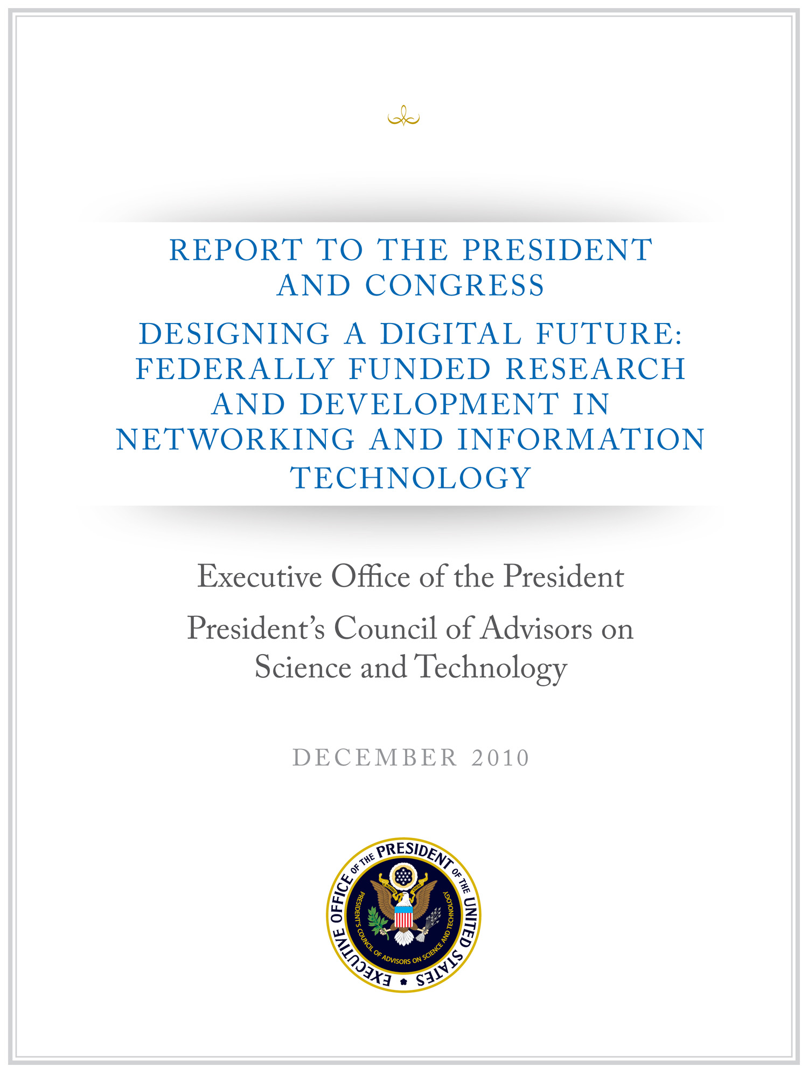
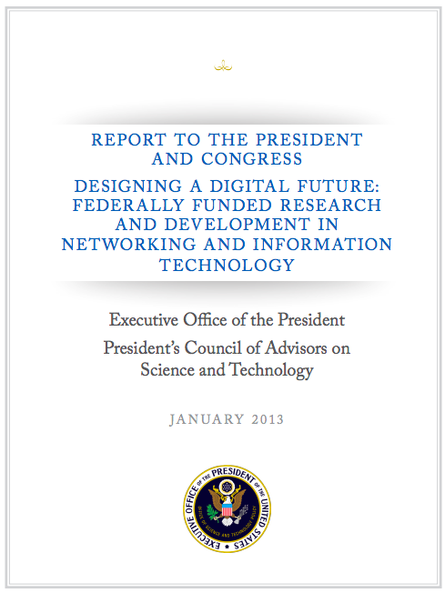
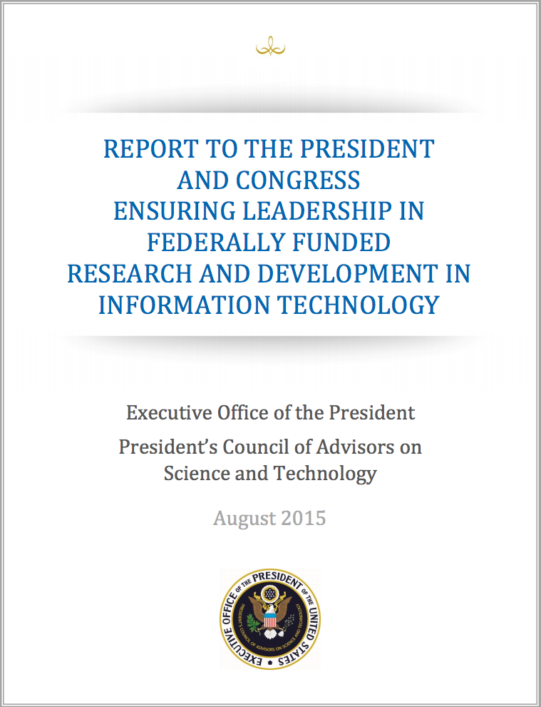
PCAST NITRD Report
2010
1/3 of the PCAST NITRD Working Group members were CCC Council Members
The report drew extensively on CCC White Papers
An excellent roadmap for the field
2013
¼ Contributing Members were CCC Council Members
An excellent review of progress from 2010 report
The challenge now: Continuing to translate it into action
2015
1/3 Contributing Members were CCC Council Members
An update to the 2013 report, including recommendations for Federal Agencies
The challenge now: restructuring NITRD

Slide 22
CCC goals and activities
June 20, 2017

Slide 23
Goals For CCC
Bring the computing research community together to envision audacious research challenges, and to articulate concrete pathways to enable pursuit of these challenges.
Communicate these challenges and opportunities to the broader national community.
Facilitate investment in these research challenges by key stakeholders.
Inculcate values of leadership and service by the computing research community.
Inform and influence early career researchers to
engage in these community-led research challenges.

Slide 24
Desired Outcomes
Create broad awareness of the role computing research will play in future science and technology advances within federal agencies, philanthropic organizations, and industry through concrete examples and products.
Facilitate broad engagement of the computing research community in identifying and articulating new directions for computing research, in shaping priorities for those new directions, and in responding to existing opportunities in the computing research ecosystem.
Create high-impact tangible resources that inform stakeholders as to the current and potential impact of computing research.
Sustain the CCC as a widely accepted catalyst and voice for the computing research community.
Grow leadership and community capacity to engage in and respond to national science policy needs.

Slide 25
Mapping CCC Strategic Goals to Priority Outcomes
 | Goal 1: Research Challenges | Goal 2: Communicate Broadly | Goal 3: Research Investments | Goal 4: Leadership | Goal 5: Influence Community
Outcome 1: Agency Awareness | ✔ | ✔ | ✔
Outcome 2: Community Engagement | ✔ | ✔ |  | ✔ | ✔
Outcome 3: Tangible Resources | ✔ | ✔ | ✔ |  | ✔
Outcome 4: CCC Role | ✔ | ✔ |  | ✔
Outcome 5: Leadership and Capacity | ✔ | ✔ | ✔ | ✔ | ✔

Slide 26
Planned Activities
Envisioning Future Computing Research
Engaging and Aligning with National and Computing Research Priorities
Communicating Future Computing Research
Cultivating Computing Leadership and Community Capacity to Engage and Respond to National Priorities

Slide 27
Envisioning Future Computing Research
“The Computing Community Consortium (CCC) solicits proposals that will galvanize the community to define visions and agendas for exciting frontiers of computing research.”
Create a new community of researchers.
Inform a new funding initiative.
Help an extant community define a new trajectory.
Goals for next phase
Increase the participation of industry leadership and early career researchers at Visioning Workshops
Expand the adoption of Blue Sky tracks at computing conferences
Establish a biennial symposia series Computing Research: Addressing National Priorities and Societal Host on odd years and host in DC

Slide 28




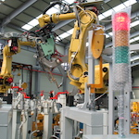
Visioning Processes
Periodic RFP for Community Initiated Activities
6 workshops per year in the last 3 years
Top-down (agency initiated)
Bottom-up (open call)
Sideways (council initiated, joint with other agencies,….)
Cyber Social Learning Systems
Nanotechnology-inspired Information Processing Systems
Smart Health
Sociotechnical Cybersecurity
Cybersecurity for Manufacturers
Notes:
Outline visioning and other activities over course of grant (2012-2014)
Make a point of discussing process a bit
Point out that we reach out widely to all directorates within NSF and other agencies.
Robotics, Automation, and Computer Science
Sponsored by Robotics-VO, NSF, OSTP, and CCC
Goal: frame concrete problems used to guide basic and applied research through the National Robotics Initiative
Point out how the processs works – we work with them

Slide 29
VISIONING Activities
Workshop | Date
Privacy by Design – Catalyzing Privacy by Design | January 6-7, 2016
Robotics | March 5 and 11, 2016
Cyber-Social Learning Systems Workshop 1 | August 29-30, 2016
Nanotechnology-Inspired Information Processing Systems of the Future | August 31-September 1, 2016
Cyber-Social Learning Systems Workshop 2 | November 2-3, 2016
Discovery and Innovation in Smart and Pervasive Health | December 5-6, 2016
Sociotechnical Cybersecurity Workshop 1 | December 12-13, 2016
Cyber-Social Learning Systems Workshop 3 | January 24-25, 2017
Cyber Security for Manufacturers | March 14-15, 2017
Over 40 visioning activities in 10-year history
Average of 6 activities per year in the last 4 years
Research areas include:
  Smart and Pervasive Health
  Nanotechnology-inspired Information Processing Systems
  Cyber Social Learning Systems
  Privacy by Design
  BRAIN Initiative
  Inclusive Access
  Personalized Education
13 workshop reports released
in past 4 years
20 white papers released
in past 4 years

Slide 30
Successful Visioning Activities
Engage the community and relevant stakeholders
Facilitate broad thinking with compelling examples
Create new avenues for (interdisciplinary) collaboration
Prepare and energize the community for future opportunities
Rapidly capture and synthesize ideas from the community.
Present ideas and engage possible funders and stakeholders
Articulate needs and barriers to research impact

Slide 31
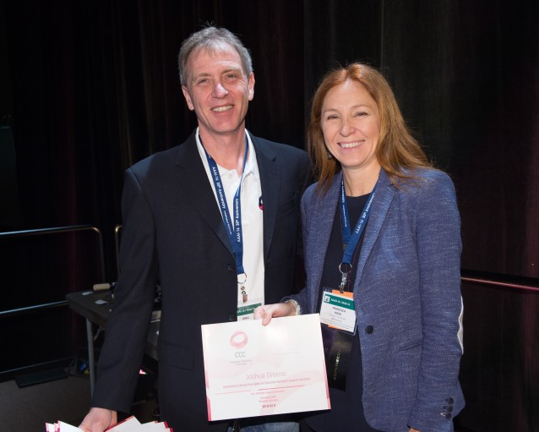
Blue Sky
Goal - Help conferences reach out beyond the usual research papers. Papers are opened ended and possibly “outrageous” or “wacky.”
  8 different tracks at 6 different conferences in last 4 years
  On average, 13 papers submitted per track at a conference
  Winners are asked to submit Great Innovative Ideas
Past CCC Chair Gregory Hager with AAAI-16 Blue Sky award winner Francesca Rossi

Slide 32
Recent Blue Sky Ideas
Conference Tracks
^{BuildSys 2012}
Computational Sustainability Track @ AAAI 2013
Computational Sustainability Award @ CHI 2013
Robotics: Science and Systems 2013
Conference on Innovation Data Systems Research (CIDR-2013)
Autonomous Agents and MultiAgent Systems (AAMAS-2014, AAMAS-2016, AAMAS-2017)
Foundations of Software Engineering (ACM SIGSOFT 2014)
Advancement of Artificial Intelligence (AAAI-15, ^{AAAI-16, AAAI-17 )}
Advances in GIS (ACM SIGSPATIAL 2015, ACM SIGSPATIAL 2016)
Robotics: Science and Systems (RSS) 2015
Advancement of Artificial Intelligence (AAAI-15 and AAAI-16)
International Conference on Software Engineering (ICSE 2016)
^{Upcoming:}
Robotics: Science and Systems (RSS) 2017
^{AAAI-18}

Slide 33
Engaging and Aligning with National and Computing Research Priorities
Agility to respond to requests and ideas.
Outreach pulls together visioning with stakeholder needs and timely opportunities
Increase scale and capacity through CCC Task Forces
Increase engagement with industry, sister organizations and other relevant stakeholders (philanthropy)

Slide 34
CCC Task Forces
CCC task forces are organized around national priorities, community needs, and council member interests. Our current set of topics are:
Computing in the Physical World
Convergence of Data and Computing
Artificial Intelligence and Robotics
Healthcare
Privacy and Fairness
Goal is for CCC to be engaged in ongoing activities around these topics, to identify needs and opportunities in the topic area, and to identify actions (generating white papers, convening a workshop, publicizing information, etc.) that have the possibility of “moving the needle” for these topics.
Annual process to determine topics, membership and priorities. Informed by major stakeholders (NSF, OSTP, PCAST, NITRD, workshops and council members)

Slide 35

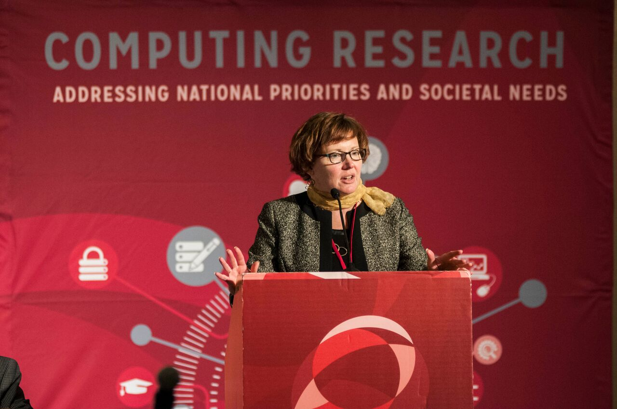
Held first National Symposium to Highlight the Impact of Computing Research in 2016
Establish a biennial Symposium to communicate the role of computing research to address national and societal priorities
Bring in early career researchers to connect them with and invigorate the community
Notes:
39 early career faculty
On average, 300 hits/day
Big Data is constant
Increase in interest for posts on other agencies (NIH, DARPA)
We track hits, reposts, etc.

Slide 36


COMMUNICATING
Workshop Reports
White Papers
  CCC works with community to produce timely white papers that inform policymakers and the broader community on national priorities
CCC Blog
  Provides a continuous stream of information on advances in computing research
  Opportunities for community to get involved
  Forum for community discussion
Great Innovative Ideas
  A way to showcase the exciting new research and ideas generated by the computing community
Annual events
  CCC Symposium
  CRA Snowbird
Special Events
Computing Research
2016
AI for Social Good
2016

Slide 37
Nurturing next generation of leaders
Grow leadership and community capacity to engage in and respond to national science policy needs and identify new directions for computing research.
Leadership in Science Policy Institute
  Educates and trains computing researchers on how science policy in the U.S. is formulated and how to advocate for computing research
  Co-sponsored by CRA’s Government Affairs Committee
Industry – Academic Collaborations
  CCC collaborated with Big Data Regional Hubs
  Activities to enhance the research of early career faculty
Postdoc Best Practices
  Program to study institutional support structures for postdocs
  3 programs: University of Washington, NY ASCENT, Arizona
Computing Innovation Fellows (CIFellows) Project
  Rapidly created the CI Fellows program to preserve human capital when faculty positions became scarce with the financial crisis

Slide 38
impact

Slide 39


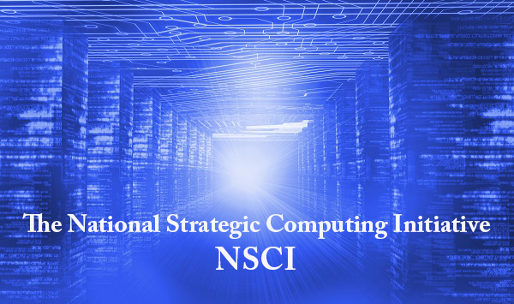
Amplification
BRAIN Initiative launched in 2013.
CCC co-hosted the Brain Workshop with NSF in 2014.
CCC co-hosted the SA+TS workshop with SRC and NSF in 2013.
Produced Research Needs for Trustworthy, and Reliable Semiconductors
Report in 2015.
NSCI announced in July 2015.
CCC produced a series of blog posts on the topic, featuring one from Doug Burger, and the Convergence of Data and Computing task force frequently overlaps with this topic.
Smart and Connected Health Program in NSF and NIH.
CCC has hosted several workshops on related topics, including: Aging in Place (2014), Inclusive Access (2015), and Smart and Pervasive Health (2016) and produced related reports and white papers.
Notes:
2004 – Ed was on PITAC under President Bush – Computational Science was one of the three sections of the report and Big Data was mentioned
2008 – CCC White Paper for the transition team
2008 – CCC Workshops
2010 – Series of White Papers, first PCAST Report
2012 – Presidential Initiative
2014 - Ubiquitous

Slide 40
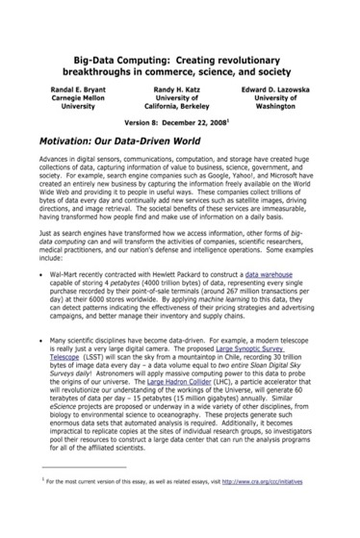
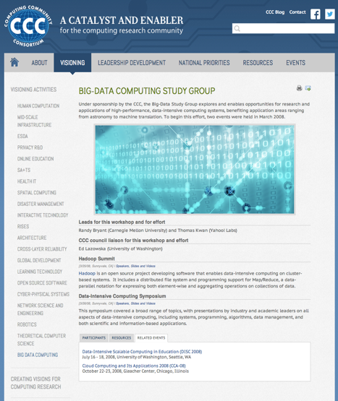
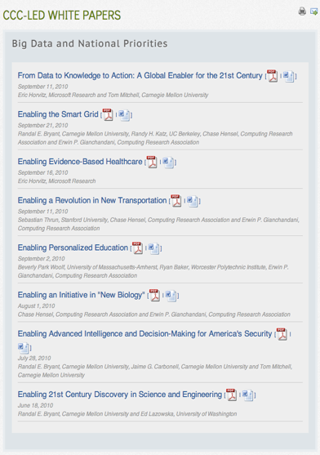
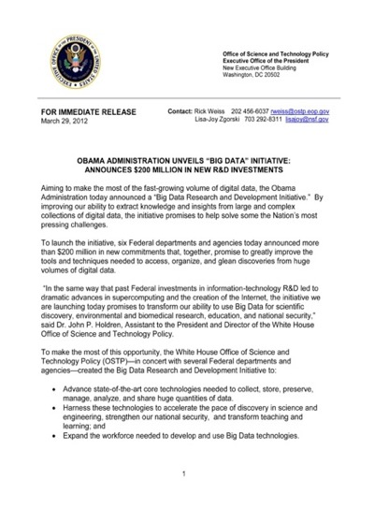

Impact: Big Data
2008
2008
2010
2012
2016
Notes:
2004 – Ed was on PITAC under President Bush – Computational Science was one of the three sections of the report and Big Data was mentioned
2008 – CCC White Paper for the transition team
2008 – CCC Workshops
2010 – Series of White Papers, first PCAST Report
2012 – Presidential Initiative
2014 - Ubiquitous

Slide 41
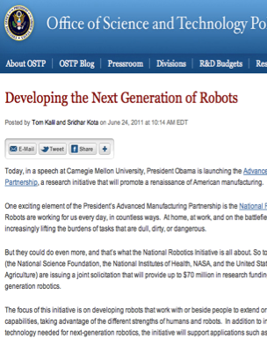
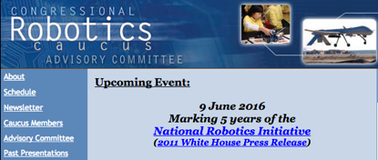
Impact: Robotics
2 meetings in Spring, 2016
Report and
Congressional Briefing in June, 2016
4 meetings during
summer 2008
Roadmap published
May 2009
Extensive discussions
between visioning
leaders & agencies
OSTP issues directive to all
agencies in summer 2010
to include robotics in
FY 12 budgets
National Robotics
Initiative announced
in summer 2011
Henrik Chistensen
Notes:
CCC had been working on a robotics White Paper (2007-2009) – Rodney Brooks
Henrik Christiansen, Sebastien Thrun and Robotics people came to CCC wanting help to get the robotics community on track (2008)
Tom Kalil was looking for a focus area
Henrik and CMU President (Jared Cohon) were instrumental in setting up the Robotics Caucus, using the Roadmap

Slide 42
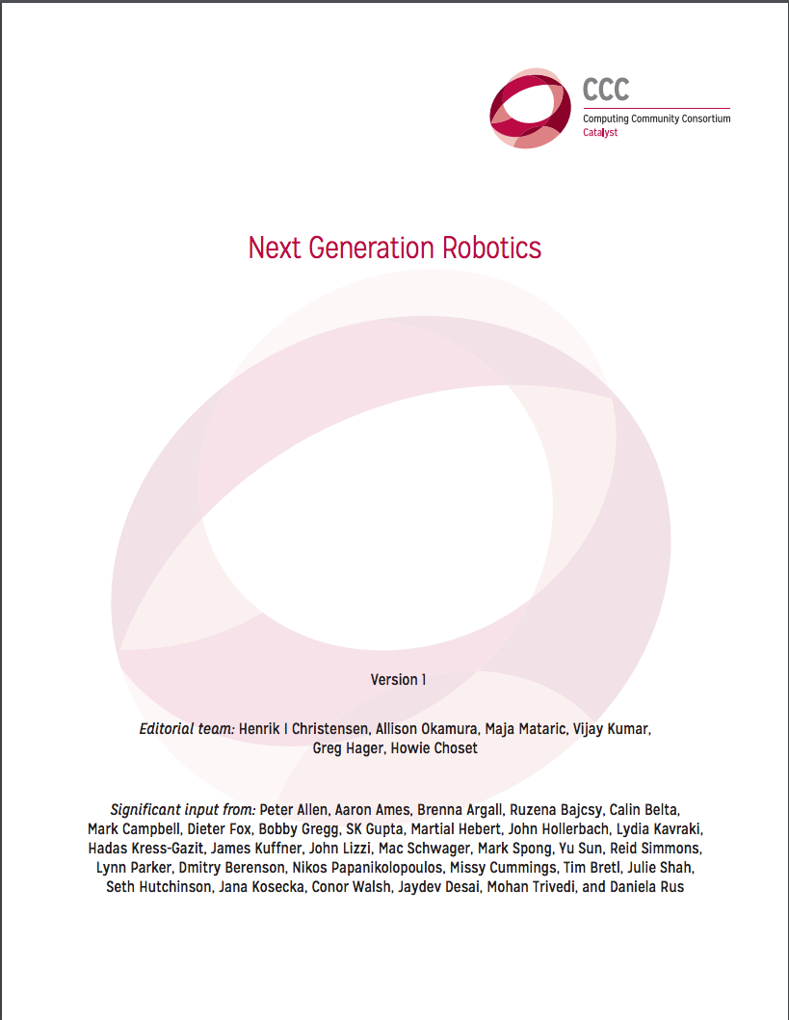
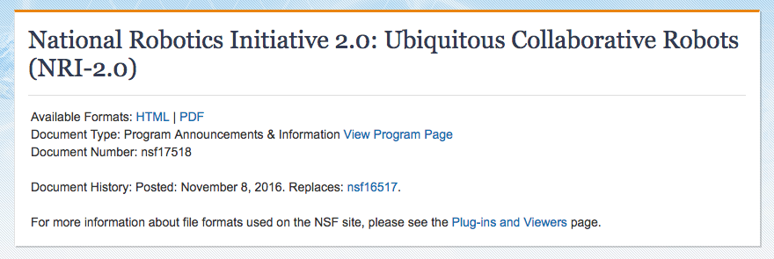
Impact: Robotics
2 meetings in Spring, 2016
Report and
Congressional Briefing in June, 2016
NRI 2.0 announced November 2016
Next Generation Robotics
published June, 2016
Henrik Chistensen
Notes:
CCC had been working on a robotics White Paper (2007-2009) – Rodney Brooks
Henrik Christiansen, Sebastien Thrun and Robotics people came to CCC wanting help to get the robotics community on track (2008)
Tom Kalil was looking for a focus area
Henrik and CMU President (Jared Cohon) were instrumental in setting up the Robotics Caucus, using the Roadmap

Slide 43
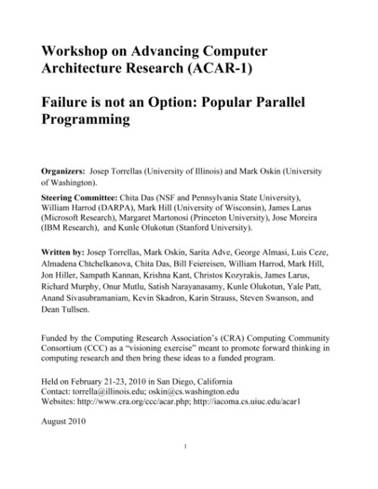
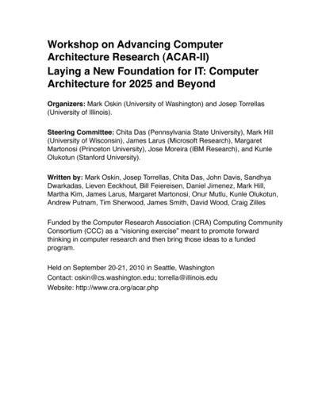
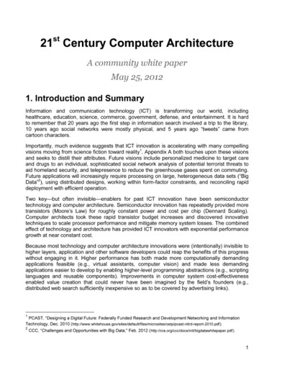
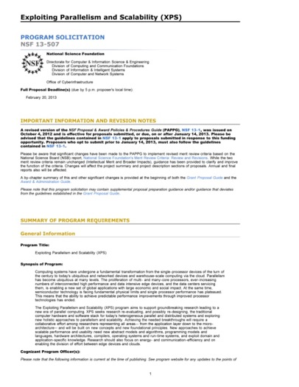
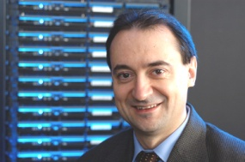
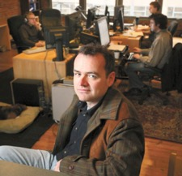
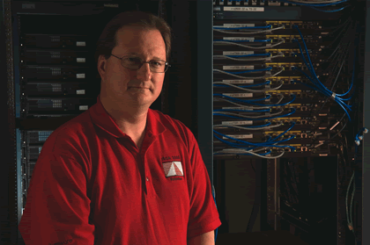
Impact: architecture
2010
2010
2012
2013
Josep Torrellas
UIUC
Mark Oskin
Washington
Mark Hill
Wisconsin
Notes:
2012 White Paper:
March – group forms(launched by CCC)
April – brainstorming, read related documents, outline
May – solicit feedback on drafts
May 25 – release report
February, 2013 – XPS solicitation quoting report

Slide 44
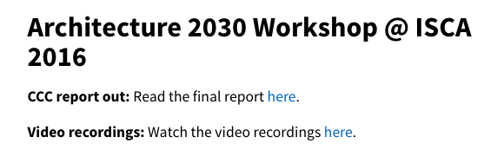

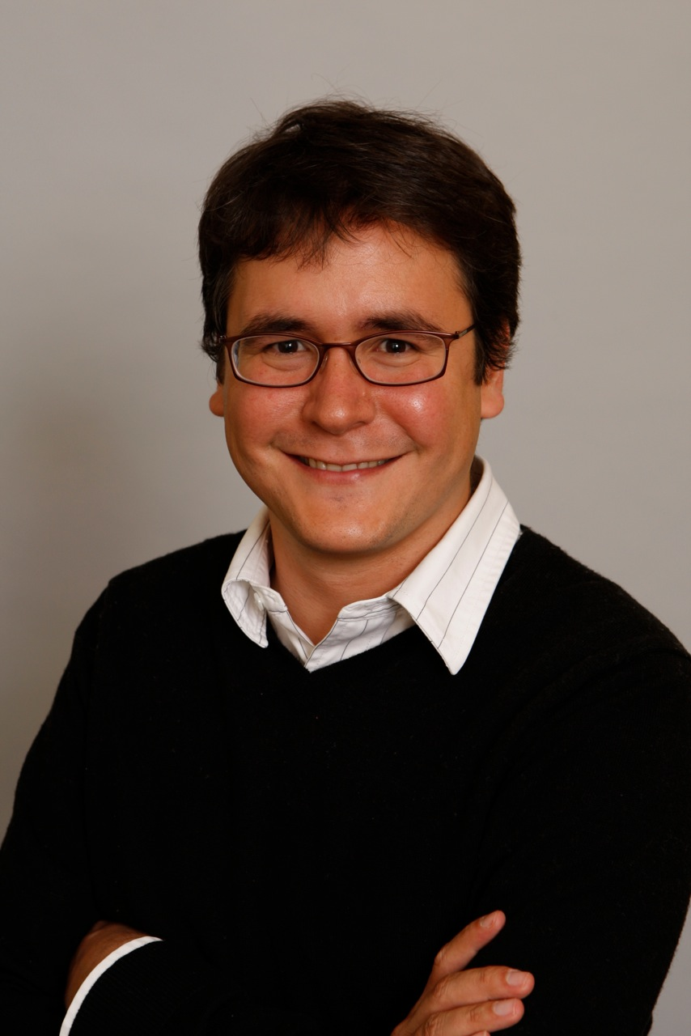
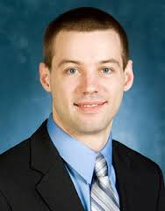
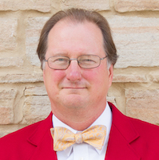
Impact: architecture
2013
2016
2016
Luis Ceze
Washington
Tom Wenisch
Michigan
Mark Hill
Wisconsin
Notes:
2012 White Paper:
March – group forms(launched by CCC)
April – brainstorming, read related documents, outline
May – solicit feedback on drafts
May 25 – release report
February, 2013 – XPS solicitation quoting report

Slide 45
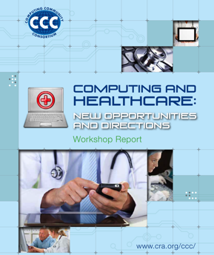
impact: Health IT
October 2012 Workshop
Notes:
SHW first in 2010, updated in 2013 as a joint initiative with NIH

Slide 46
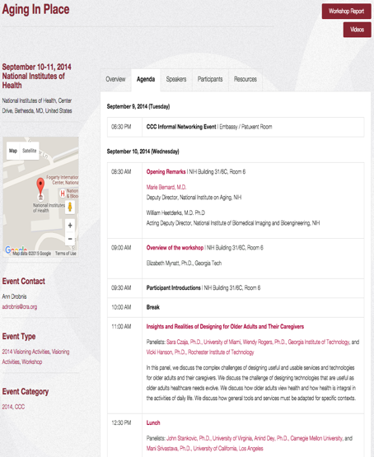
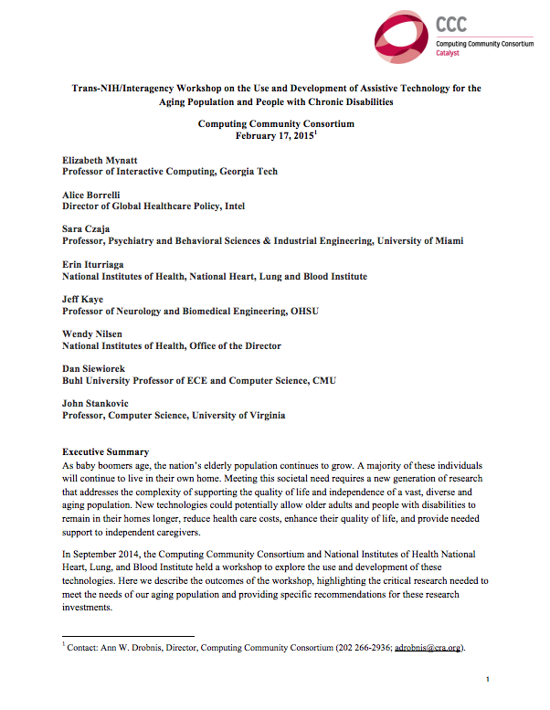
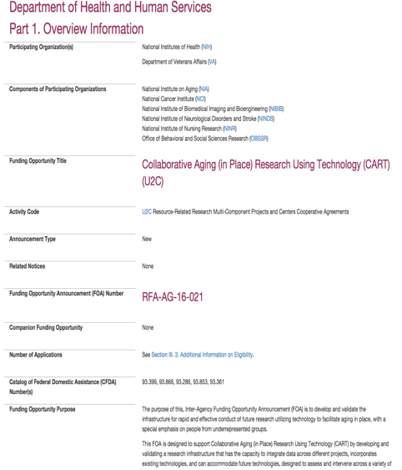
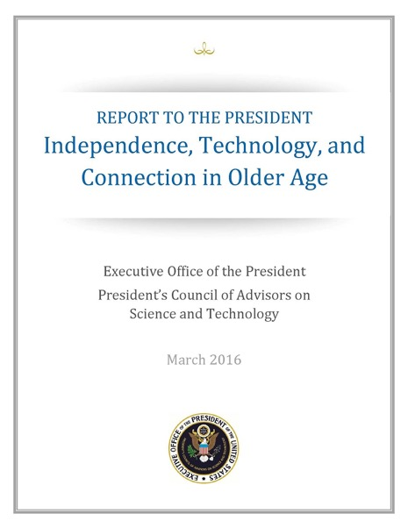
Impact: Aging in Place
Joint NIH/CCC Meeting
September 2014
Produced Workshop Report
February 2015
NIH released new RFP informed by AIP Workshop
October 2015
PCAST Report
March 2016
Notes:
2004 – Ed was on PITAC under President Bush – Computational Science was one of the three sections of the report and Big Data was mentioned
2008 – CCC White Paper for the transition team
2008 – CCC Workshops
2010 – Series of White Papers, first PCAST Report
2012 – Presidential Initiative
2014 - Ubiquitous

Slide 47
Computing Community Consortium
The mission of Computing Research Association's Computing Community Consortium (CCC) is to catalyze the computing research community and enable the pursuit of innovative, high-impact research.
Promote Audacious Thinking:
  Community Initiated Visioning Workshops
  Blue Sky Ideas tracks at conferences
Communicate to the Community:
  CCC Blog - http://cccblog.org/
  Great Innovative Ideas
  White Papers and Workshop Reports
  Social Media
  Council member presentations
Facilitate Investment:
  Outputs of visioning activities
  Task Forces – Health, AI, Privacy etc.
  Engage with federal agencies and industry
Inculcate Leadership and Service:
  Engage with CCC Alumni and Sister Organizations
  Biennial Symposia series
Influence Early Career Researchers:
  Industry – Academic Collaborations
  Leadership in Science Policy Institute
  Postdoc Best Practices
Notes:
Established in 2006 as a standing committee of the Computing Research Association
Funded by NSF under a Cooperative Agreement
Facilitates the development of a bold, multi-themed vision for computing research – and communicates this vision to stakeholders
Led by a broad-based Council
Staffed by CRA

Slide 48
Discussion, questions, ideas

